Slide 1
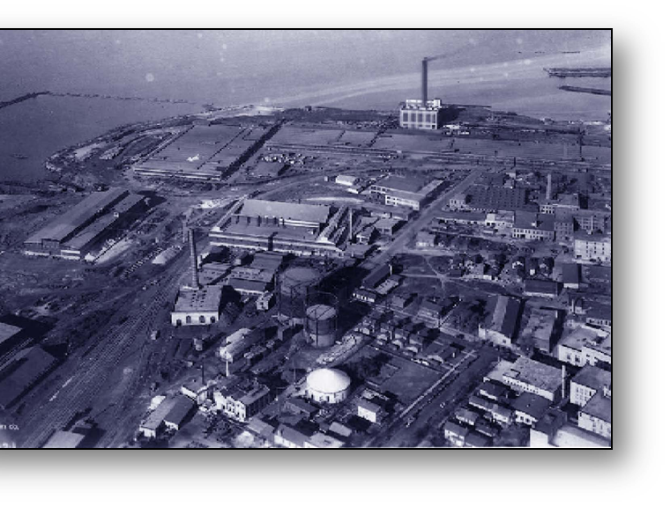
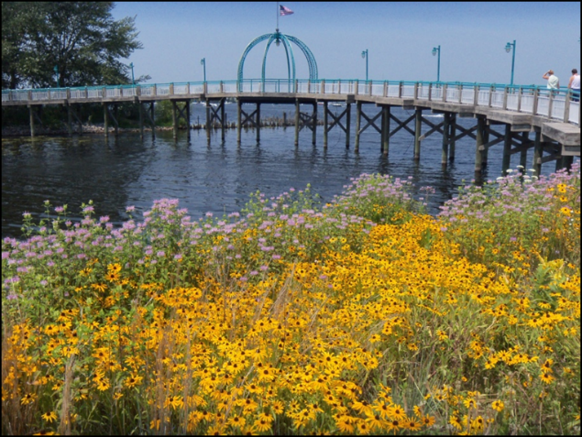
Eric Ellis Habitat Restoration Senior Program Specialist
Restoring Areas of Concern Through NOAA Regional Partnerships
13th Annual Great Lakes Restoration Conference

Slide 2
What is the Great Lakes Commission?
Interstate Compact Agency established in 1955
Members include the 8 Great Lakes states, with associate member status for Ontario & Quebec
Notes:
Represent, advise & assist members by speaking with a unified voice to promote a healthy, vibrant Great Lakes–St. Lawrence River region

Slide 3
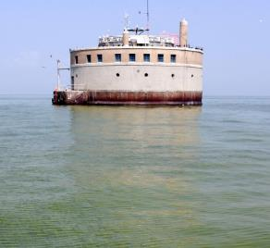
Program Areas
Water Quality
Water Management and Infrastructure
Commercial Navigation
Economic Development and Waterfront Community Revitalization
Coastal Conservation and Habitat Restoration
Aquatic Invasive Species Prevention and Control
Information Management and Blue Accounting
Notes:
Represent, advise & assist members by speaking with a unified voice to promote a healthy, vibrant Great Lakes–St. Lawrence River region

Slide 4
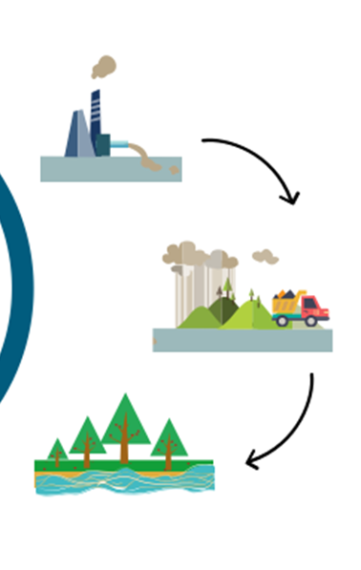
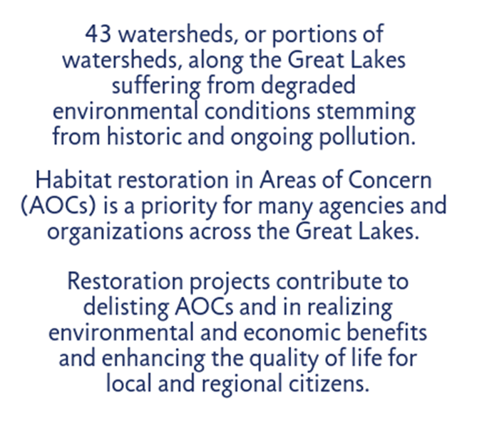
Areas of Concern (AOCs)
Notes:
Coastal Conservation and Habitat Restoration Program Area
43 areas of concern within the Great Lakes, 26 being in the United States, 17 in Canada, with five shared by the two countries.
REMOVE Beneficial Use Impairments

Slide 5
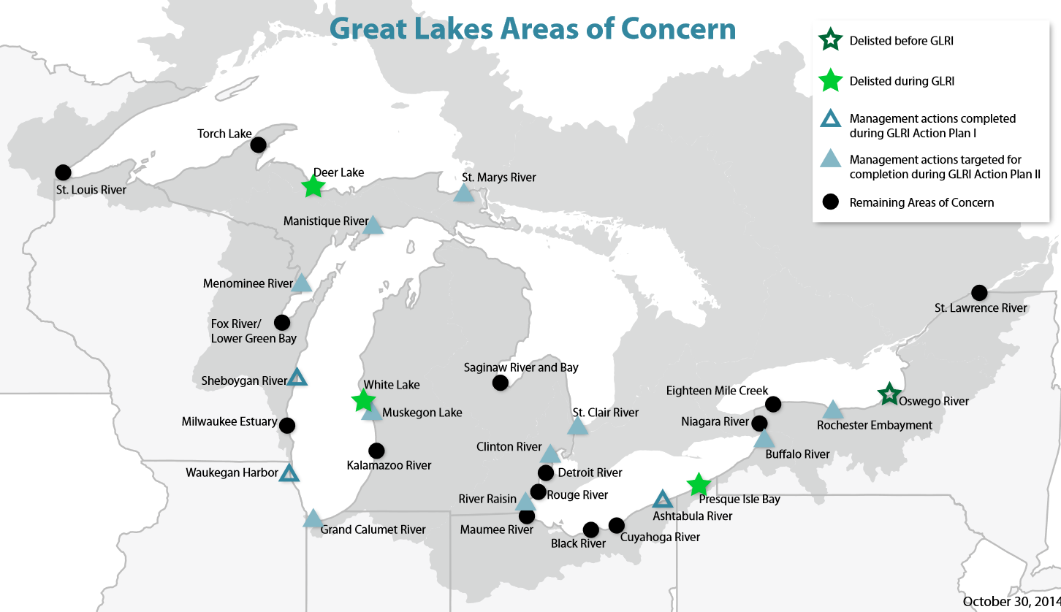
NOAA/GLC Partnership

Slide 6
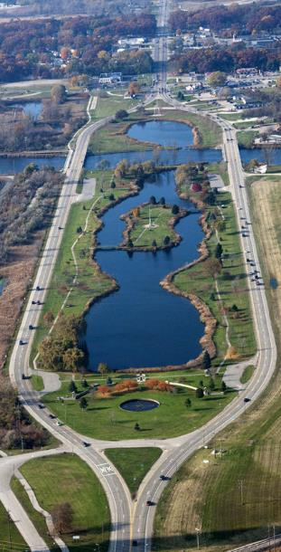
How does the NOAA Partnership Work?
Funds specific, approved, projects that address Beneficial Use Impairments
Funds multiple projects through a cooperative agreement
More flexible than grants, reduces transaction costs to increase efficiency
NOAA provides technical support and oversight
Engages strong community organizations for implementation
Notes:
Another tool for restoring areas of concern

Slide 7
How do groups receive a NOAA Partnership?
Competitive process.
Long-term engagement in AOC program
Strong state and regional relationships
Expertise in restoration, project management, facilitation and communication
Low project management costs

Slide 8
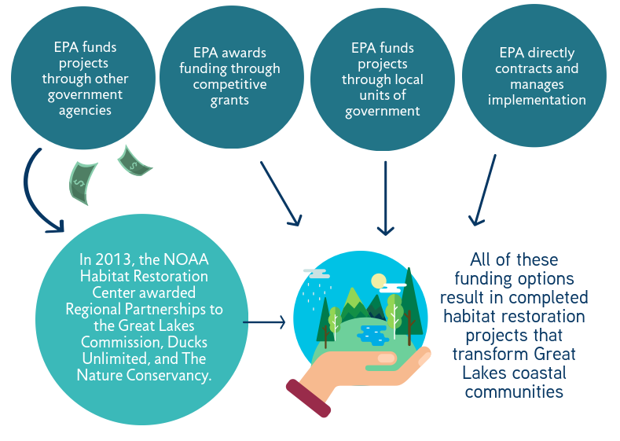
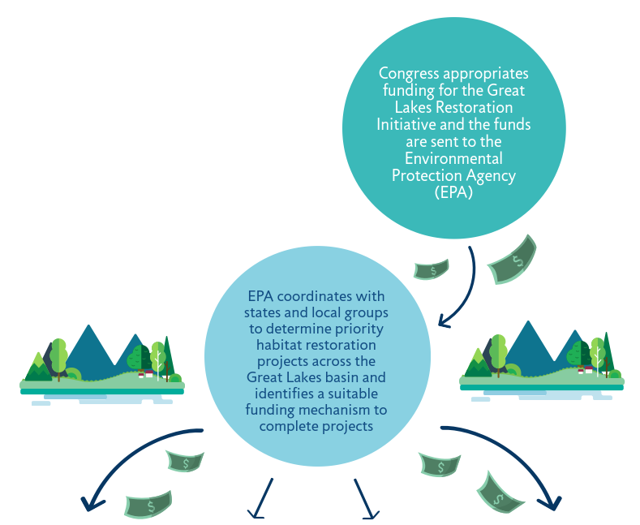
How do Regional Partnerships get funded?

Slide 9
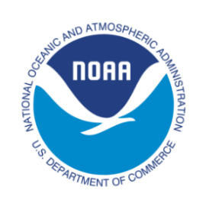
Partnership Roles
Funder
Reporting Agency
Technical Monitoring
Enforces federal requirements
Regional Partnership recipient
Completes reporting
Manages multiple subrecipients
Manages funding and requirements
Coordinates regional communication
Provides restoration expertise

Slide 10
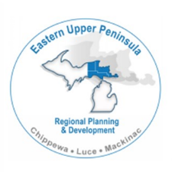
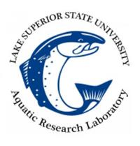
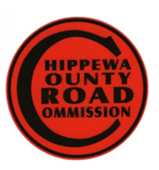
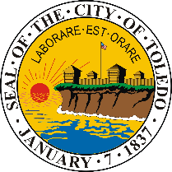
Partnership Roles
Implement projects in AOCs
Manage contractors and construction
Conduct monitoring
Plan local events
Steward into the future

Slide 11
Current GLC Partnership Status
Initial Partnership: 2008, complete
2013 Partnership allocated $29.7 million dollars (of $30 million available) toward projects
2016 Partnership has allocated $8 million. $32 million available for additional projects.

Slide 12
Little Rapids Restoration Project
$9.4 million

Slide 13
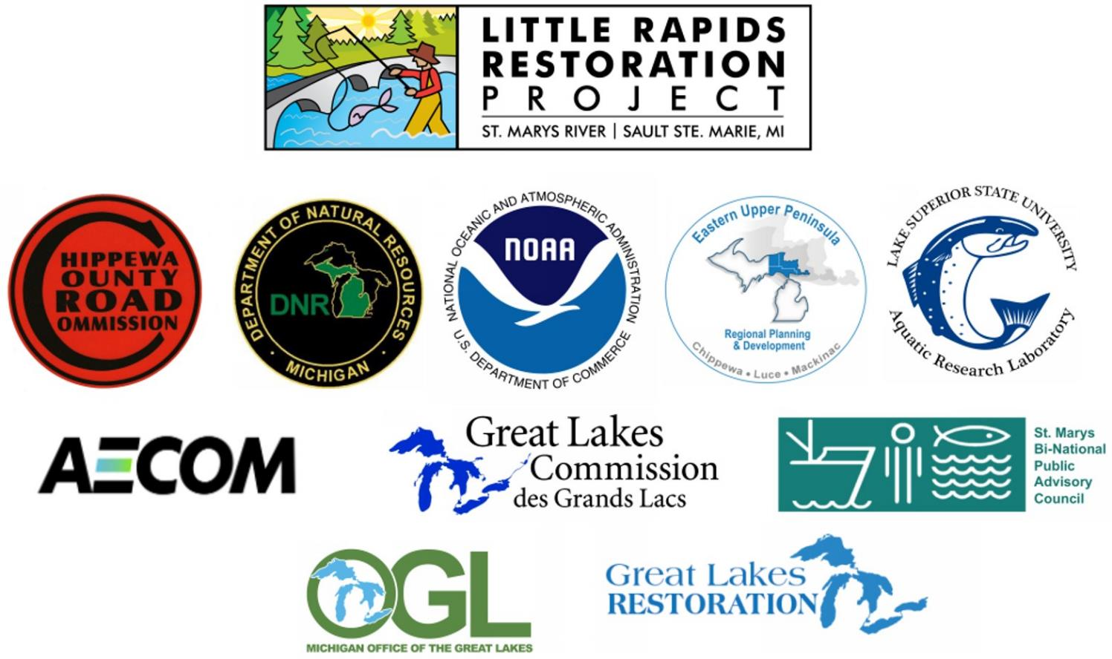
Notes:
Also sportsmens groups

Slide 14
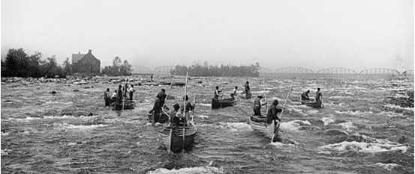
Goal: restore historic rapids. 90% lost since late 1800’s
Notes:
70 acres. Local planning from the beginning.

Slide 15
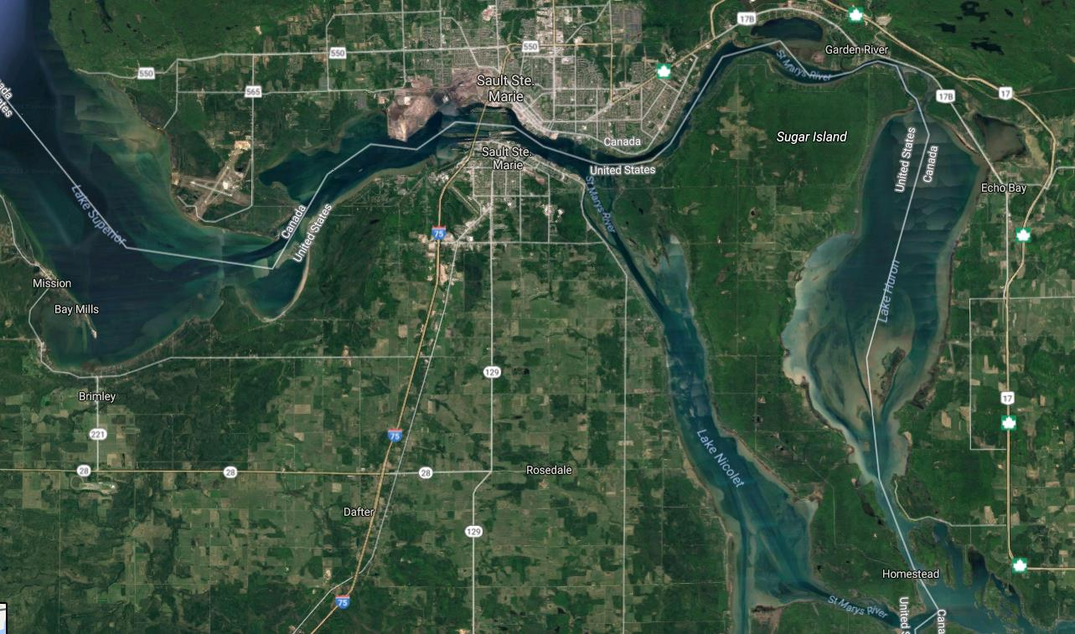

Slide 16
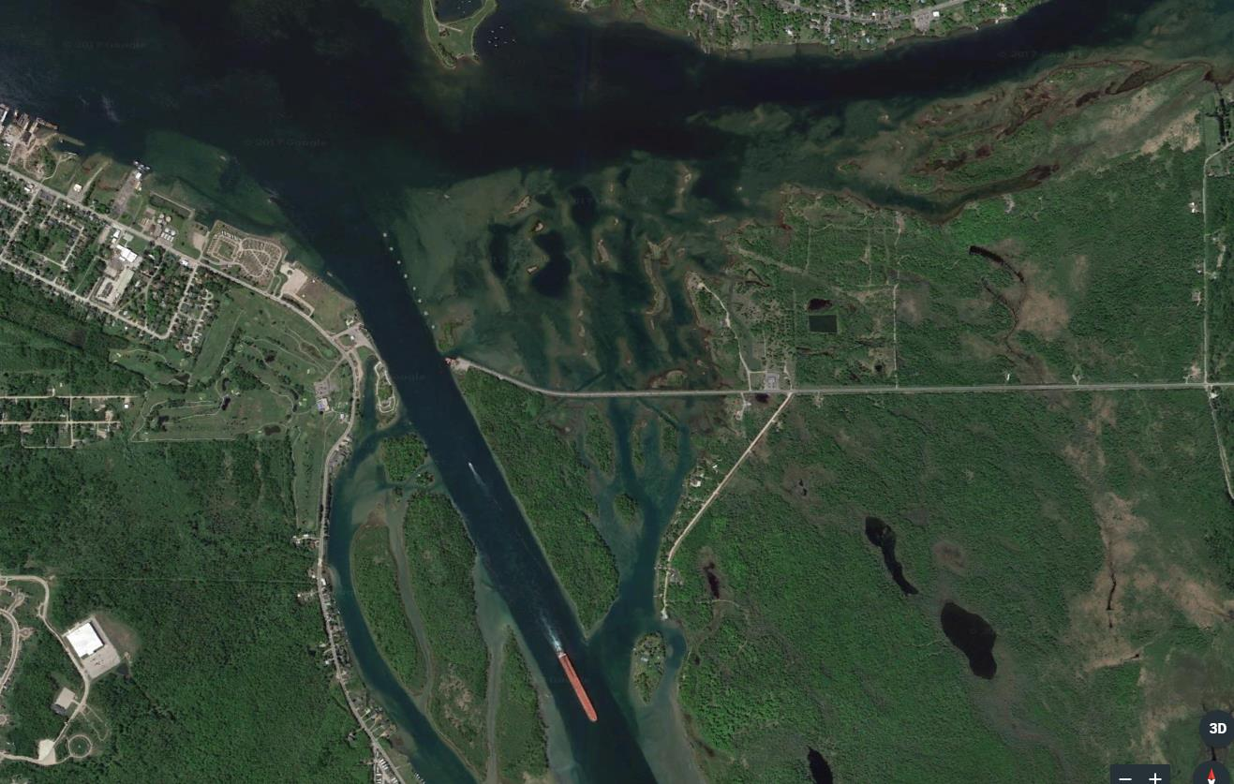
Upper Rapids
Project Location
Ferry
Lower Rapids
Sugar Island
Notes:
Sugar island access

Slide 17
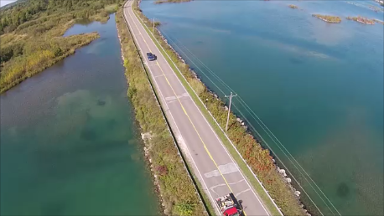
Notes:
Very little room for staging, must allow for two way traffic
Overhead power needs re-locate
UG phone needs relocate
Very poor underlying soils
Old bridges?

Slide 18
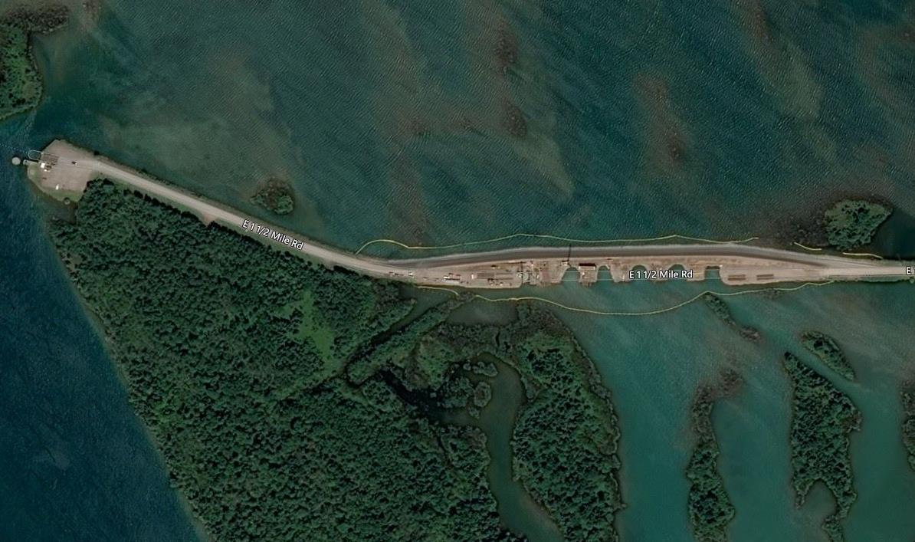

Slide 19
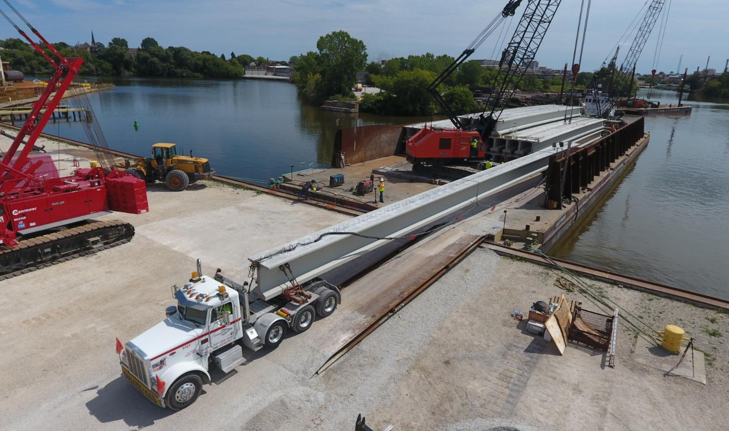
Notes:
Made in Wisconsin

Slide 20
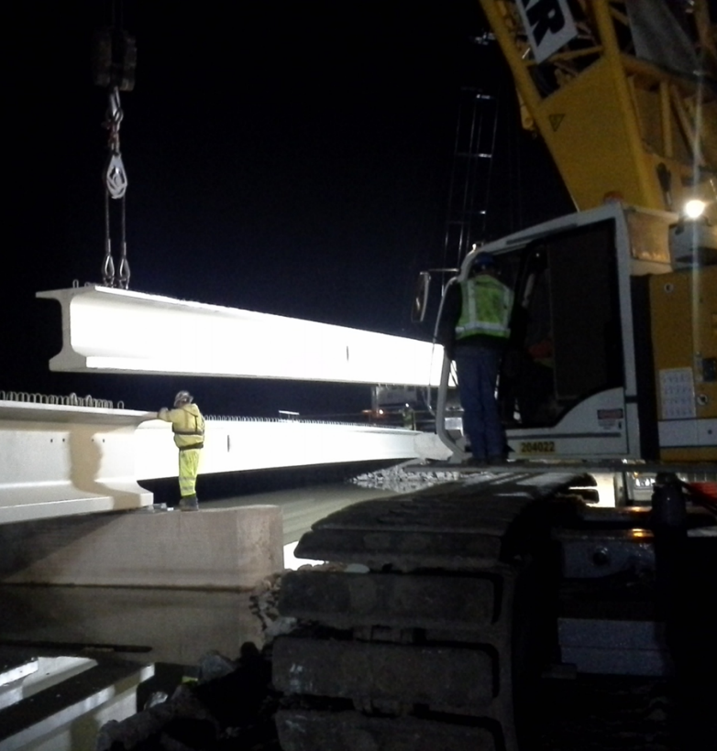
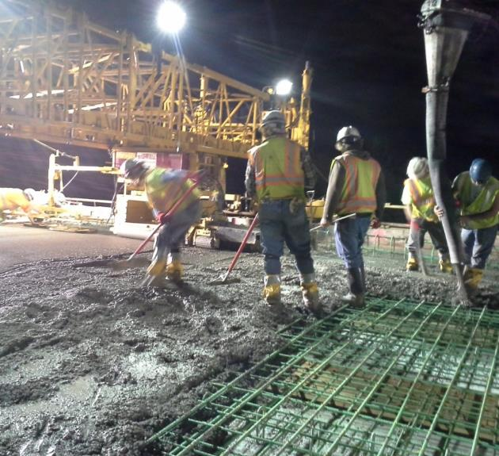
Multiple all-nighters to reduce impact on traffic

Slide 21
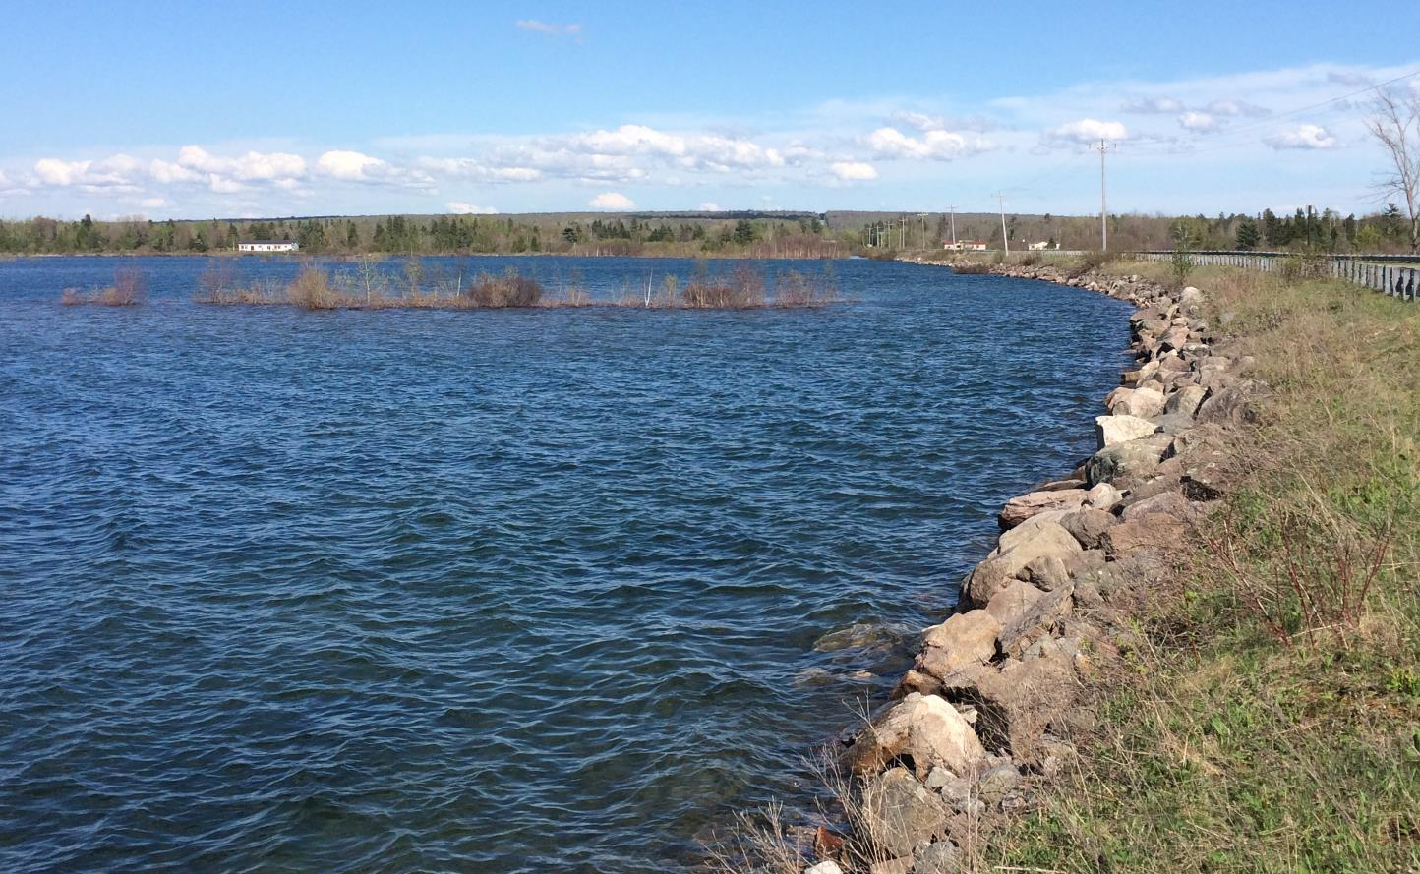

Slide 22
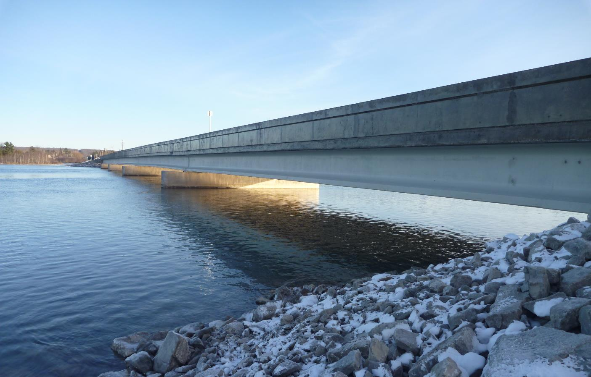

Slide 23
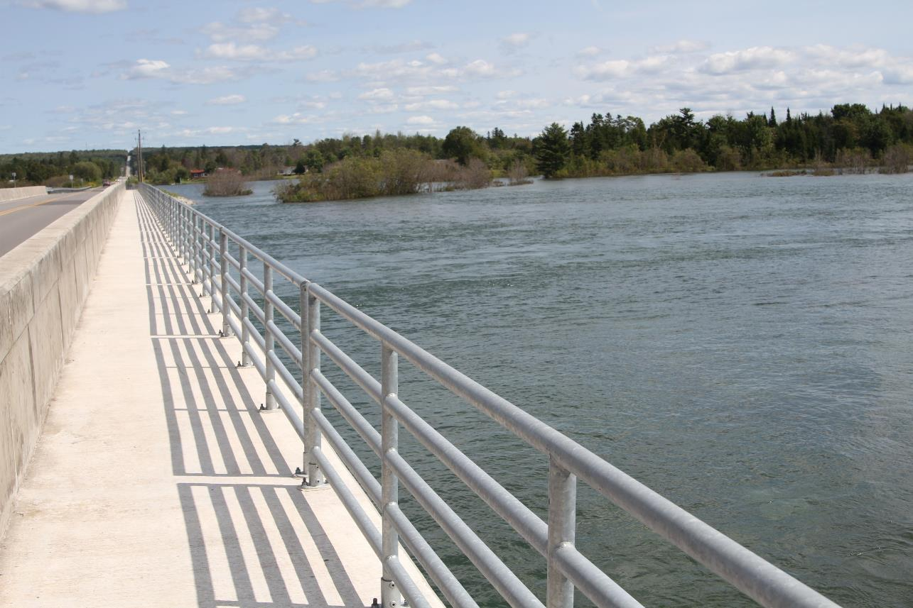
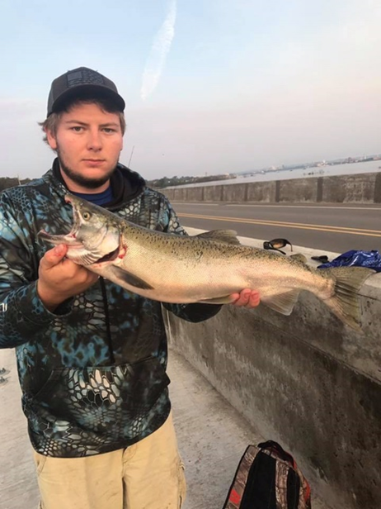

Slide 24
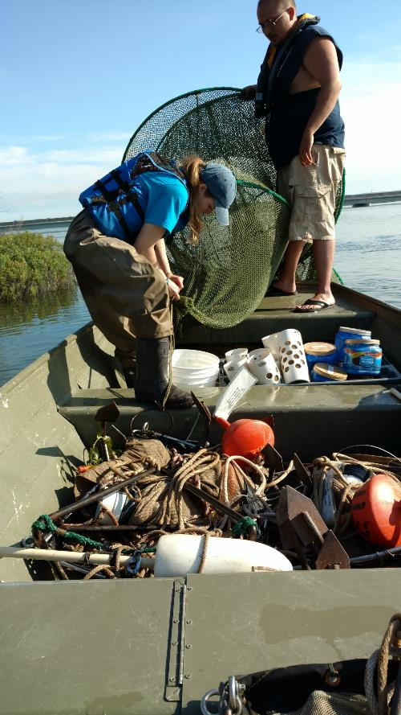
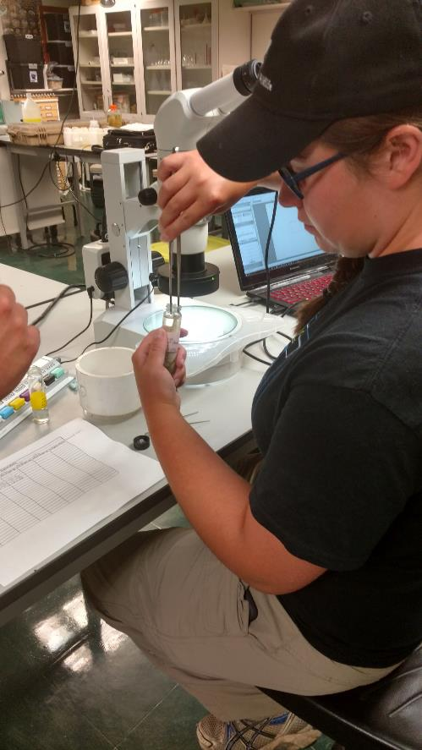
Monitoring
Lake Superior State University’s Aquatic Research Laboratory

Slide 25
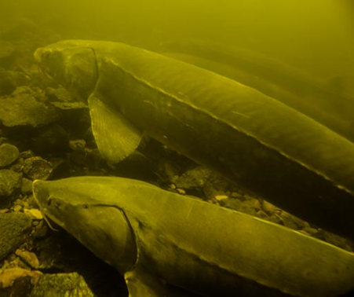
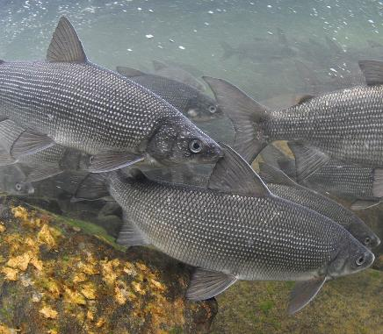
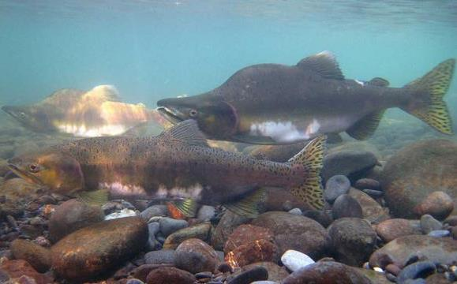
Economic
Benefits
Recreation and tourism
Enhanced sport fishing
Community Benefits
Pedestrian walkway
Safer roadway
Fishing access
Environmental
Benefits
Aquatic habitat
Complete U.S. AOC work

Slide 27
Muskegon Lake AOC Restoration
Notes:
West Michigan Shoreline Regional Development Commission and Grand Valley State University

Slide 28
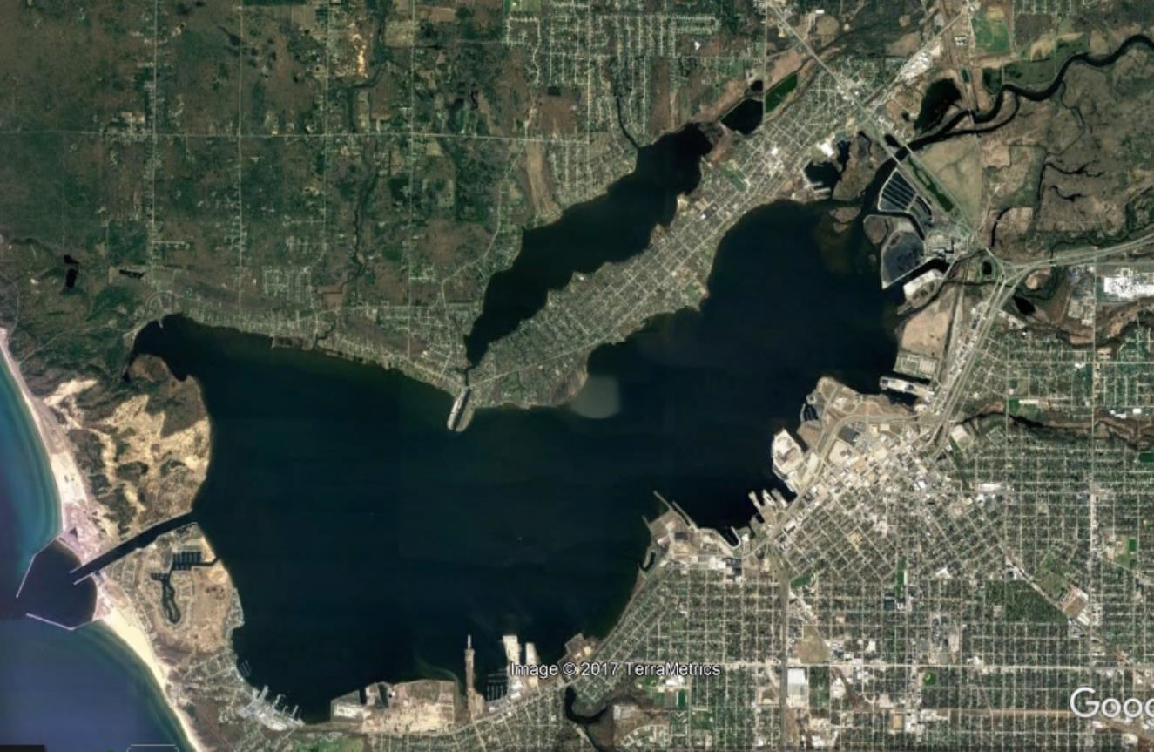
Multiple project sites and studies. 2013 and 2016 Partnerships
$21.9 million

Slide 29
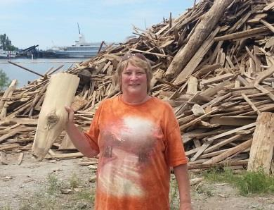
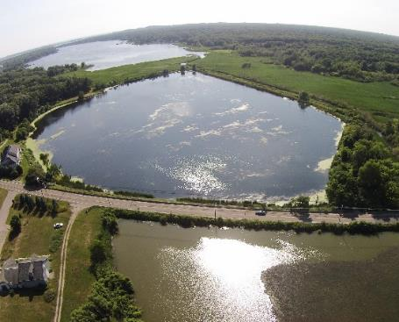
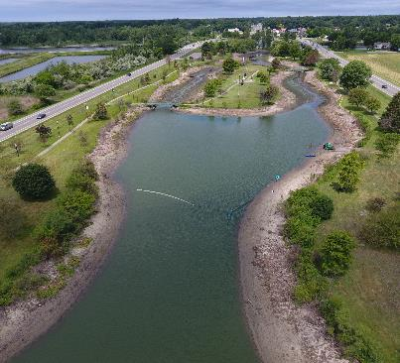
Muskegon Lake AOC Restoration
Community Benefits
Public park improvement
Increased property values
Increased tourism
Economic Benefits
Enhanced fishery
Re-use and repurpose dredged material
Environmental Benefits
Reconnected wetlands Enhanced shoreline and lake bottom habitat
Notes:
Wood board, legacy pollution.

Slide 30
Black Creek Marsh Restoration Project

Slide 31
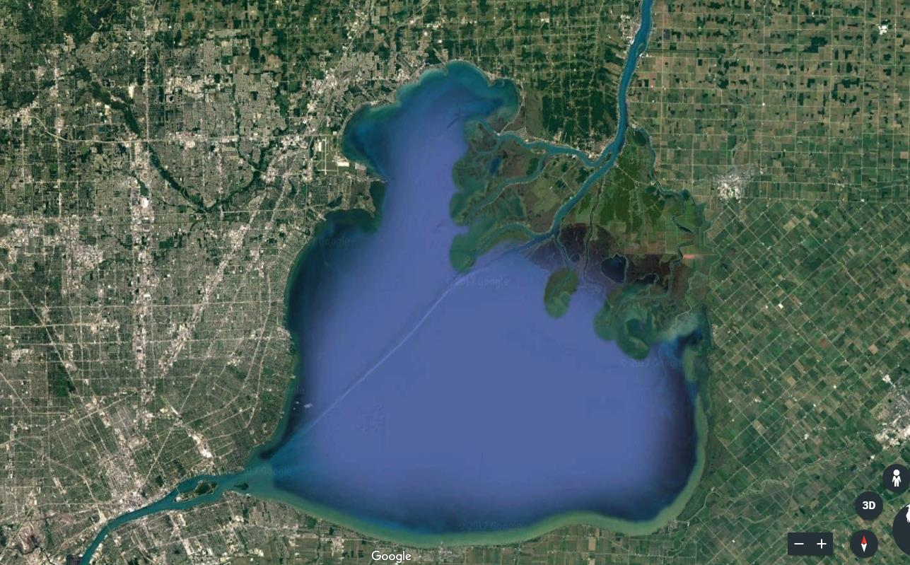

Slide 33
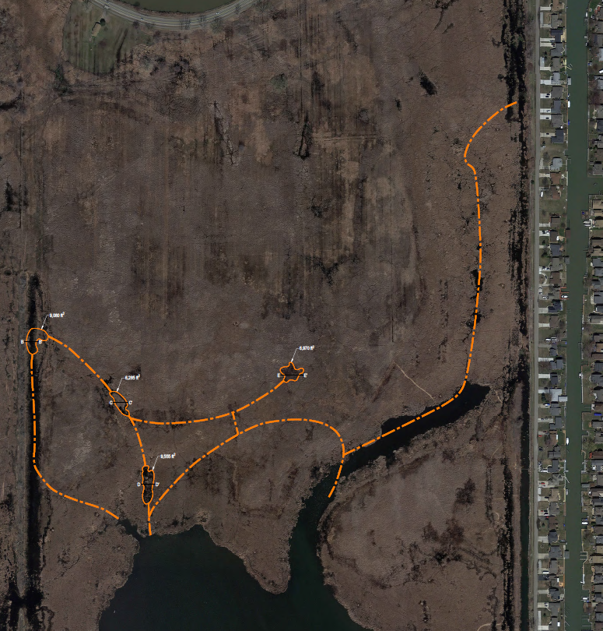
Example of partnership flexibility
Dredging of water trails and pools (in orange) to provide fish spawning and recreation
Funding a narrow portion of a larger project to cover $225,000 of unanticipated expenses
Notes:
Was already funded, partnership allowed for greatest environmental benefit and no scaling back

Slide 34
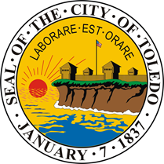
Penn 7 Restoration Project

Slide 38
Preliminary design from the feasibility study

Slide 39
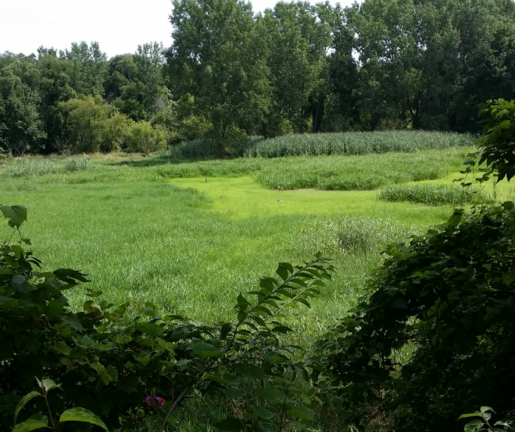
City of Toledo – Penn 7 Project
Feasibility study complete.
Funding final engineering and design work, public outreach.
$160,000
Final restoration will be a good candidate for future funding by the Partnership, est. $1.4 million

Slide 40
Buffalo River Restoration Project

Slide 41
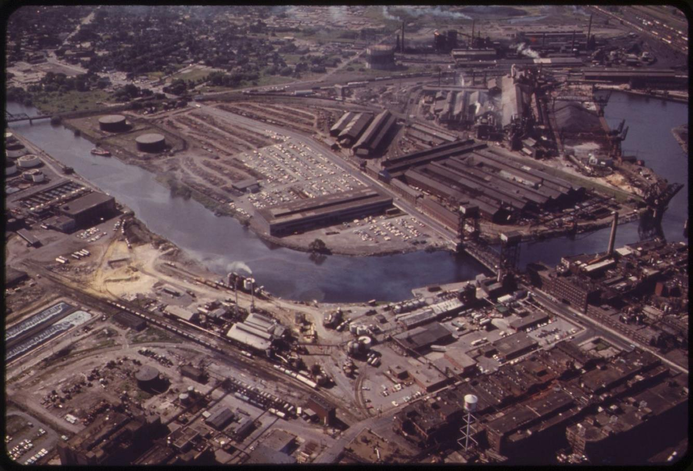

Slide 42
Notes:
Partnership is a piece of the restoration puzzle

Slide 43
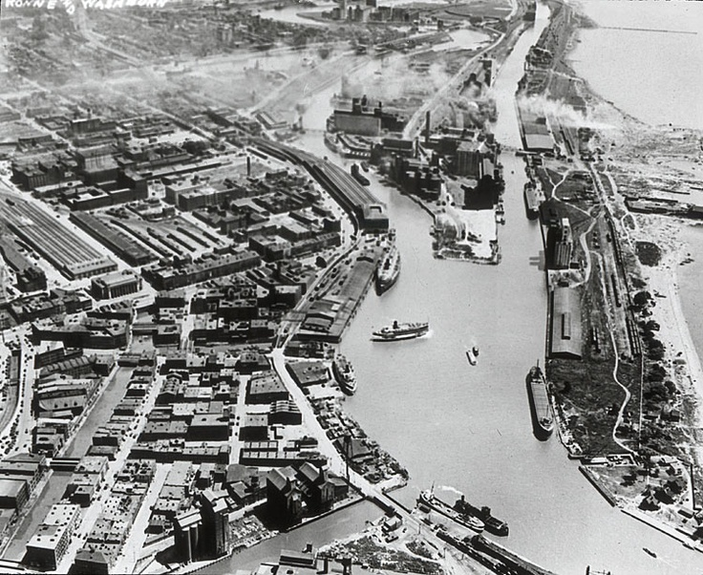
$6.3 Million for projects at 7 locations
Notes:
Project site across from dinner location.

Slide 44
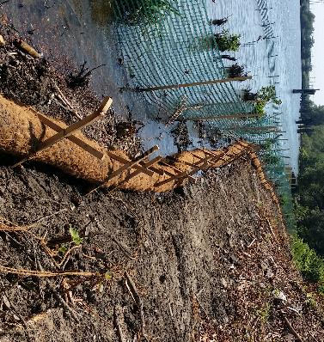
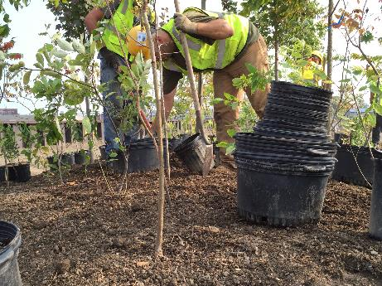
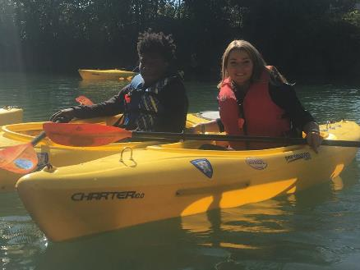
Buffalo River AOC Habitat Restoration
Environmental Benefits
Enhance 20 acres of fish and wildlife habitat
Improved aquatic ecosystem
Community Benefits
Increased water based recreation
Create shoreline destinations within the City
Economic Benefits
Recreation and tourism
Economic revitalization of the shoreline
Enhanced sport fishing
Notes:
Experience first hand tonight

Slide 45
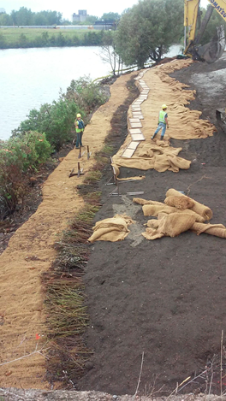
Some Lessons Learned in Restoring Habitat in the AOCs
Be creative and flexible
Design for conditions and the long term
Look for cost savings – reallocate
Expect the unexpected
Maintain an open relationship with your grant manager
Keep the public engaged and informed
Enjoy the process

Slide 46
Thank You! Eric Ellis, eellis@glc.org

