Slide 1
Watershed Management with Ag Runoff Treatment Systems
An Update
JEREMY FREUND, PE
OUTAGAMIE COUNTY LAND CONSERVATION DEPARTMENT

Slide 2
Outline
ARTS Update
ARTS Implementation Strategy
Other Efforts

Slide 4
ARTS Concept, 1 to Many BMP
Climate Change
Flooding
Water Quality (TSS, TP)
Streambank Erosion
Trap TSS/P
Detention
Routing
Phosphorus Removal Device
Local Issues
Sediment Basin
350
Solutions
Constructed Wetland 656
Water Quality
Flood Mitigation
Streambank Stabilization
Habitat Re-Creation
Spill Mitigation
Water ReUse
Nutrient Cycling
P-Removal Device 782
Trap TSS
Wetlands Hydraulics
Habitat
Tile Water Treatment

Slide 5
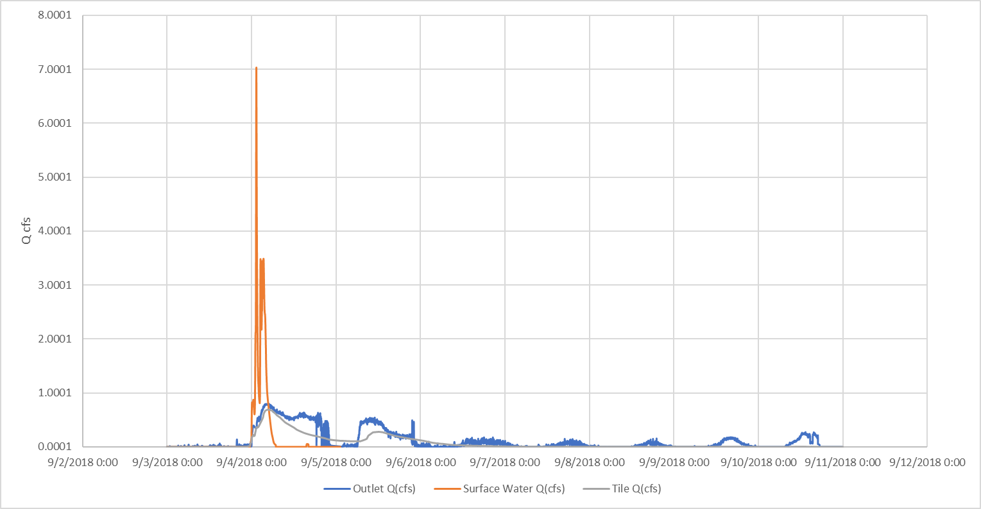
Runoff

Slide 6
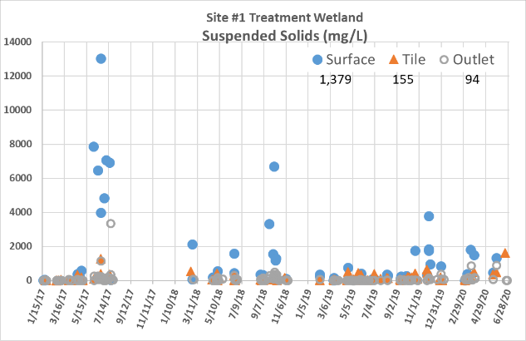
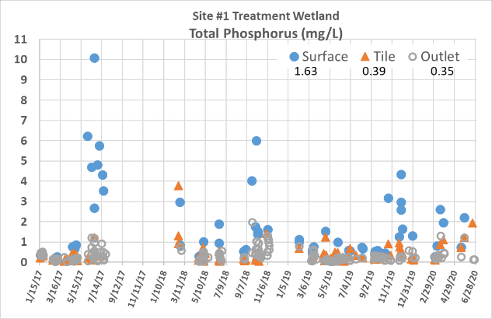
ARTS #1 concentrations

Slide 7
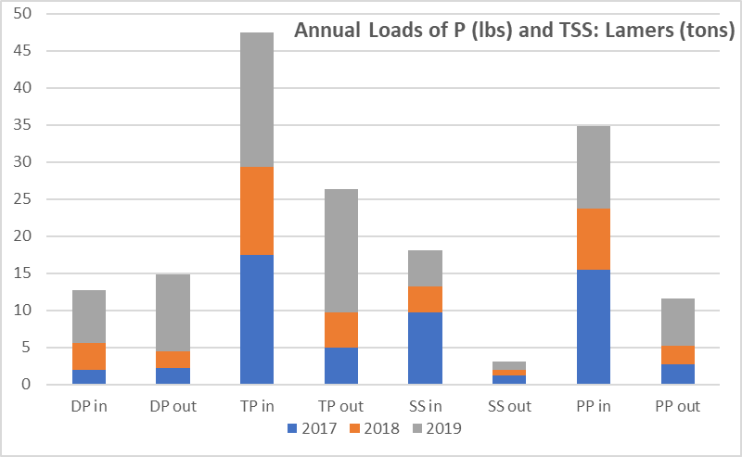
ARTS #1 (Fermanich provisional data)

Slide 8
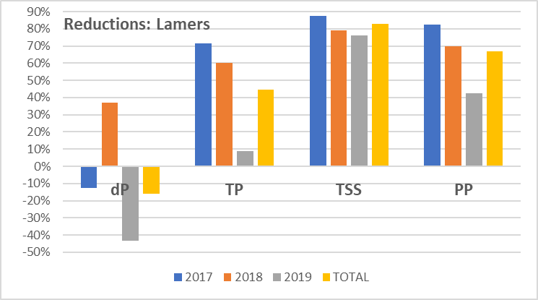
All Events
82%
67%
45%
(Provisional)
ARTS #1 (provisional data)
Notes:
PP/TSS in 1.58 2.38 2.30 1.93 concentration of P on the SS Particles: IN
PP/TSS out 2.22 3.47 5.53 3.74 concentration of P on the SS Particles: OUT

Slide 9
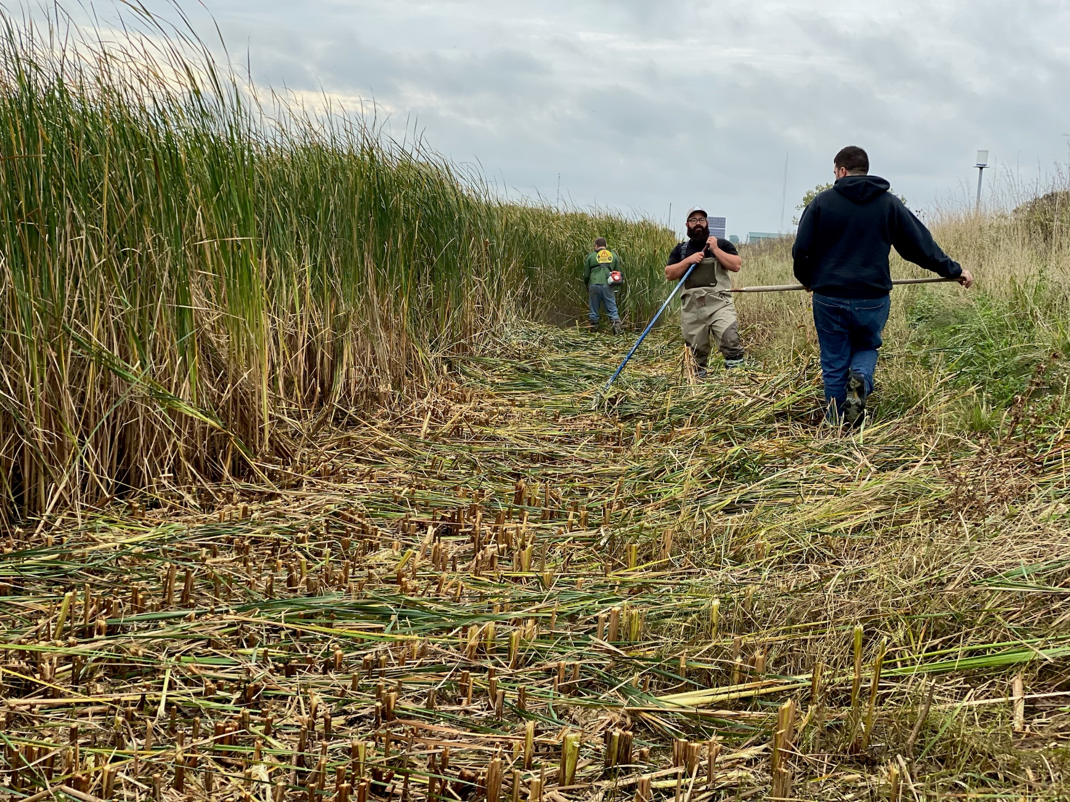
BioMass
Notes:
The wetland vegetation here has predominantly been narrow leaf cattail which is not a sought after wetland plant but it seems to do a good job of taking up phosphorus which is what we want. 2 falls ago, we went through and cut down all the cattails and raked them all out of the wetland. UWGB took samples of the cattail and was able to calculate that we removed almost 2 lbs of phosphorus that was stored in the plants when we removed them from the site.

Slide 10
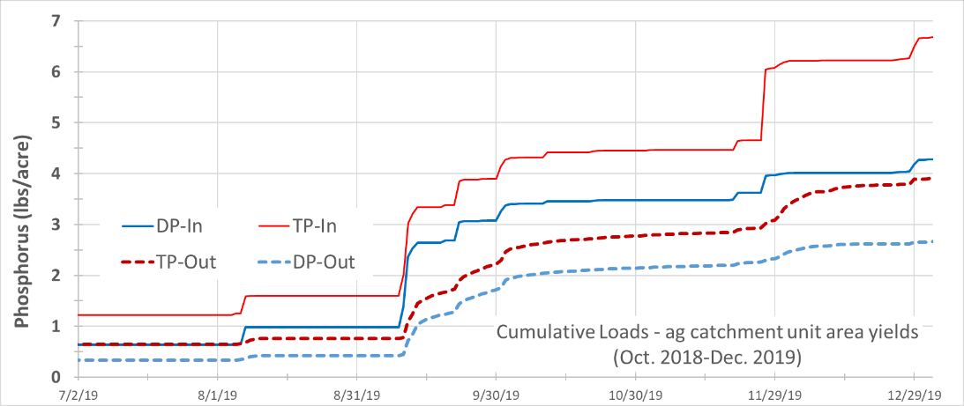
*data are preliminary
Notes:
Oct and Nov 2019: ~80+% of TSS and PP trapped
Inputs: 40% DP, 60% PP

Slide 11
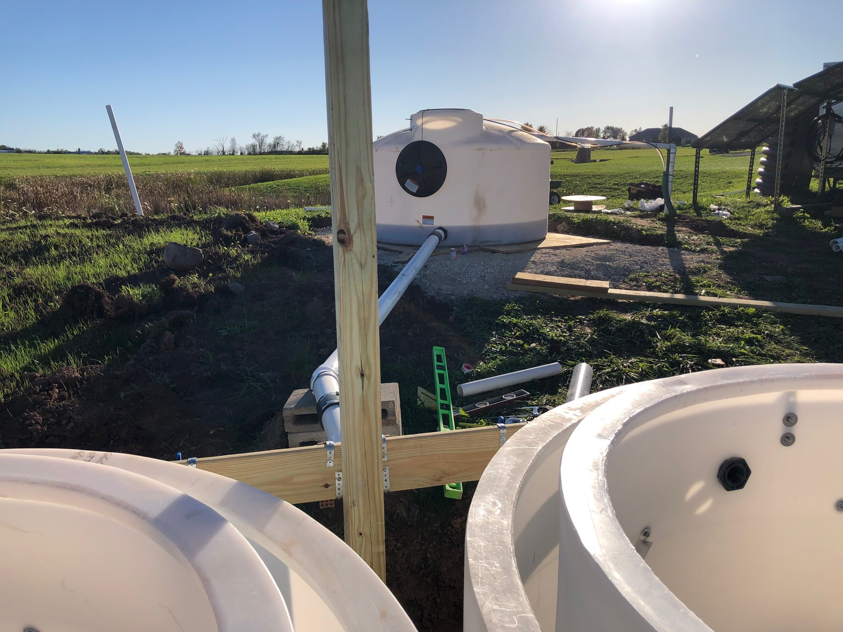
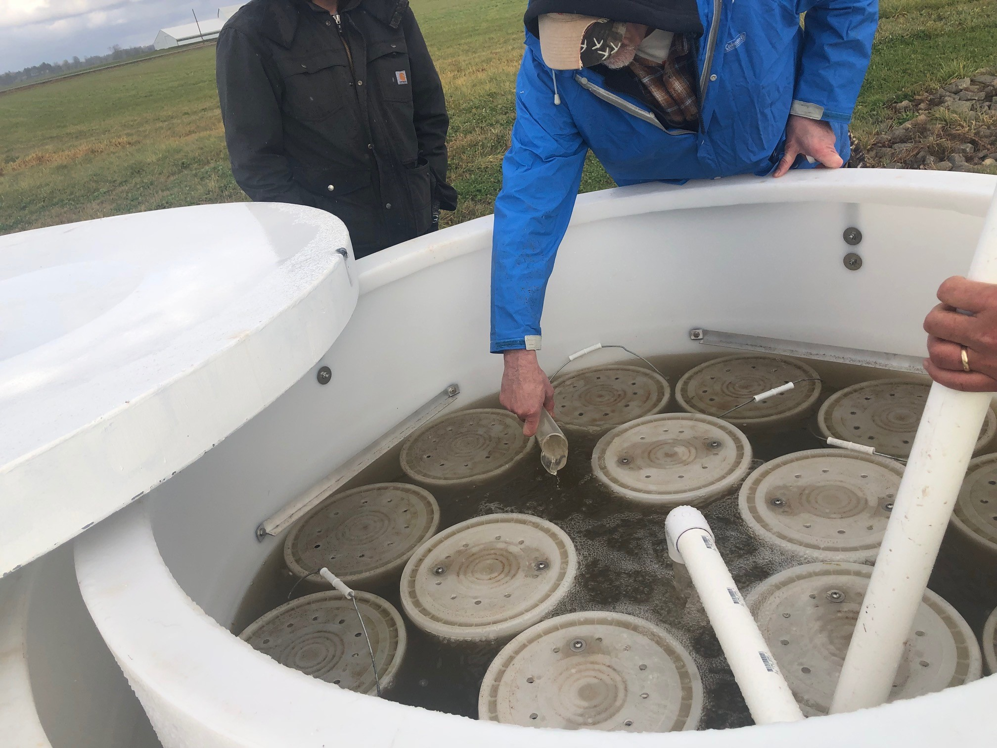
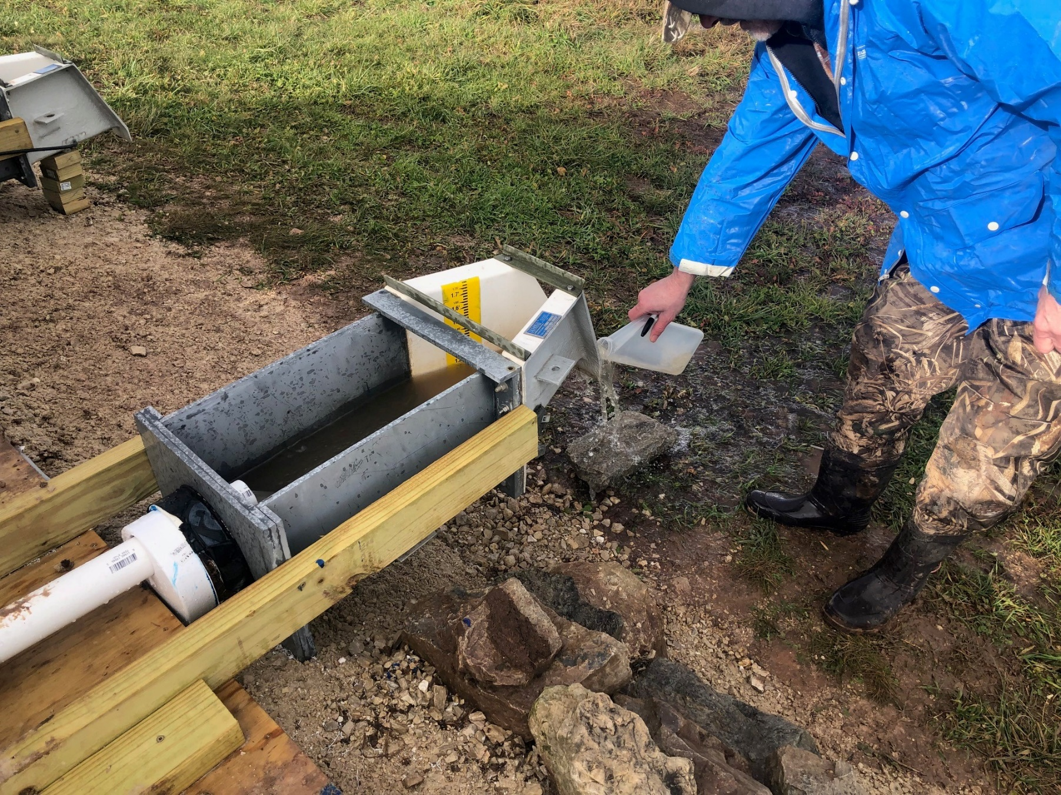
Filters

Slide 12
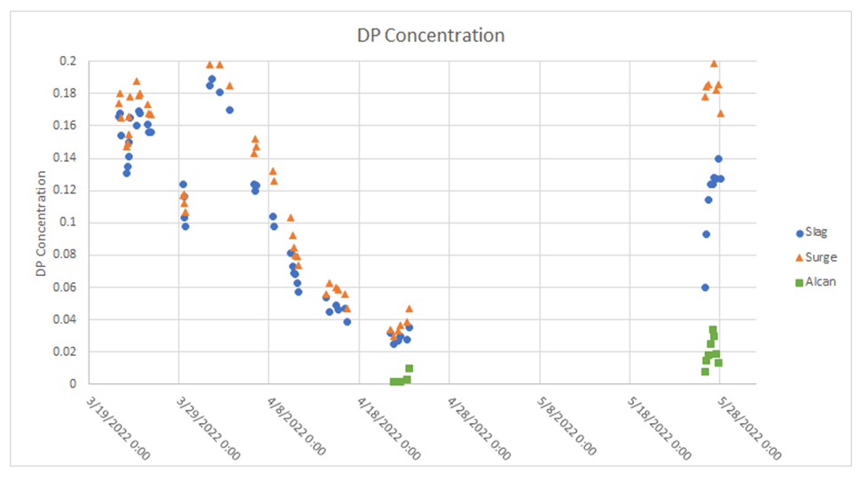
Provisional data provided by Beth Kondro, UW-Green Bay

Slide 13
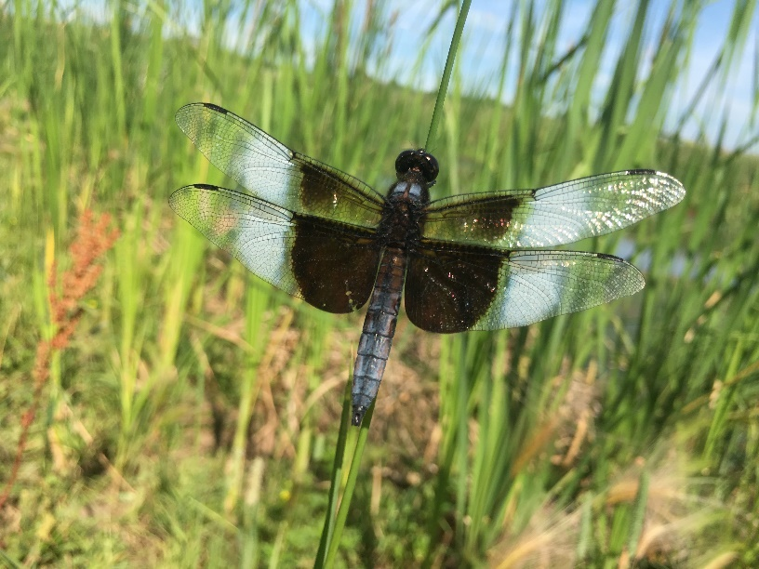
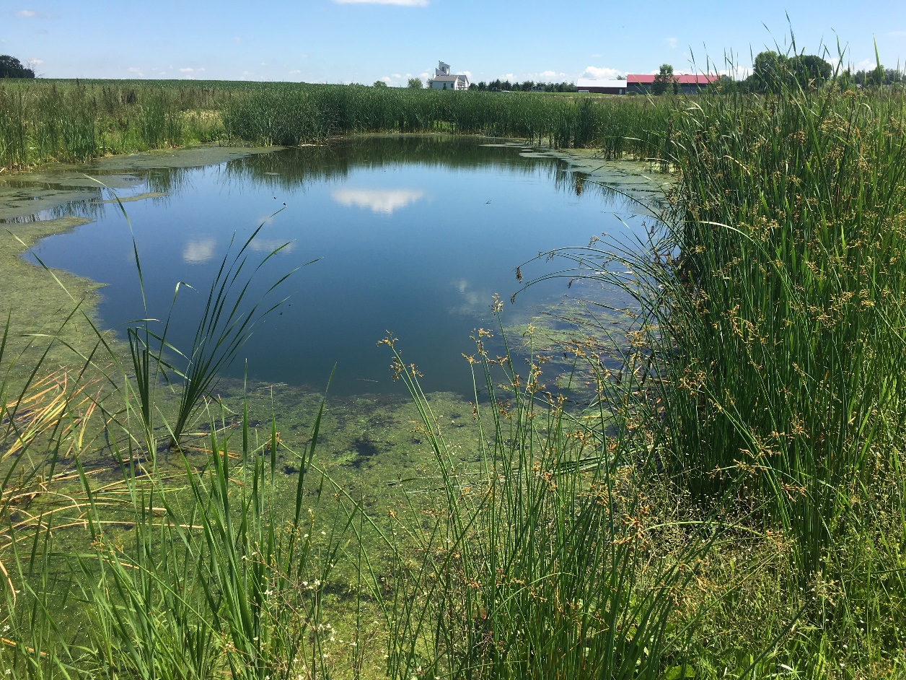
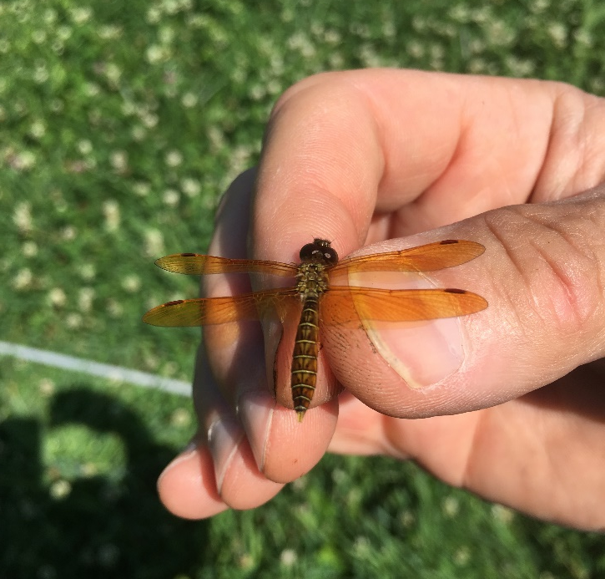

Slide 14
Mini Halfway Creek
**Pollinators & Native Seeding**

Slide 15
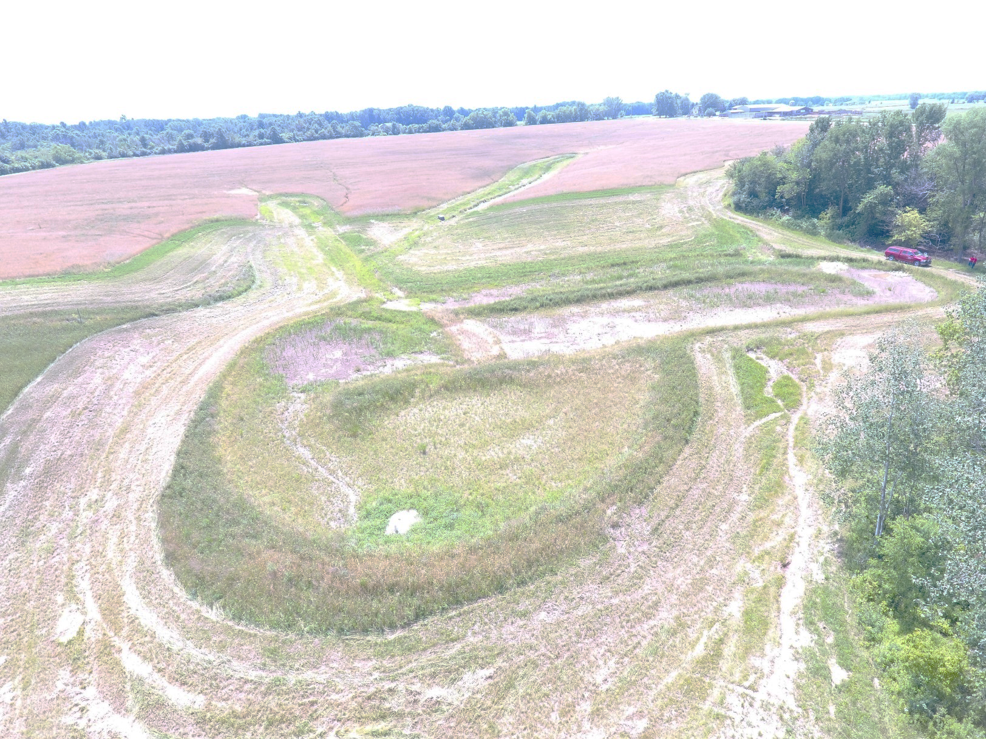
BMP Treatment
Notes:
Next location was a site designed by Jan Hosper from Brown County.
Different type of project. Due to the site being in a low lying agricultural area surrounded by steep hills, it was a hard area to farm. So the landowner was planning to turn this area into a buffer zone and installing 3 waterways and a wascb in the gullying areas of the field. Instead of just doing a buffer, we proposed to add a “polishing” station wetland. The system is designed to route small storms through the system with baffle berms to increase retention time while large storms have overflow locations.

Slide 16
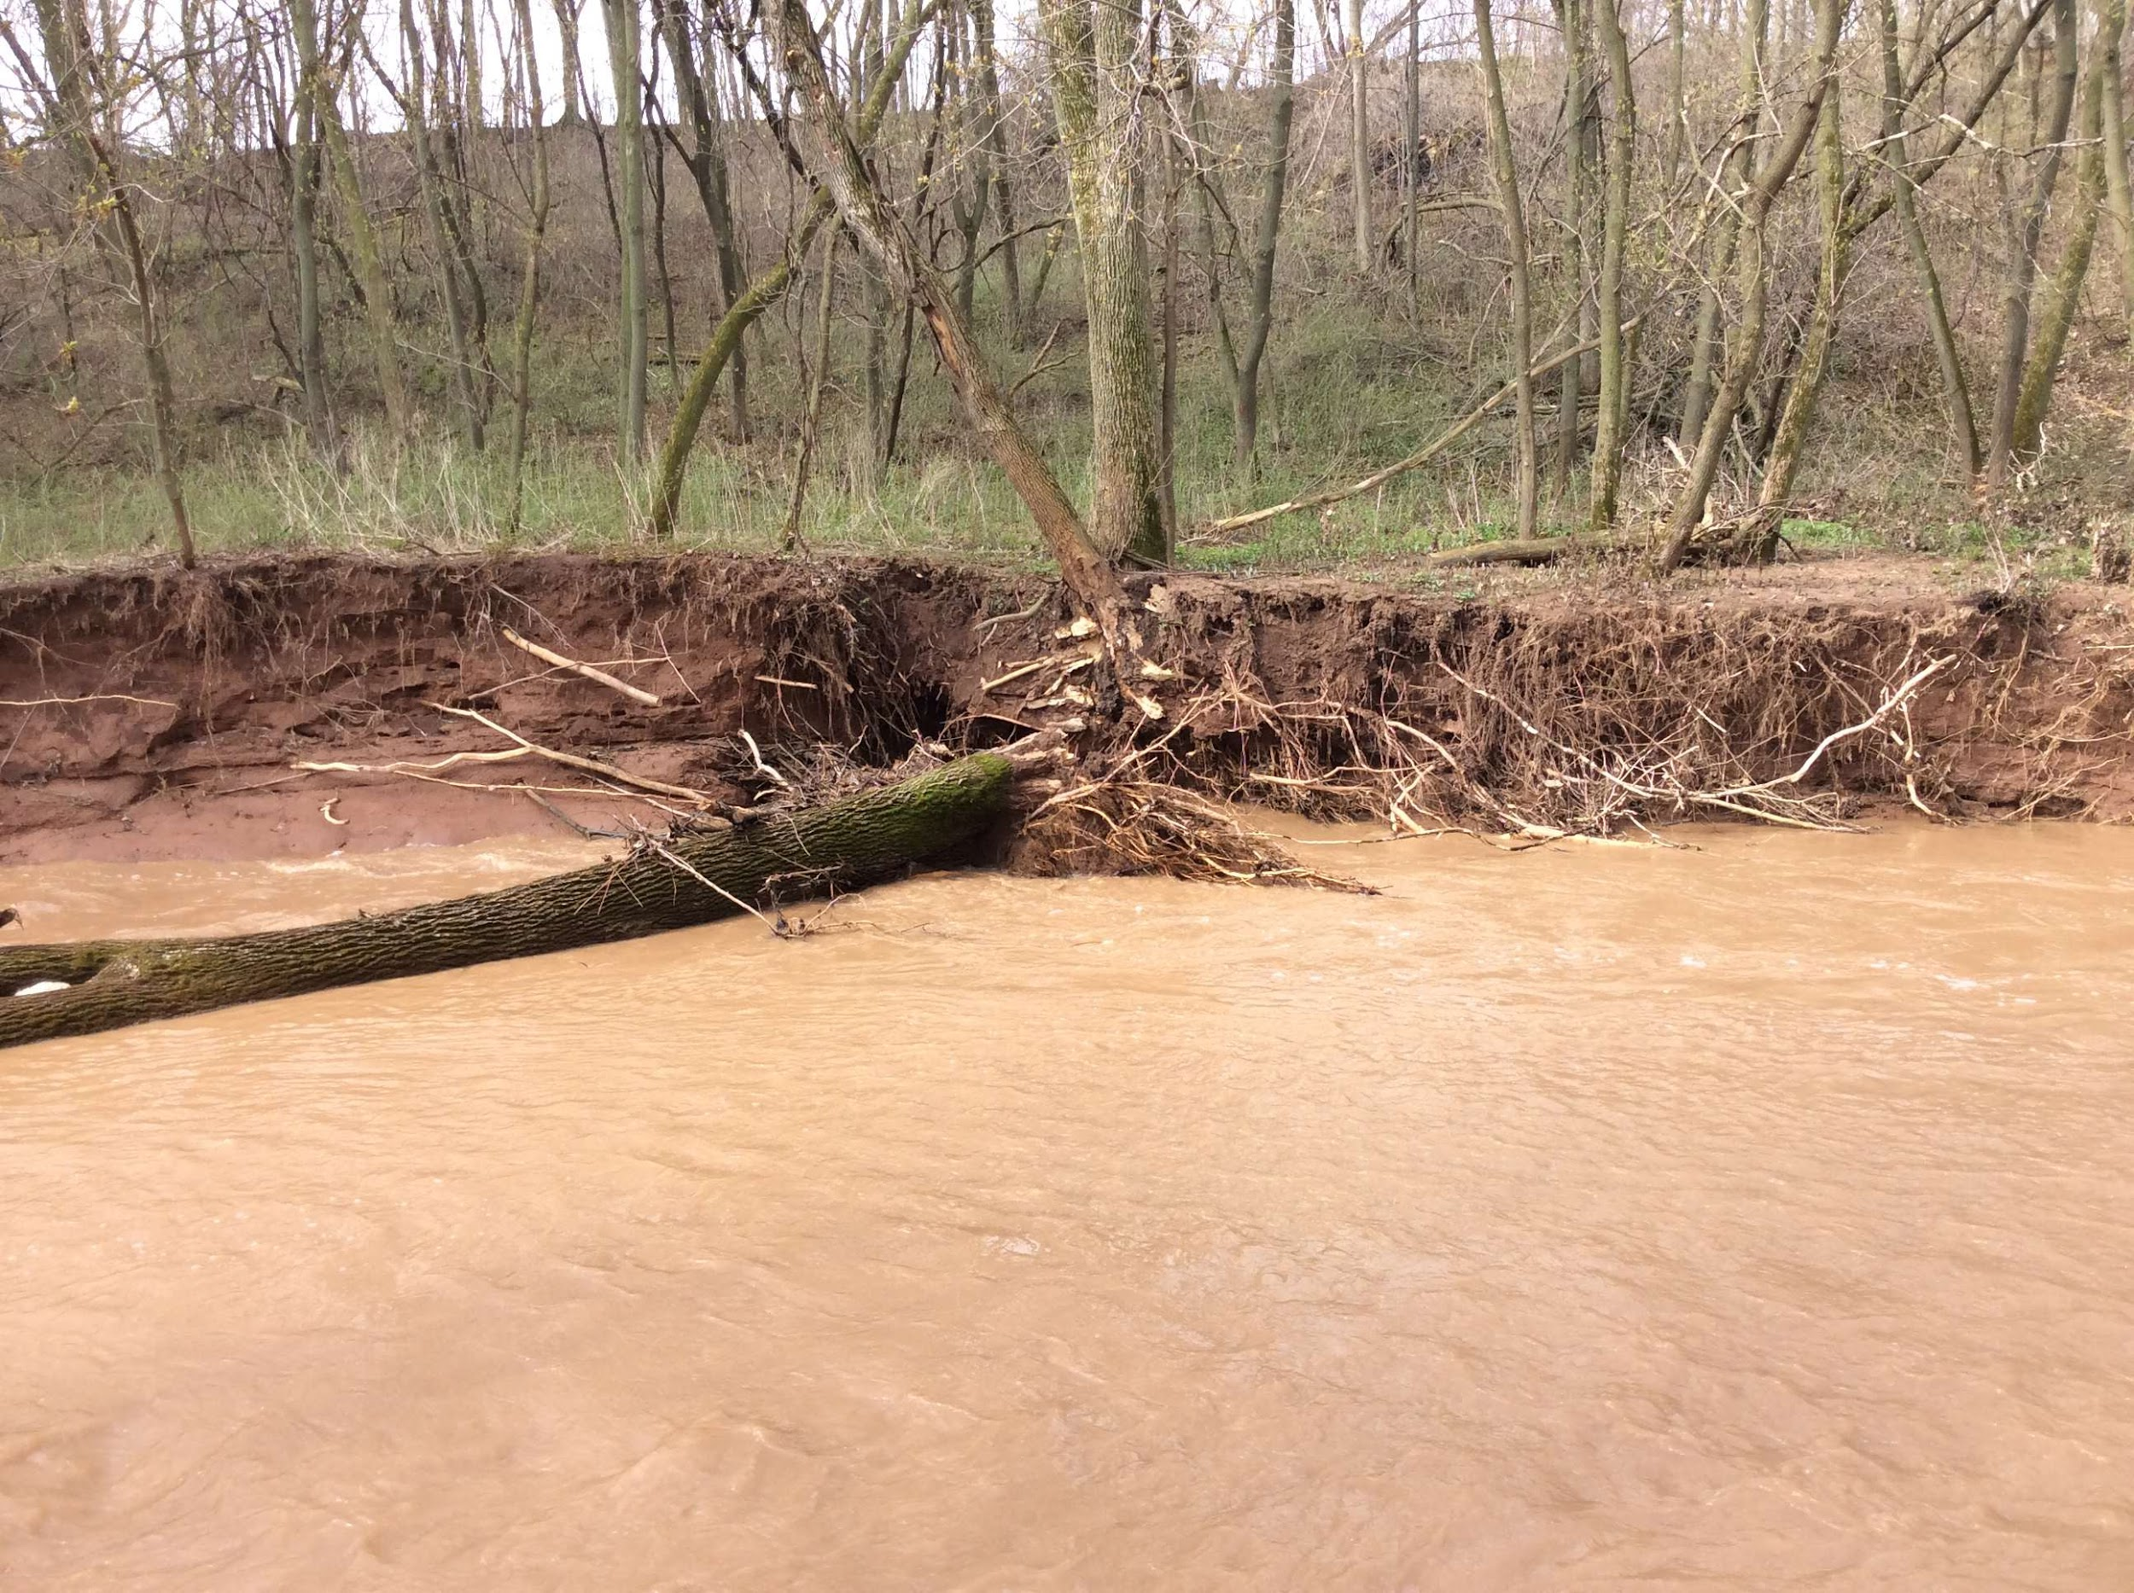
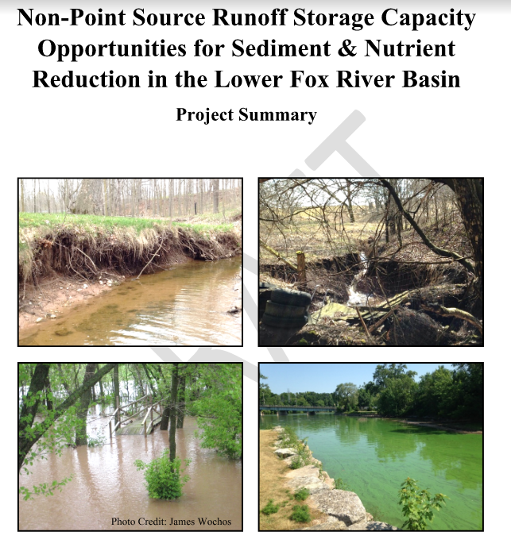
Land Use Impacts
How did my great-great grandma get up here?

Slide 17
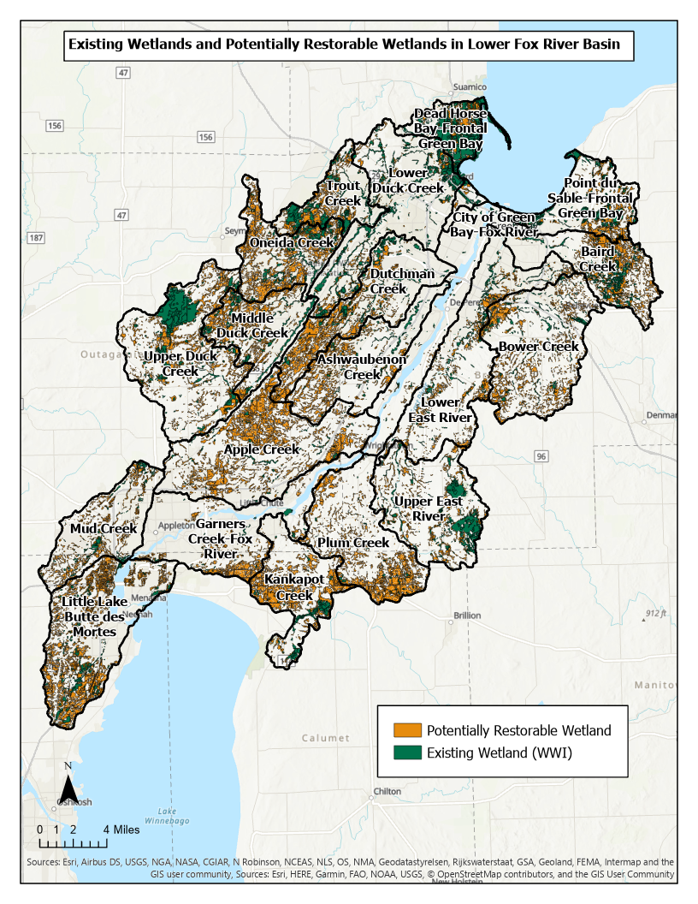
Data courtesy of TNC and Freshwater Network
https://maps.freshwaternetwork.org/wisconsin/

Slide 18
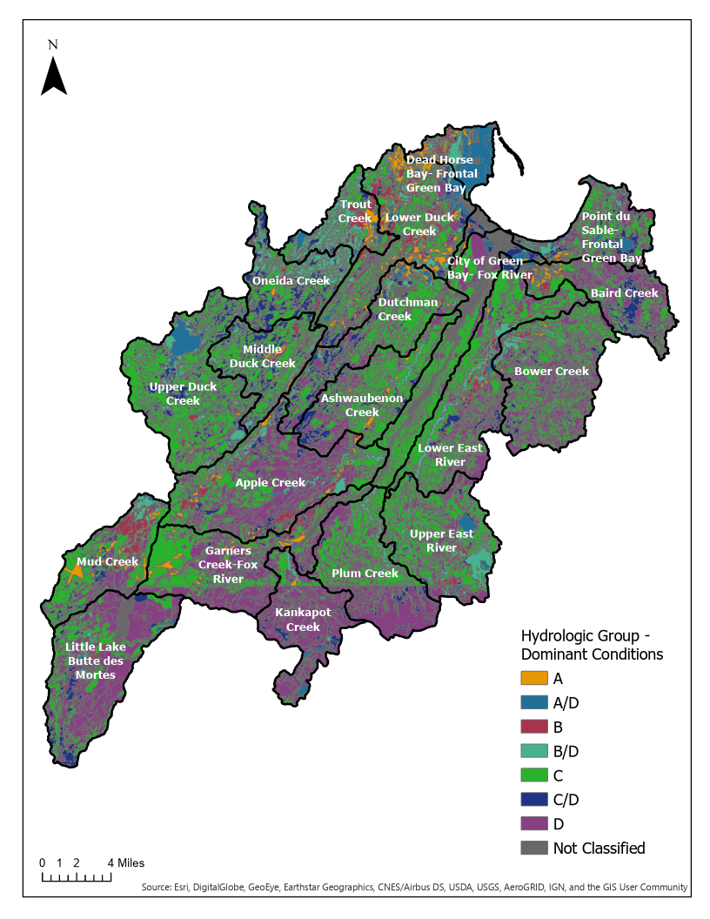

Slide 20
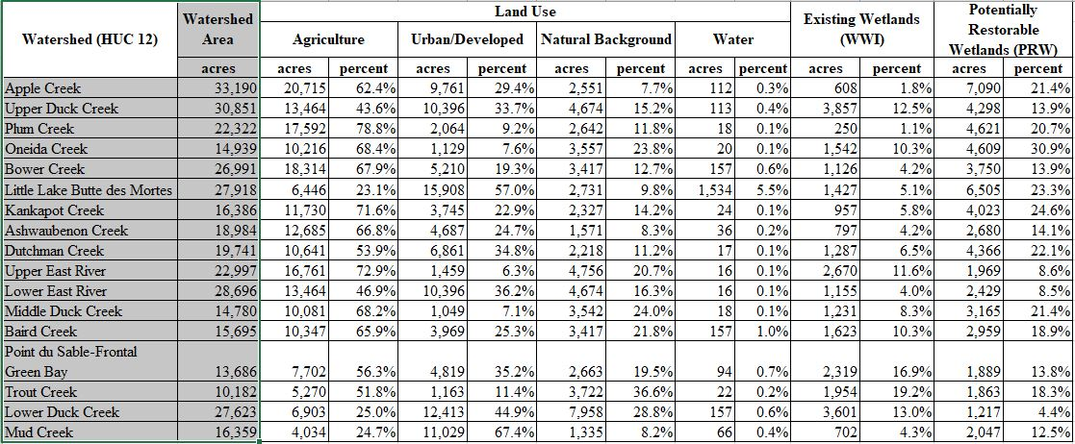

Slide 21
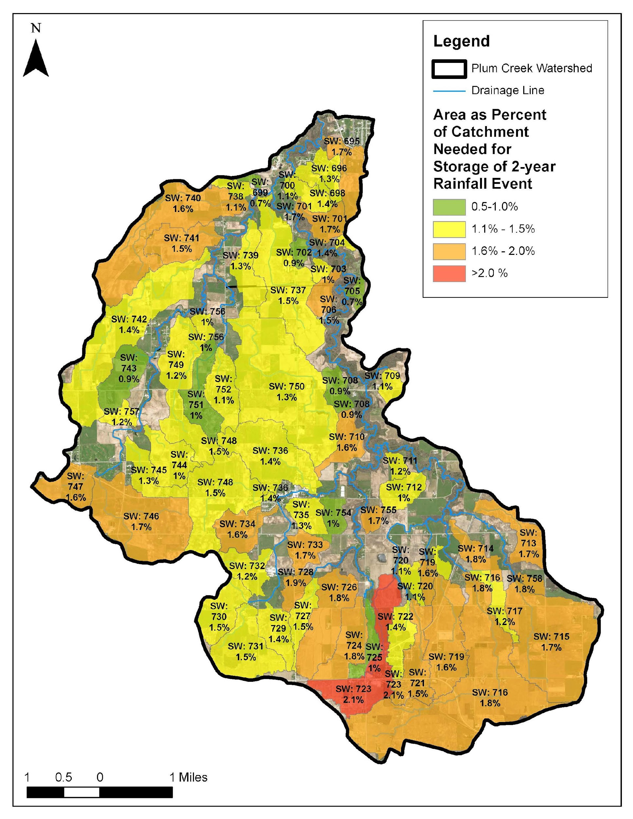

Slide 22
EFH2 Hydrology

Slide 25
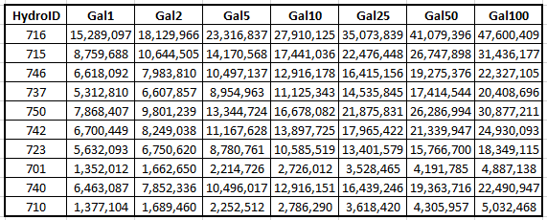
Gallons of Water

Slide 27
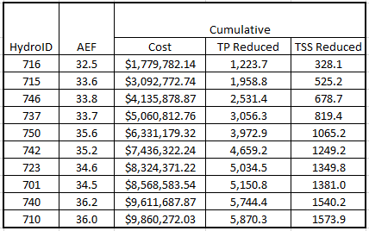
Cumulative Results

Slide 29
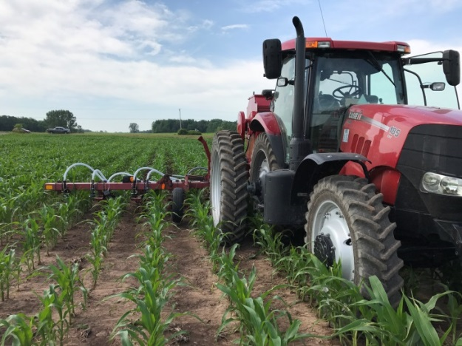
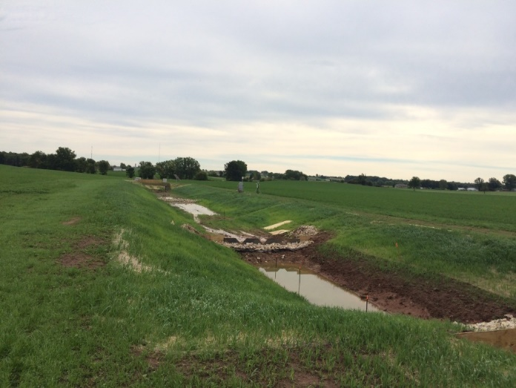
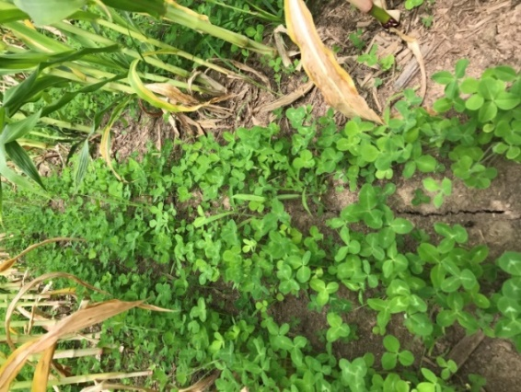
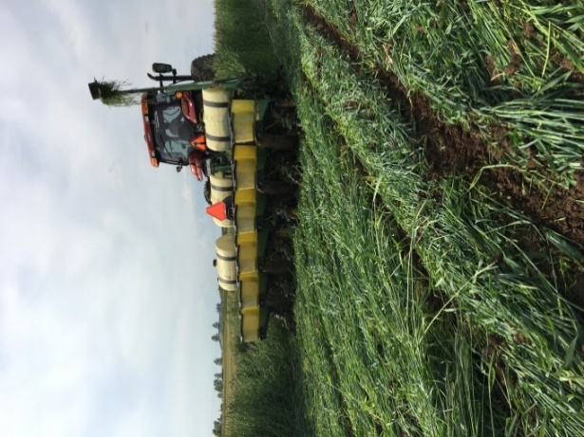
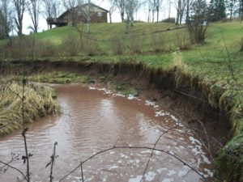
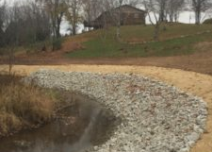
Meanwhile…. Lots of Great Conservation continues to happen in the Lower Fox
Interseeding
Agricultural Runoff Treatment Systems (ARTS)
Cover Crops
Managed Grazing
Streambank Restoration
Manure Injection
No-till Planting

Slide 30
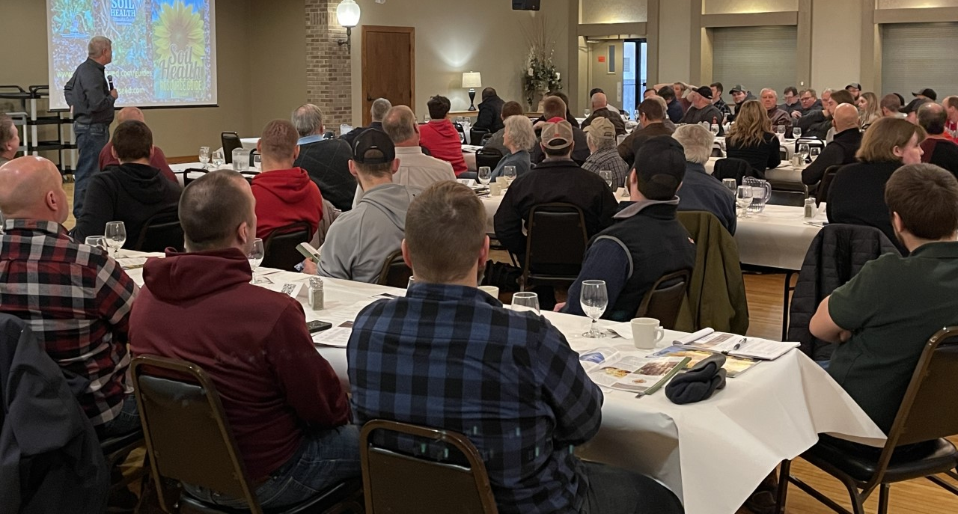
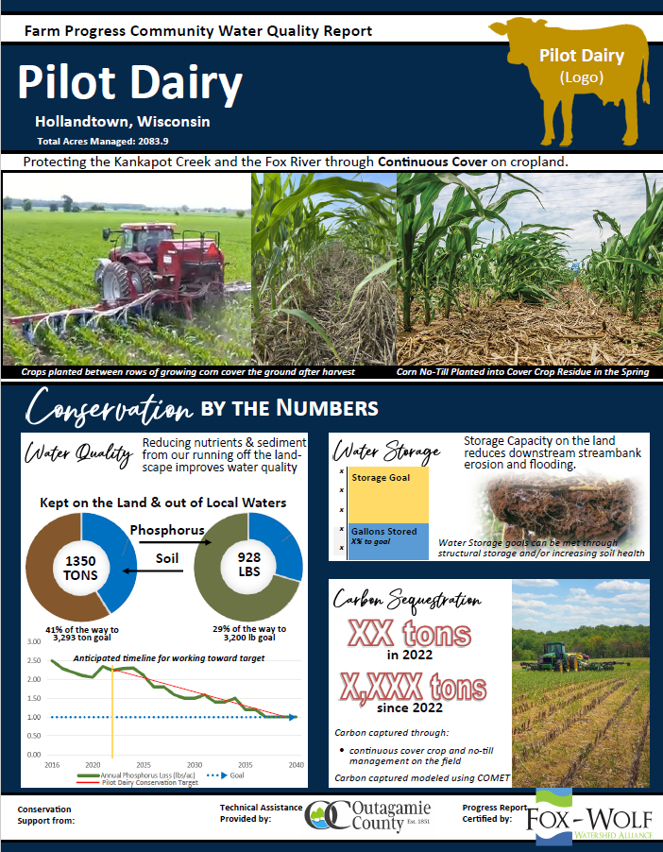
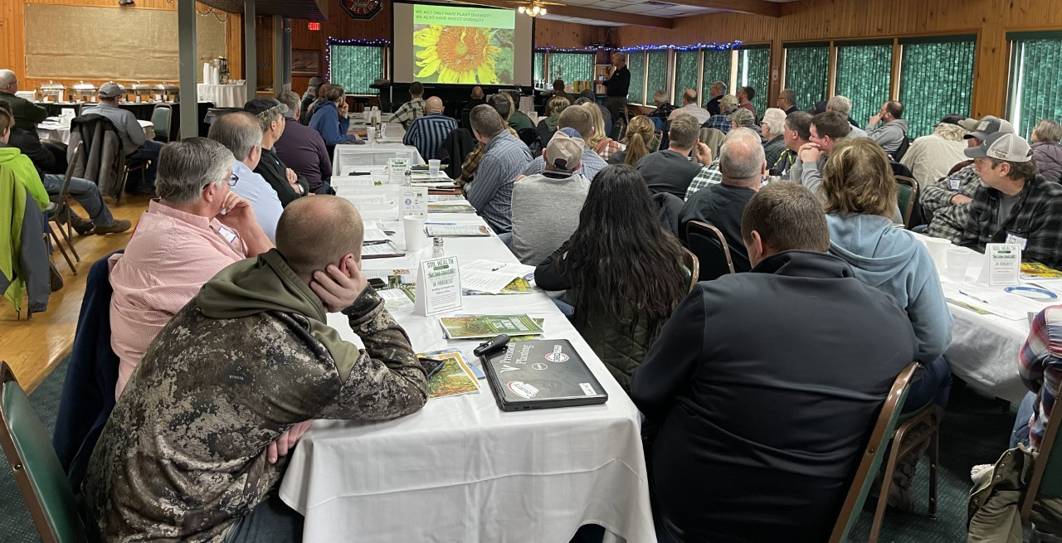
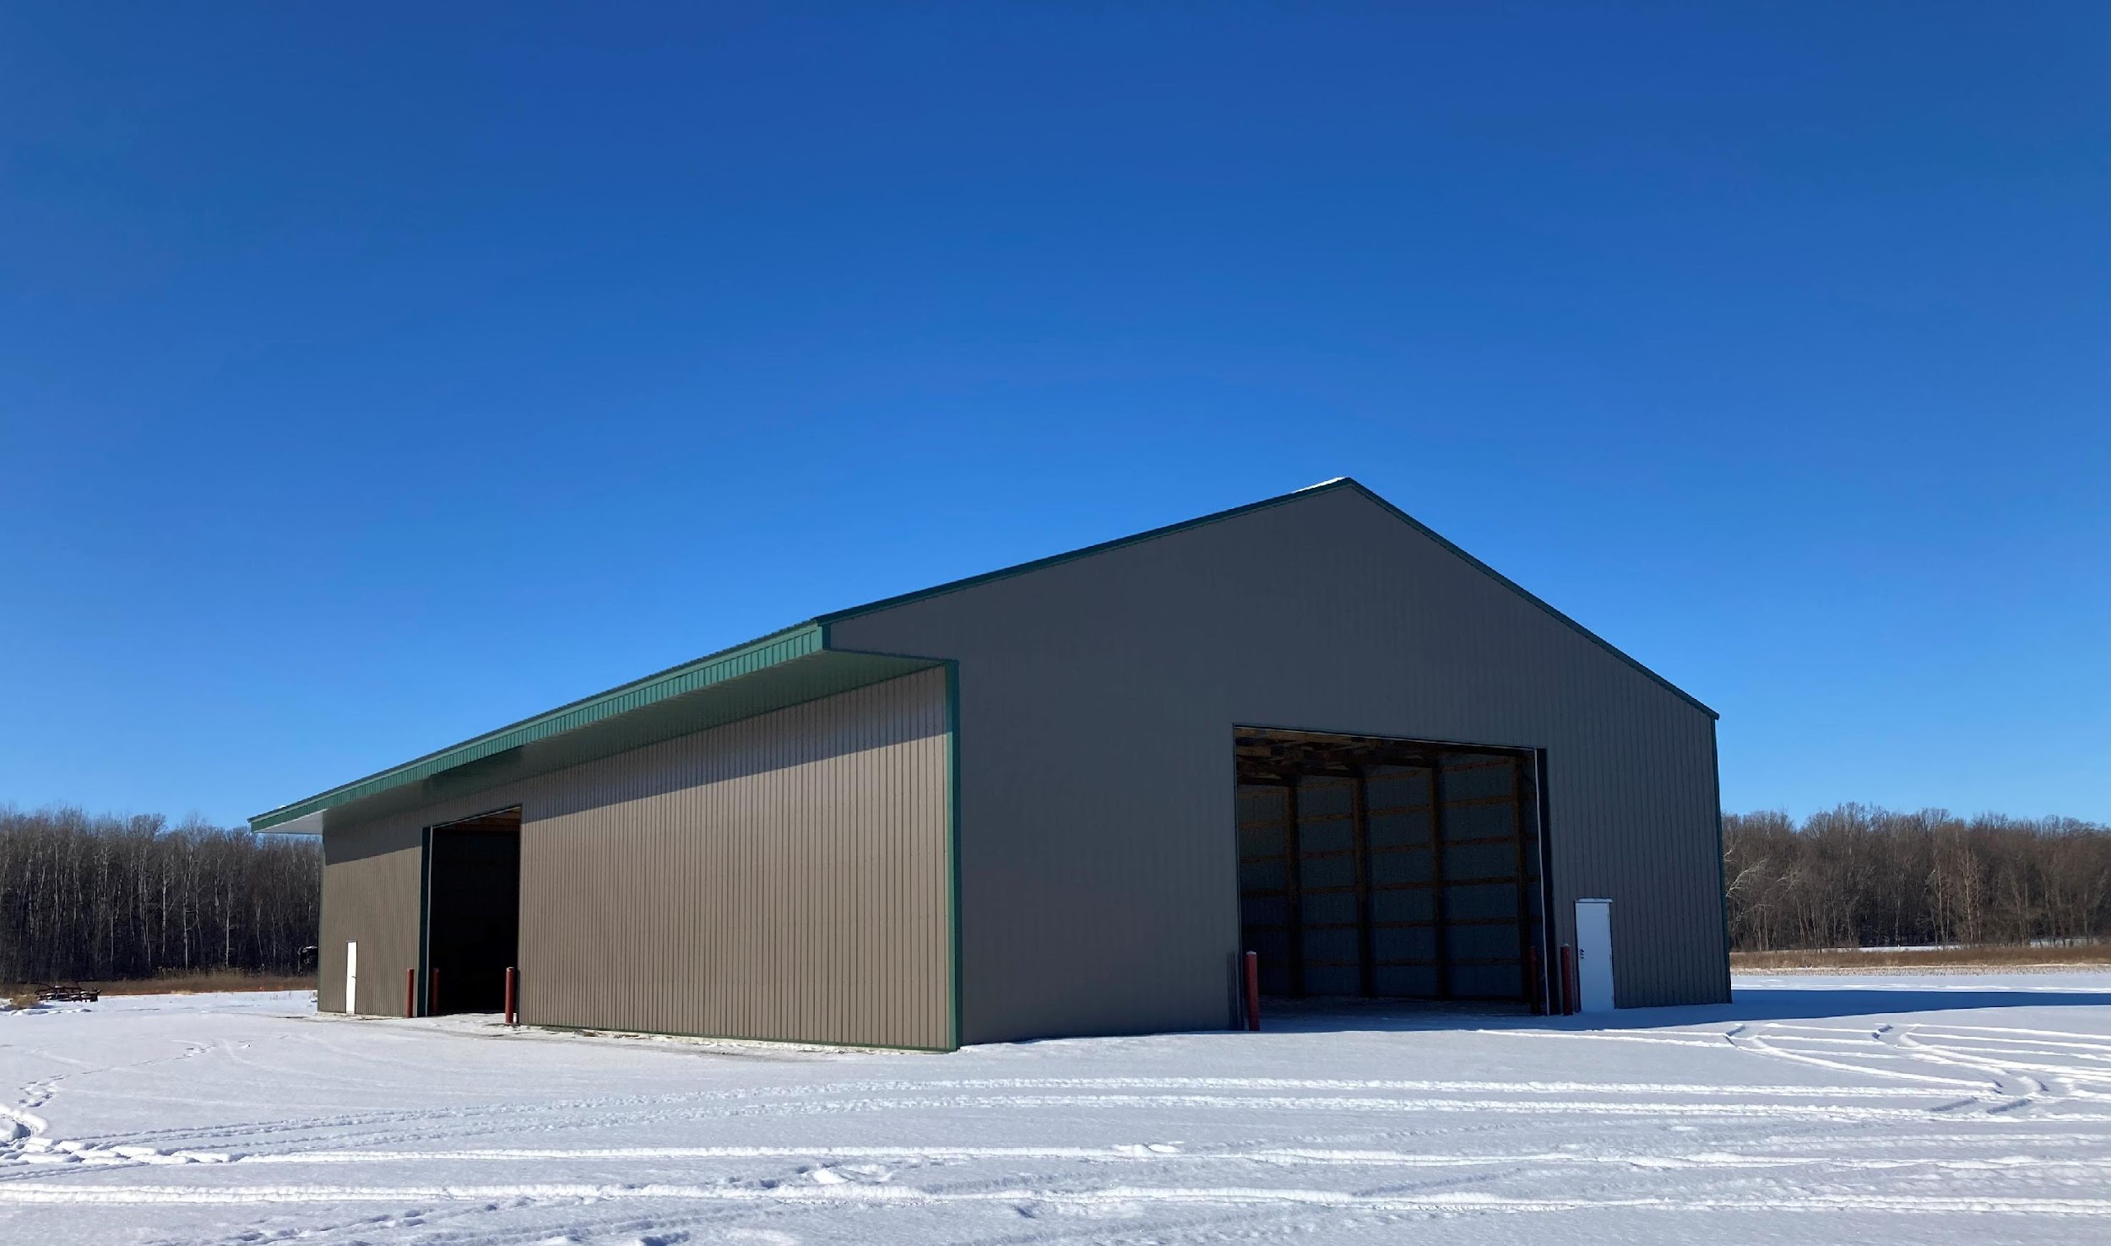
Meanwhile…. Farmer Engagement Continues to Increase
Farmer Engagement continues to Increase
Annual Roundtable events back in person in 2022!
Semi-Annual Basin Buzz newsletters going out to LFR farmers and Winnebago Waterways farmers
Farm progress Report being advanced with pilot farms
Outagamie County “SHED” built and ready for 2022 Outreach events!
Regional Recovery Initiatives
Lower Fox River Farmer Roundtable 80+ Farmers/Agronomists - Hollandtown 2/17/22
Winnebago Waterways Farmer Roundtable 100+ Farmers/Agronomists – Winneconne 2/16
Soil Health Education & Demonstration Facility The “SHED”

Slide 31
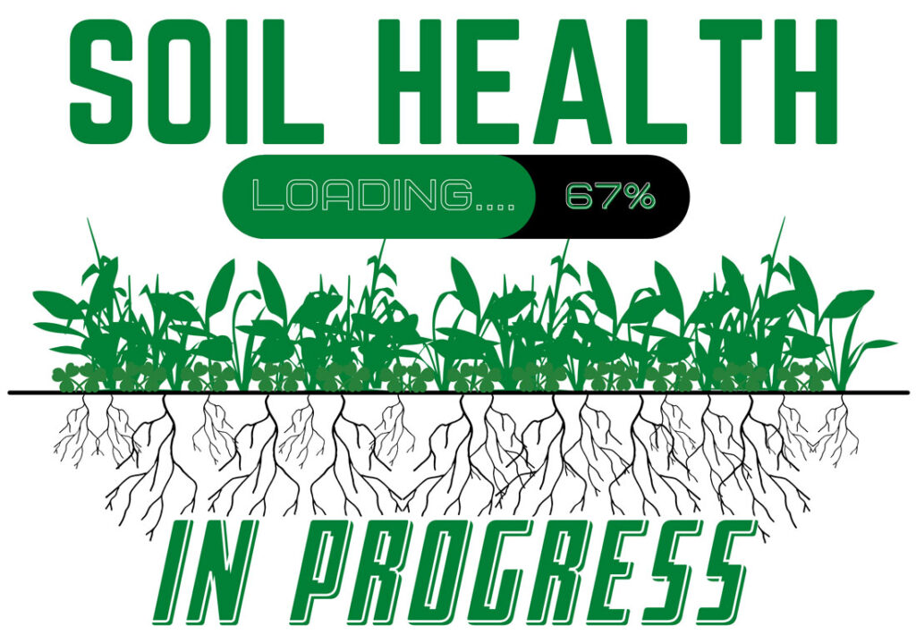
And momentum builds throughout the Basin and with the Agriculture Supply Chain.
Notes:
Our organization is structured by geography and topics.
We have two Regional Recovery Initiatives that are branded, localized efforts working towards watershed recovery. We’ll use these recovery initiatives to provide examples that get at the learning objectives for today’s session.

Slide 32
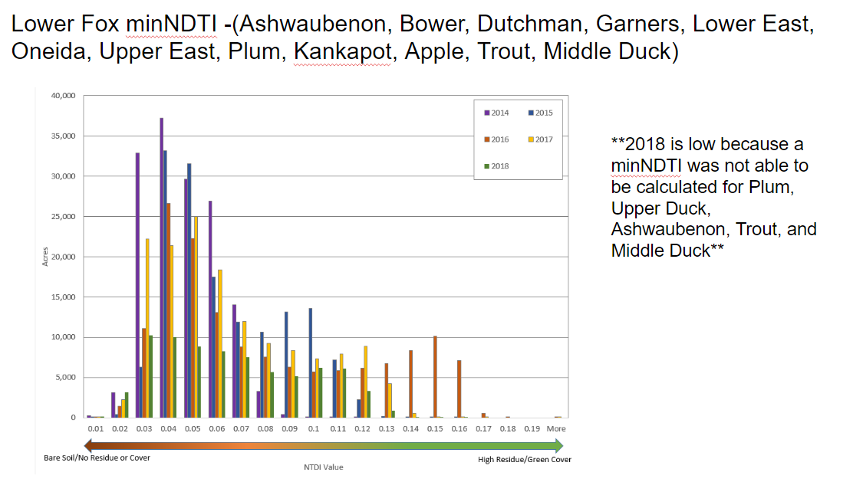

Slide 33
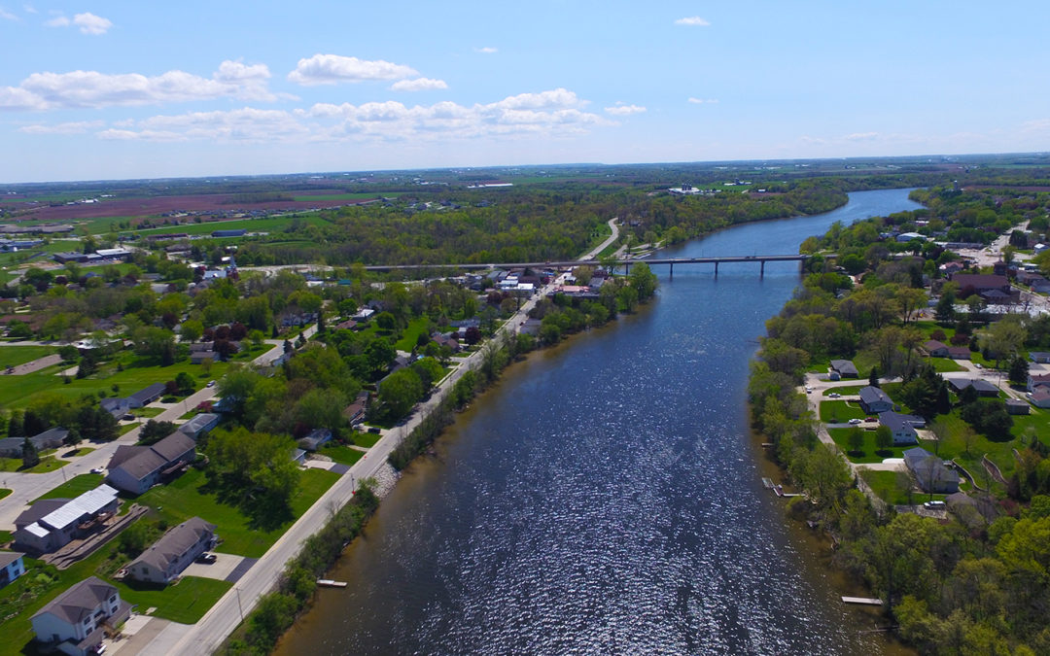
Thank you!
Jeremy Freund, PE Project Coordinator Outagamie County
jeremy.freund@outagamie.org 920.574.6965

