Slide 1
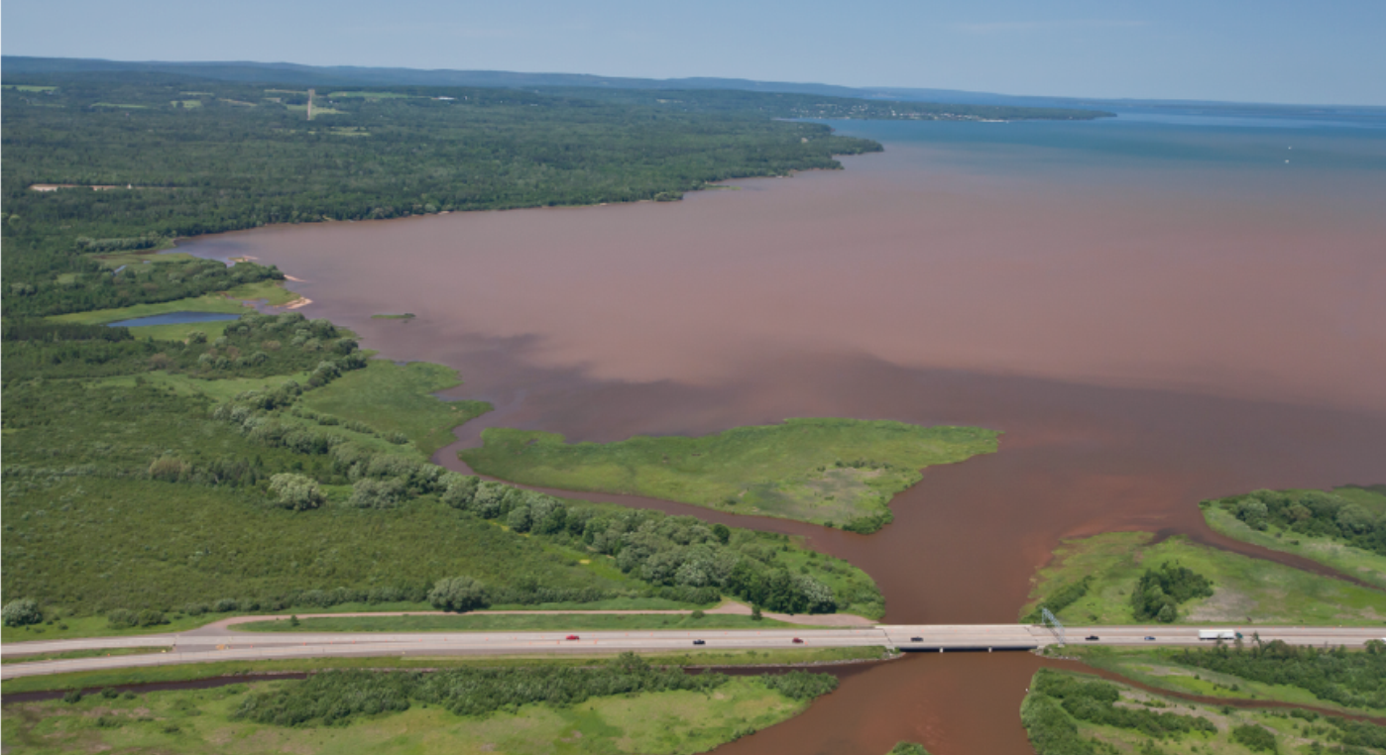

Targeted Phosphorus and Sediment Reduction to North Fish Creek and Chequamegon Bay, Lake Superior
Photo Credit: Bob Gross
Matt Hudson
Associate Director-Great Lakes
Burke Center-Northland College
Photo: Ben Lee
Mary Griggs Burke Center
for Freshwater Innovation

Slide 2
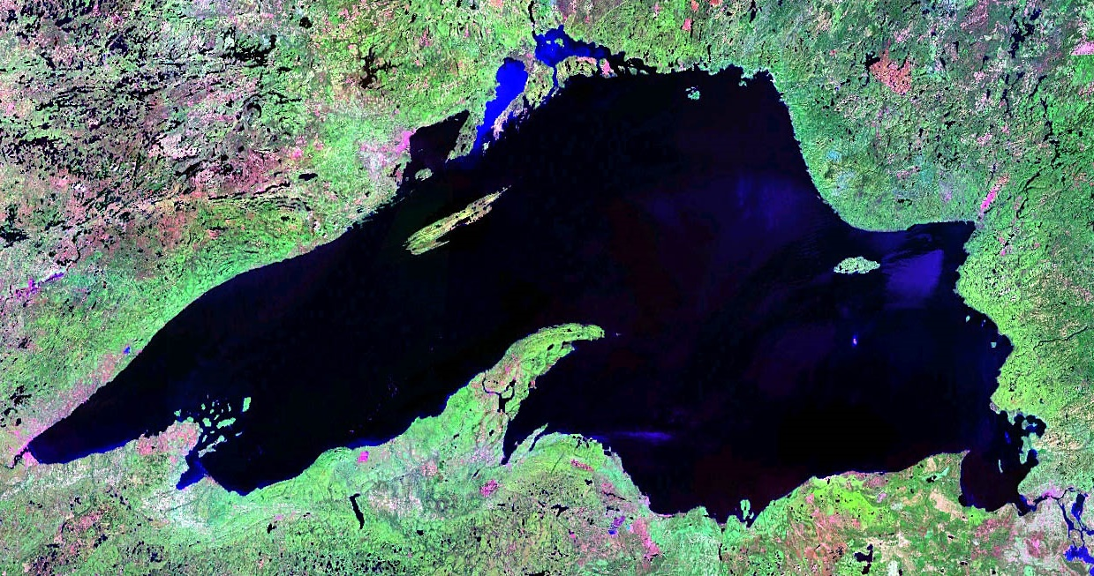
Photo Credit: NASA
Notes:
Lake Superior from space with Chequamegon Bay region shown in red square.

Slide 3
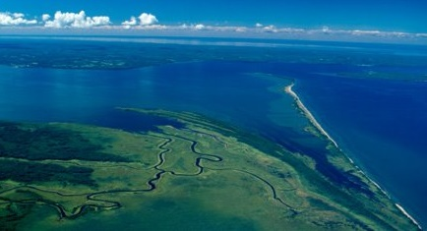
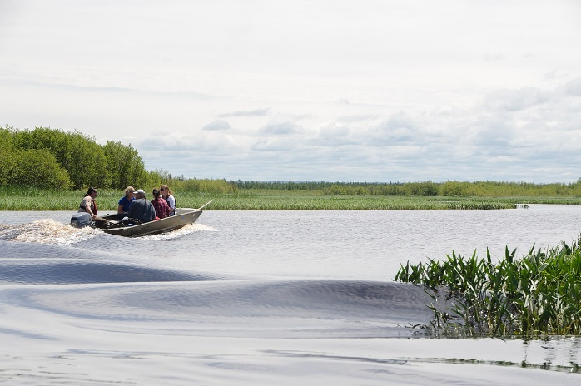
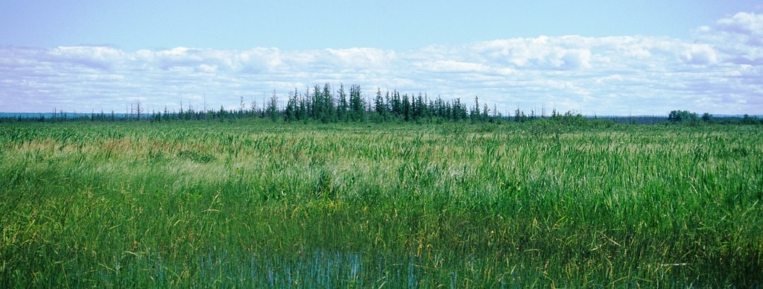
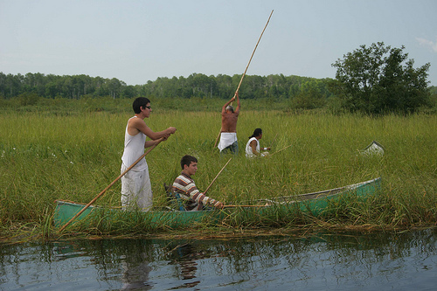
Kakagon and Bad River Sloughs
Photo: Jim Meeker, Ted Cline
Photo: Andrea Pokrzywinski
Photo: Wisconsin DNR
Photo: ramsar.org
Notes:
One of the gems of Chequamegon Bay is the Kakagon and Bad River Sloughs complex which is part of the Bad River Reservation.
This complex of costal wetlands has been designated as a Wetland of International Importance, or a Ramsar Site, and supports the largest intact beds of wild rice throughout the Great Lakes.

Slide 4
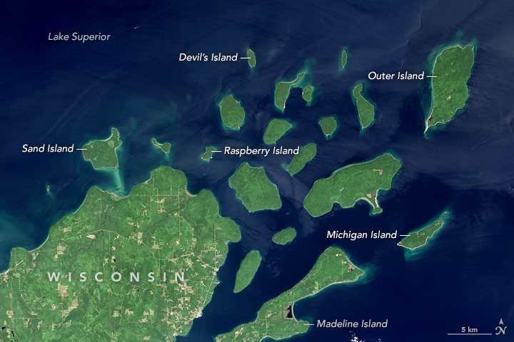
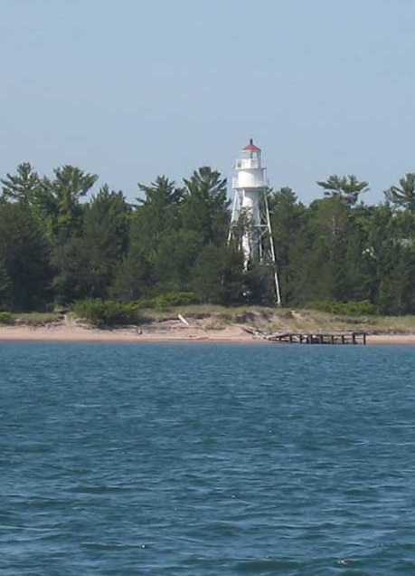
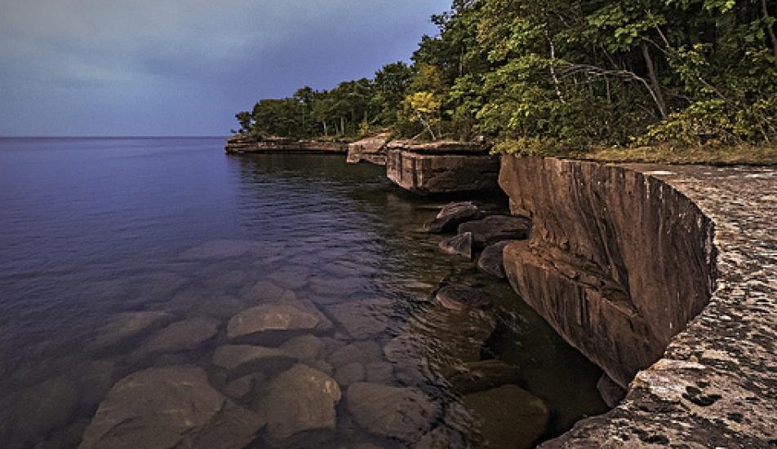
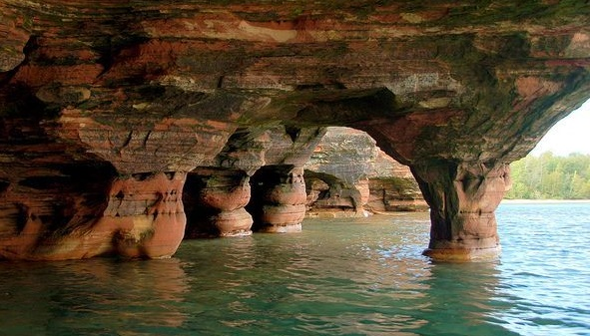
Apostle Islands National Lakeshore
Apostle Islands National Lakeshore
Photo: wisconsinshipwrecks.org
Photo: P. Ignatious Murphy
Photo: flickr.com
Notes:
The region is home to two National Parks--
The Apostle Islands National Lakeshore, is a coastal park consisting of 21 islands and a 12 mile unit of lakeshore on the mainland.
Recreational and economic significance

Slide 5
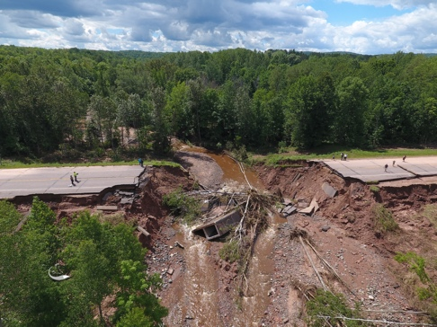
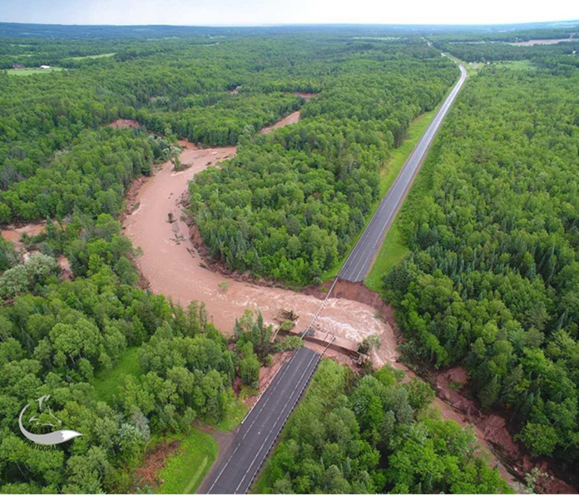
Climate Change “Hot Spot”
Notes:
The Chequamegon Bay region, known for its beautiful land and water and abundant recreational opportunities in a pristine environment, has become a climate change hotspot over the past several years, as photos like these continue to demonstrate how this region is unprepared for the climate realities that are now upon it.

Slide 6
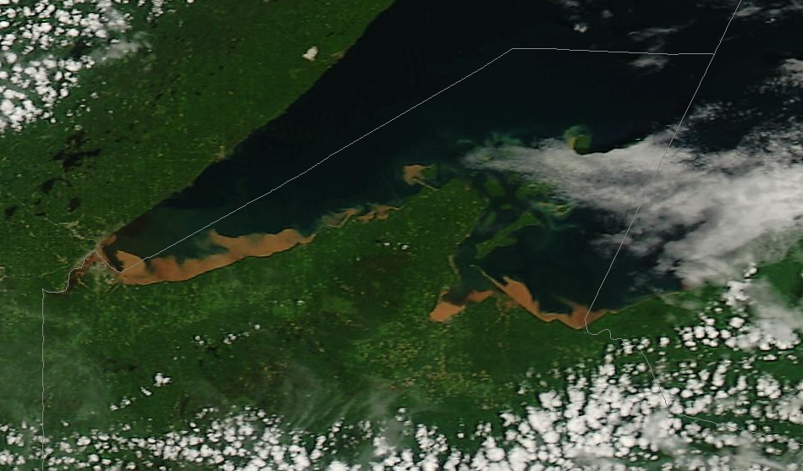
NOAA MODIS Satellite Imagery
June 19 2018
Notes:
June 19 2018
MODIS Satellite Imagery from NOAA
Sedimentation from recent flood events has been so massive that it is easily seen from space. Brown water is not something typically associated with Lake Superior.

Slide 7
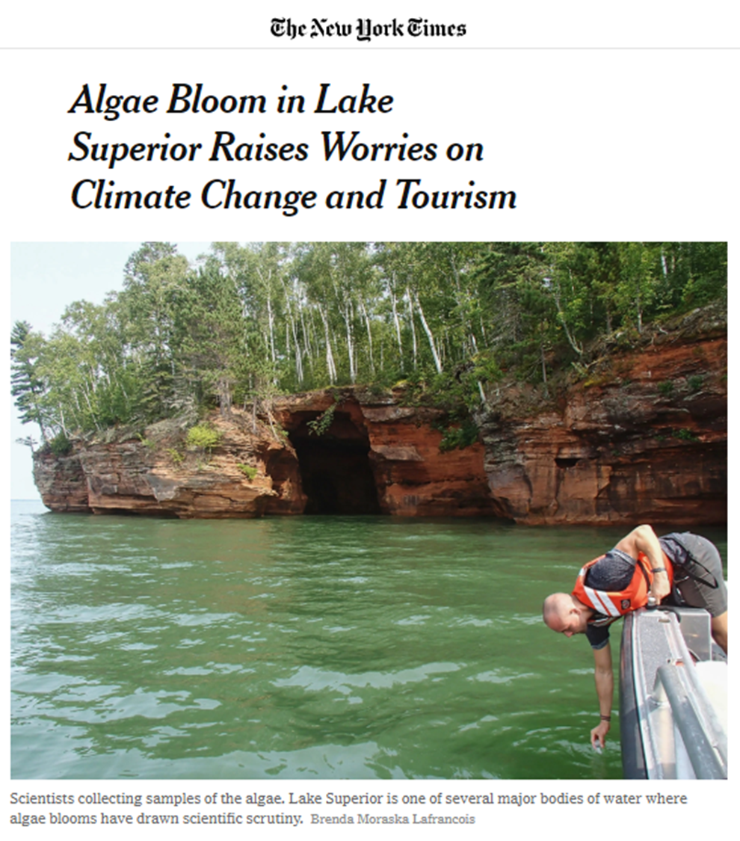
2018 Bloom in Cornucopia, WI. Photo Credits: Brenda Moraska Lafrancois –NPS.
Notes:
Nor are blue green algae blooms…something that has become an increasing concern as recent bloom events have drawn national attention.

Slide 8
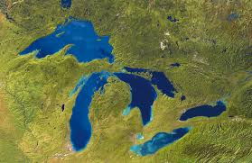
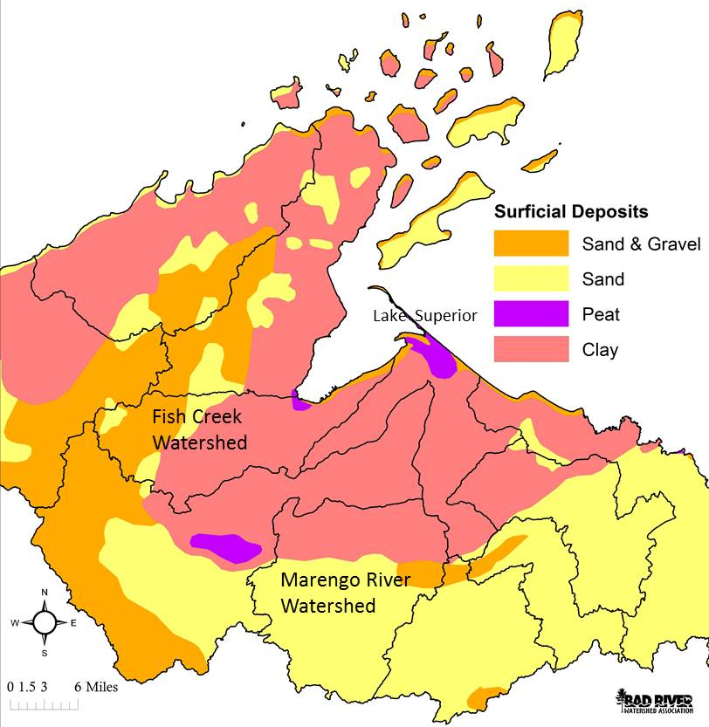
Vulnerable to Erosion
Notes:
The natural geology of the Chequamegon Bay watershed makes it very sensitive to disturbance. Note the boundary of sand and clay deposits that cuts across the major LS watersheds in WI and into parts of MI and MN. Issues are very similar across all these watersheds. Past land use, intensive logging and farming over last century caused significant damage to local streams and rivers that are still seen today.

Slide 9
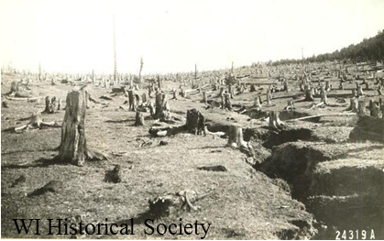
Land Cover Change
Northern Wisconsin landscape post-cutover.
Notes:
The “cut-over” that occurred across regions of the upper Midwest in the late 1800s and early 1900s brought large-scale land cover change to these regions. The forest cover acted as a sponge to soak up water and without it, water rapidly ran off the landscape, causing significant erosion and sedimentation problems on land and in streams and rivers.

Slide 10
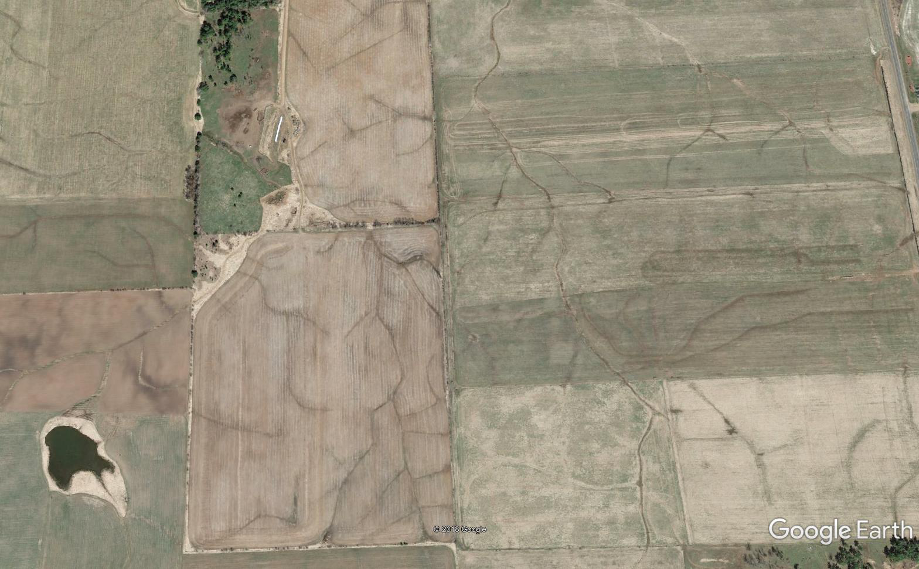
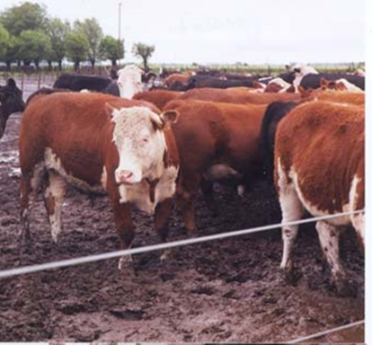
Agricultural Intensity
Chequamegon Bay area fields showing typical drainage network and livestock in upper right.
Notes:
Following the cut-over, there were efforts to intensively farm the region, which peaked in the 1920s and 1930s. This caused further erosion and sedimentation in regional water bodies. Note the network of surface drainage in fields from this aerial image near Ashland. In order to farm on clay soils, these surface drainage networks are needed to get water off the landscape so it can dry out enough to be farmed. Over time, intensive farming in the region has declined and today, long rotation hay (like this photo) is a more common kind of crop than corn and soybeans, mostly because of the cold climate and challenges associated with farming on clay.

Slide 11
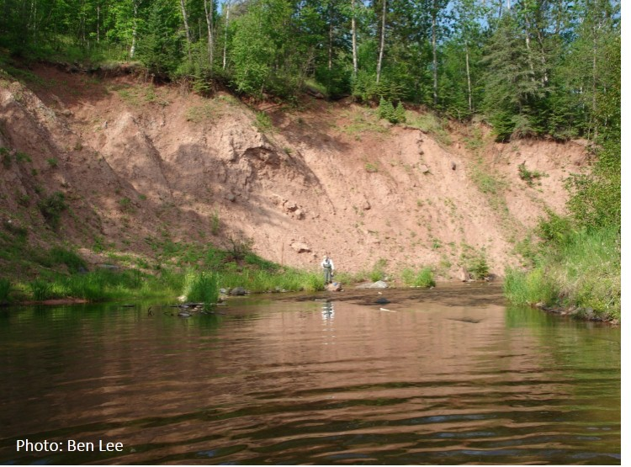
Bluff & Valley Wall Erosion
Notes:
The combination of forest removal and intensive agriculture led to increased runoff and increased erosion and sedimentation in streams, particularly at the transition between sand and clay soils at the old beach shoreline for glacial Lake Duluth. This picture from Fish Creek shows a large, eroding bluff in this soil transition area.

Slide 12
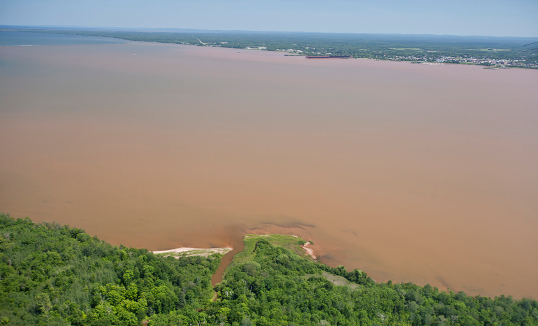
Sediment Plumes
Photo: Bob Gross
Notes:
This aerial photo of Chequamegon Bay following a large rain event in 2012 shows the extent of the sedimentation issue in our region. Much of the sediment comes from the large, eroding bluffs like I showed in the previous slide.

Slide 13
Historical Land Cover Change Drives Excess Erosion and Sedimentation
Fitzpatrick and Knox, 2001
Notes:
Faith Fitzpatrick (now a researcher with the USGS in Madison, WI), did her PhD research on North Fish Creek with the goal of understanding where all the sediment in Fish Creek comes from. Her research forms the backbone of our understanding of how past land cover change from the cut-over and intensive agriculture that followed caused dramatic increases (~3-fold) in the size of erosive peak flows in the stream (left graph) and corresponding 4-5 fold increases in the amount of sediment transported by the stream, ultimately to Chequamegon Bay (right graph). Notice that current peak flows and sedimentation rates in Fish Creek are still about double pre-settlement rates, indicating our watersheds are still recovering from the cut-over and are still in an unstable, vulnerable state.

Slide 14
Increase in Event Magnitude
From: NOAA Atlas 14, vol. 8, 2013
Notes:
The increase in precipitation in the Chequamegon Bay region has come in the form of more intense events, rather than spread out evenly across the year. This figure shows the increase in size of 1% annual recurrence interval storm event (24-hour, 100-year storm) has increased about 35-40% since mid-20th Century. This is among the largest changes anywhere in the upper Midwest and indicates the Chequamegon Bay region is a “hot spot” for changes in precipitation patterns since mid-20th Century. Data used to conduct these analyses through 2011.

Slide 15
Science-informed Management Recommendations
Target “Slow the Flow” practices in upper watershed to reduce flood peaks and bluff erosion
Reduce In-Stream Sediment Sources Through Bluff Stabilization

Slide 16
Phase 1: Targeted Sediment Reduction to Chequamegon Bay
Great Lakes Restoration Initiative: 2013-2018
  Great Lakes Commission: $173,172
  US Fish and Wildlife Service: $118,000
Goal of reducing excess sedimentation from Fish Creek to Chequamegon Bay and to improve fish habitat in creek.
Working long-term goal of reducing sediment load from Fish Creek to Chequamegon Bay by 50%, or from about 29,000 metric tonnes to 14,500 metric tonnes annually.

Slide 17
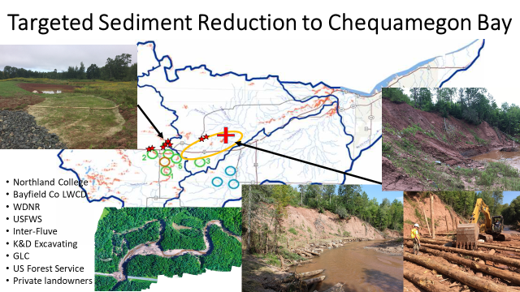
Notes:
A CBAP project funded in 2013 through a $227,300 from GLC, with an additional $50,000 from local USFWS office. Additional $68,000 from USFWS after GLC funds expired prior to bluff project completion. All funds GLRI. Goal of reducing sedimentation from Fish Creek to Cheq. Bay, also improve fish habitat in creek.
With sedimentation rates about double pre-settlement (Faith’s work), overall Fish Creek sediment reduction goal to reduce from approx. 29,000 metric tonnes/year to 14,500 mtric tonnes/year over an unspecified time period.
Project implements management recommendations from Fitzpatrick, Blodgett, and others to target upstream runoff attenuation in headwater areas of Fish Creek (to reduce erosion-inducing peak flows) and instream sediment sources at one/two of the 15-20 eroding bluffs along the transitional main stem of North Fish (where about 2/3 of the sediment from North Fish is generated).
Bayfield Co LWCD contacted 20 landowners, conducted 6 surveys, completed 5 designs, and constructed wetlands at 3 sites in headwater areas of North Fish near Blodgett’s priority areas for runoff attenuation. A total of 8 wetland basins were constructed, covering 2.8 acres and treating 435 acres.
Initial bluff project site was surveyed and designed but not constructed due to failure to achieve landowner support. Second bluff site identified – former vanes site where that treatment had not stabilized bluff – landowner approval, survey, design, permitting, and construction all completed by the end of August 2018. Final tree planting to occur in spring 2019.
Bluff project will reduce approx. 600 metric tonnes of sediment to North Fish, thus achieving about 4% of the overall sediment reduction goal for Fish Creek.
Project partners included:
Northland College – project lead
Bayfield Co LWCD – upland project implementation
Inter-Fluve, Inc – Bluff project implementation
K&D Excavating, Inc – Bluff and upland project construction
WDNR – Project support & permitting
US Forest Service – Log donation
USFWS – funding and project support
GLC Program for Soil Erosion & Sediment Control – funding
Private landowners

Slide 18
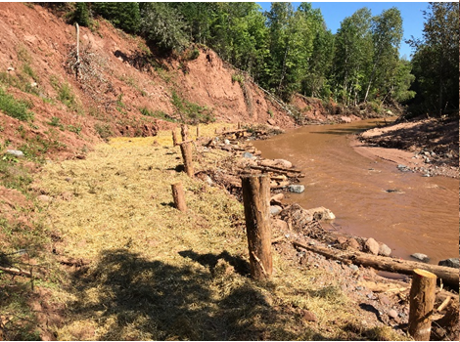
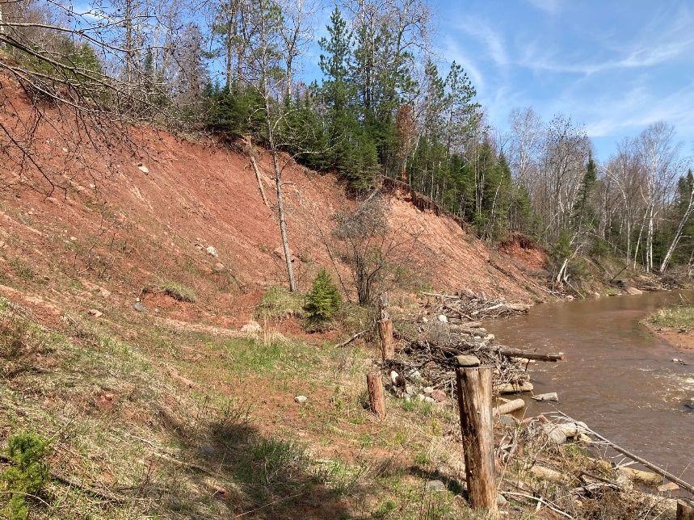

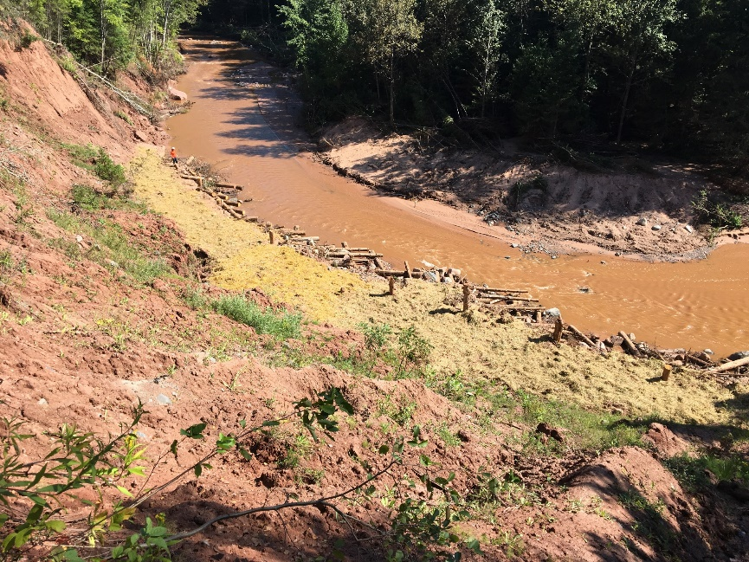
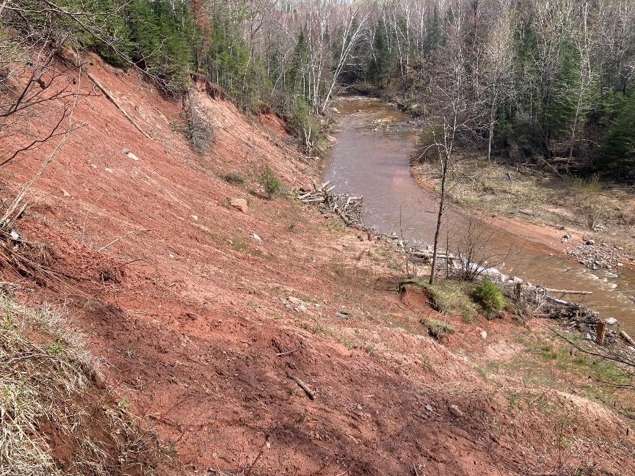
Photo Monitoring of Project Performance
Notes:
Final project cost ~$177K

Slide 19
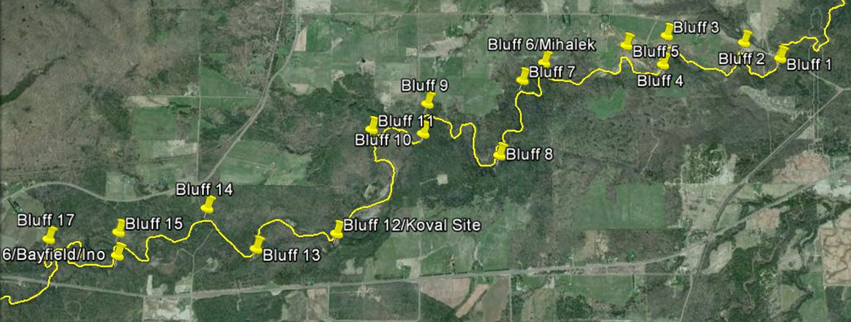

Phase 2 Project – Bluff Stabilizations Only
Great Lakes Commission, GLSNRP: $199,726
Coastal Program, USFWS: $122,881

Slide 20
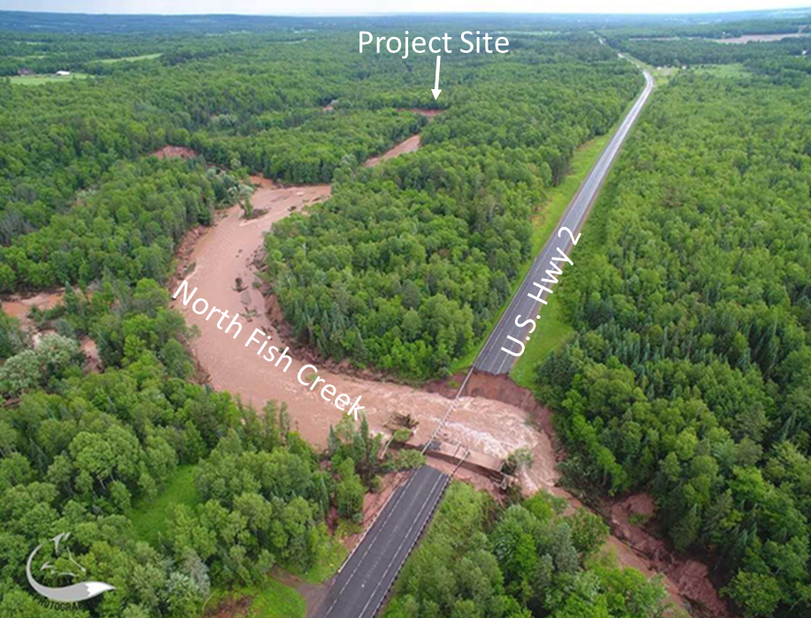
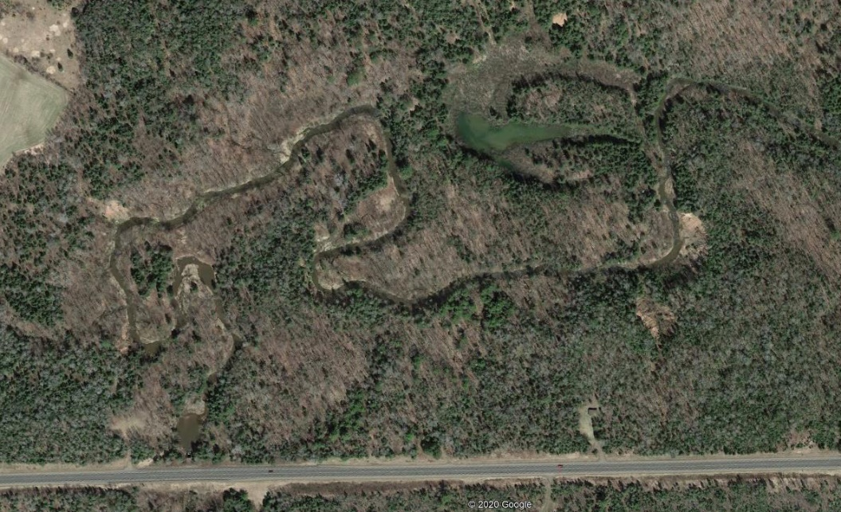
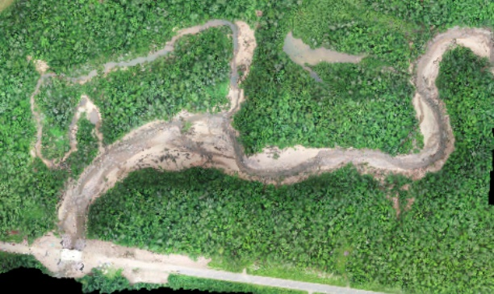

Project Site: Casualty of 2018 Flood
Mary Griggs Burke Center
for Freshwater Innovation
Notes:
An estimated 45,000 tonnes of sediment were released into the river when the bluff failed in June 2018.

Slide 21
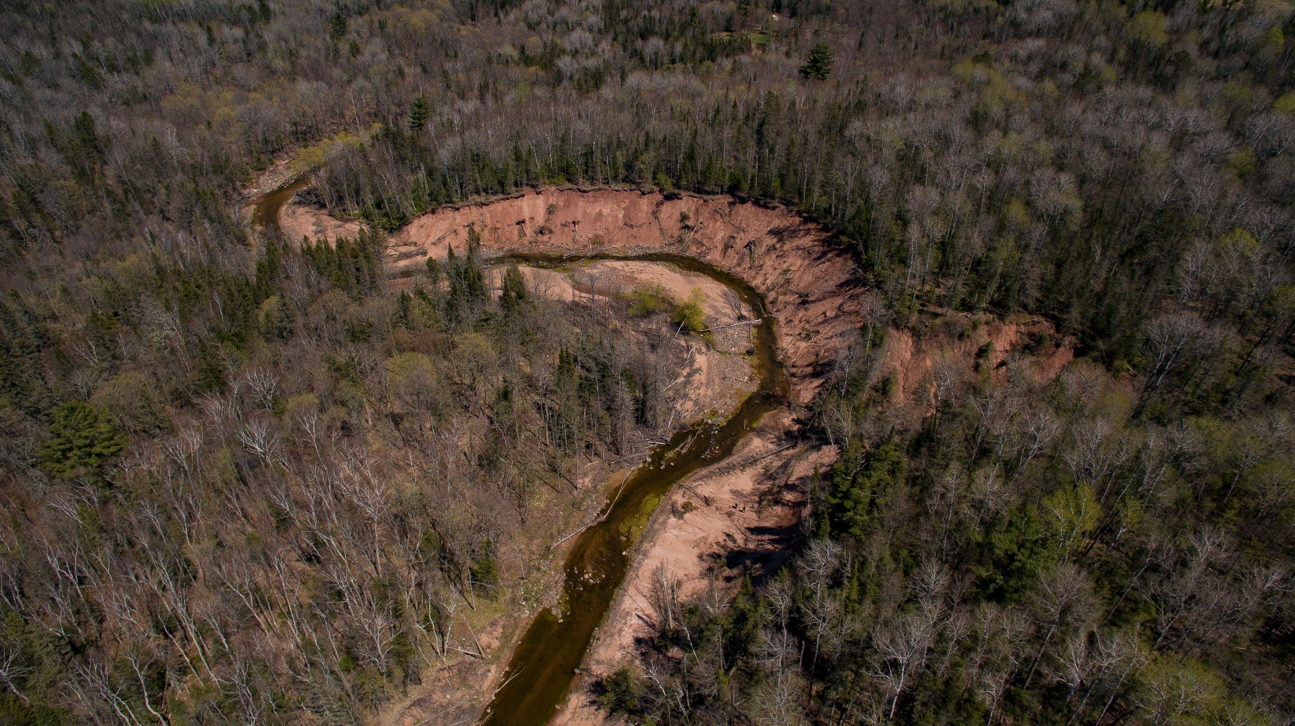
Project Site: About 630ft long, 55ft high
Estimated to contribute 4,444 tons of sediment and 3,777 pounds of P annually (STEPL estimate).

Slide 22
Phase 2 Project Partners
Northland College: Project coordination and communications
Wisconsin DNR: Landowner, permitting
Fish Creek Restoration & Inter-Fluve: Engineering
US Forest Service & Bayfield Co: Sourcing logs
Private landowners – John and Laura Moore

Slide 23
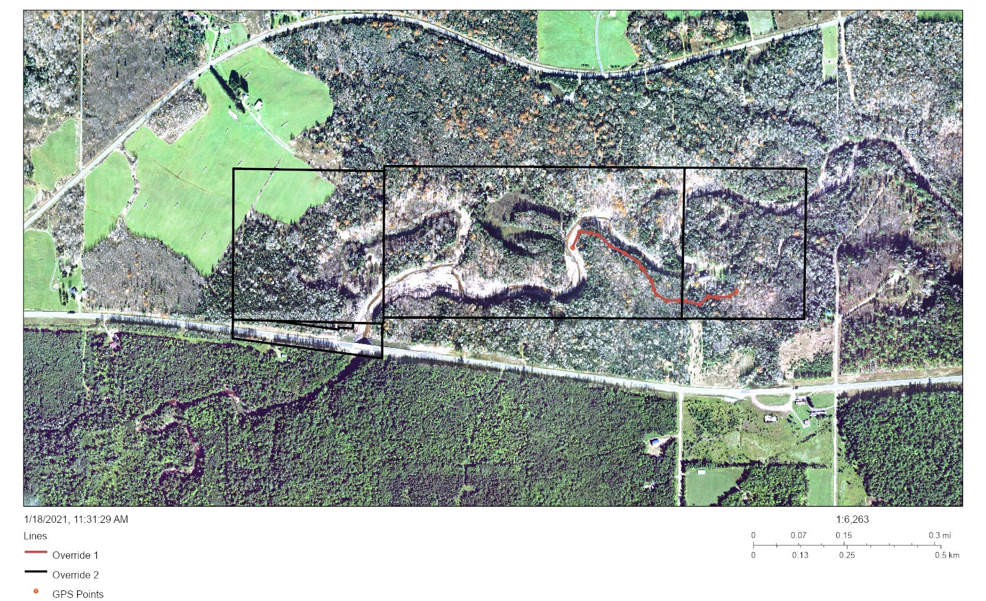
Construction Access
Keith Elliot Wilber
John W. Moore
DNR State of Wisconsin
HWY Commission
Access Road Estimated Length
From Moore Property: 1840 ft
From HWY 2: 2650 ft

Slide 24
Project Timeline
10/1/2020: grant period begins
Fall 2020: survey and preliminary design work
Winter/spring 2021:
  project partner & pre-application meeting
  Final design, permitting, material sourcing
9/30/2021: in-stream construction completed!

Slide 25
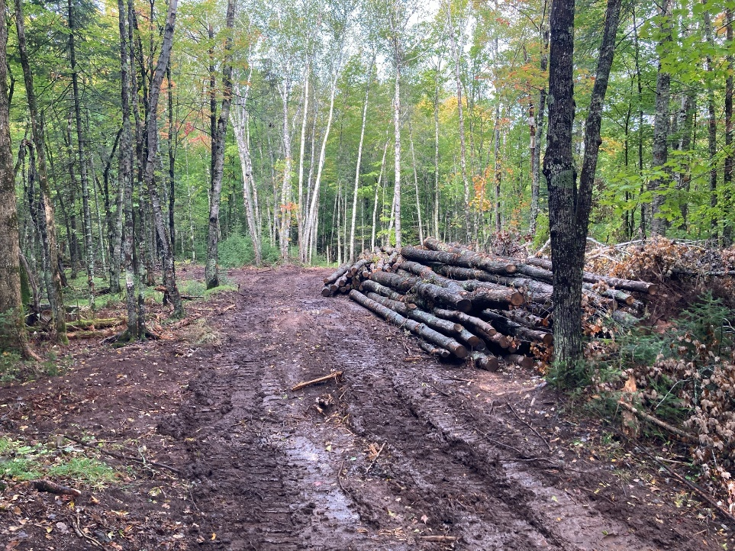
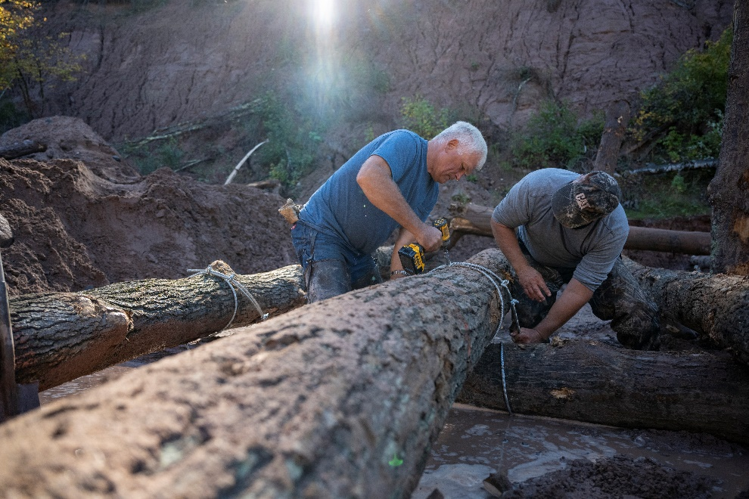
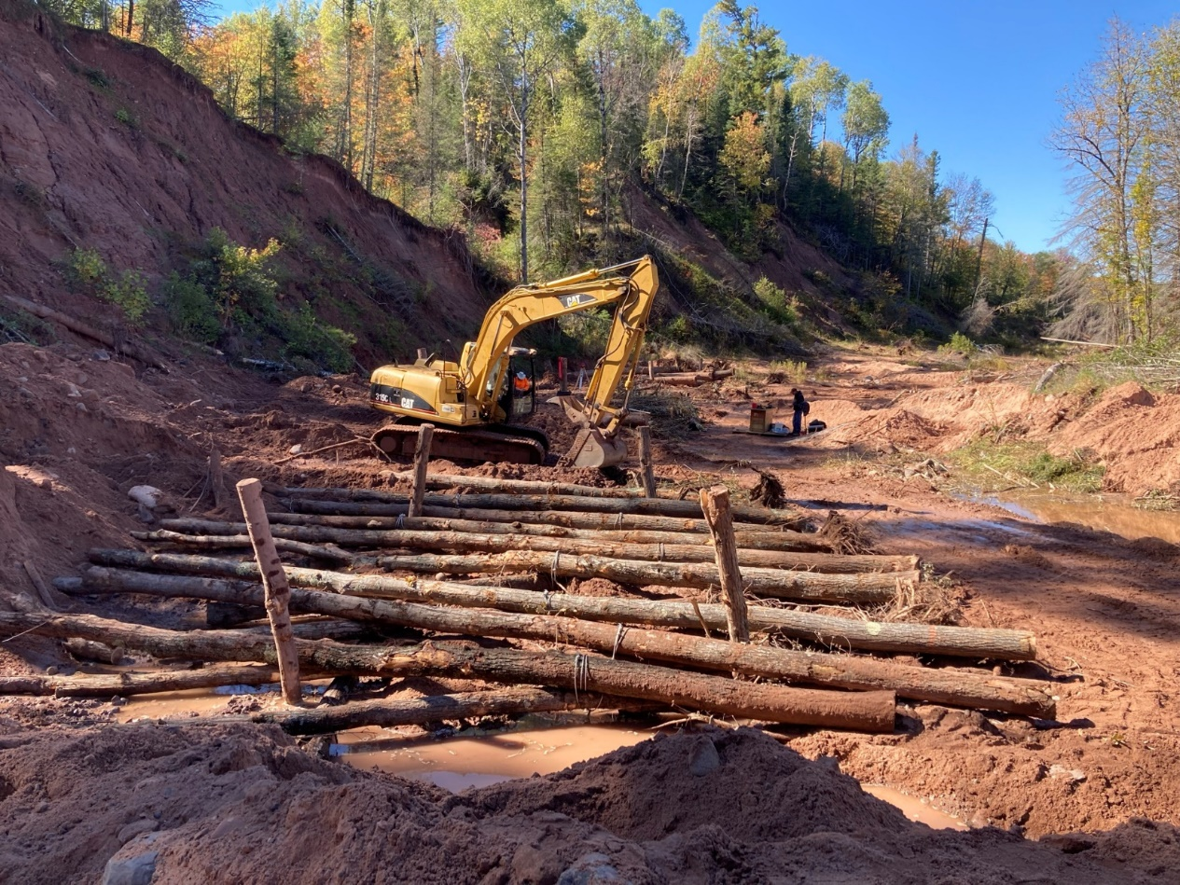
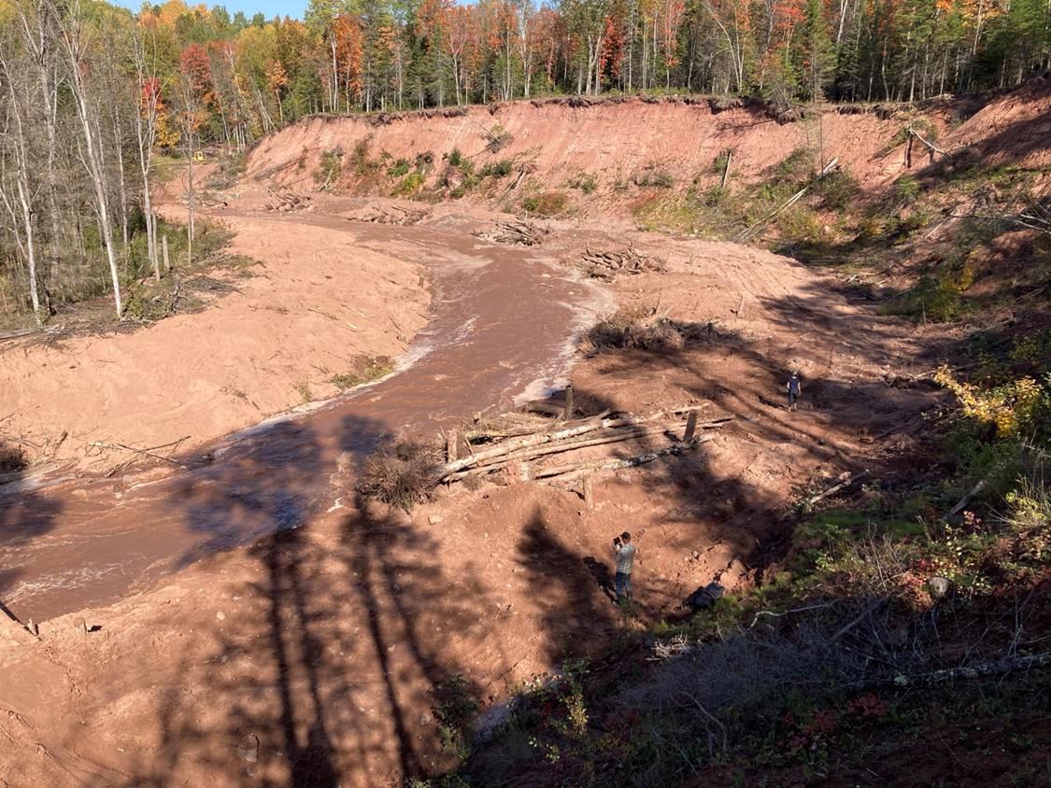

Slide 26
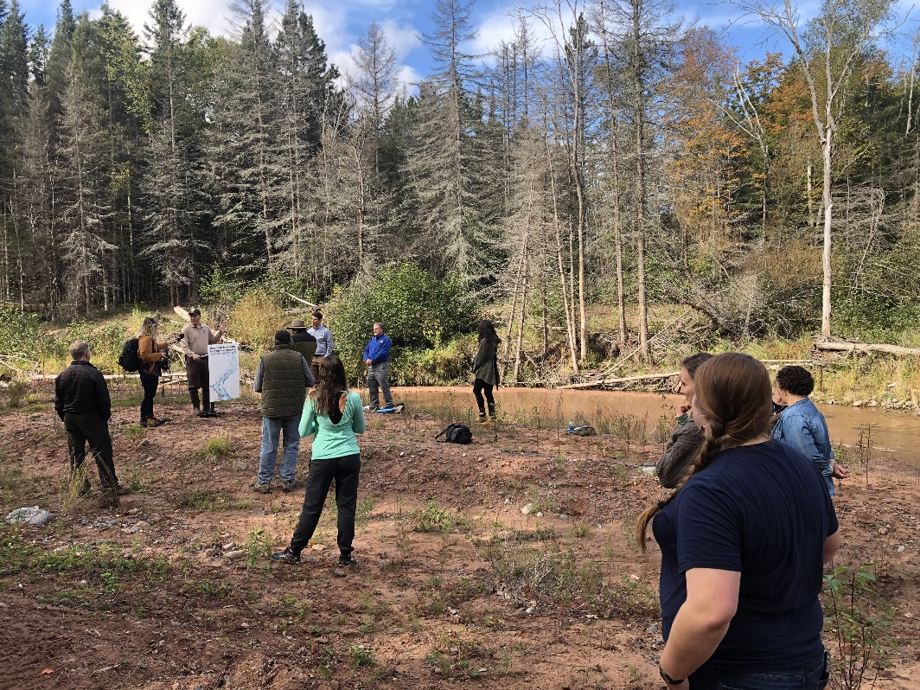
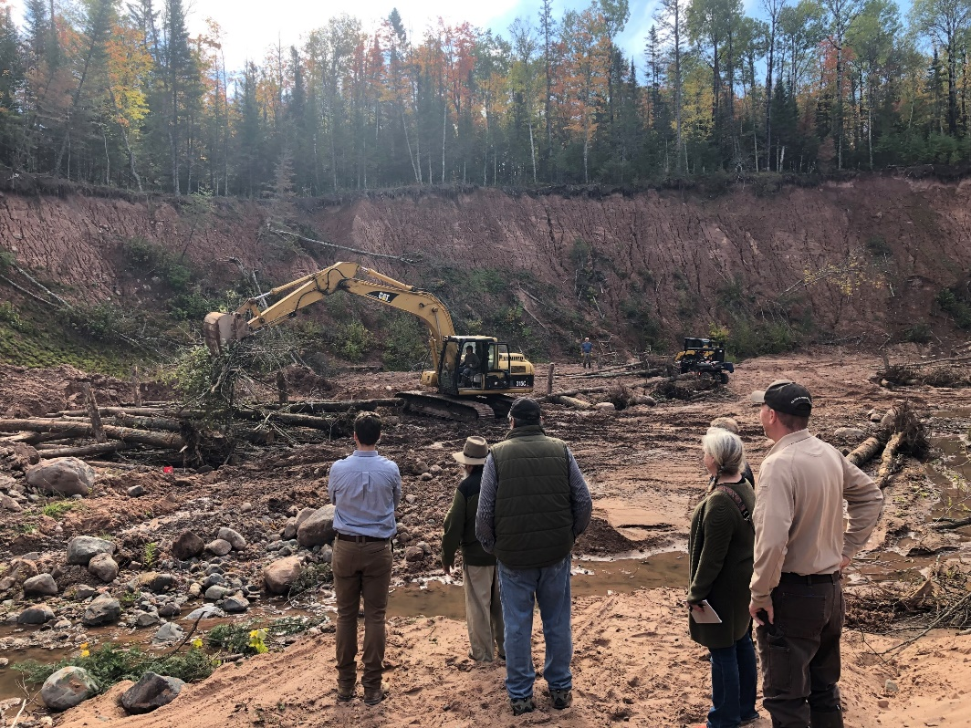
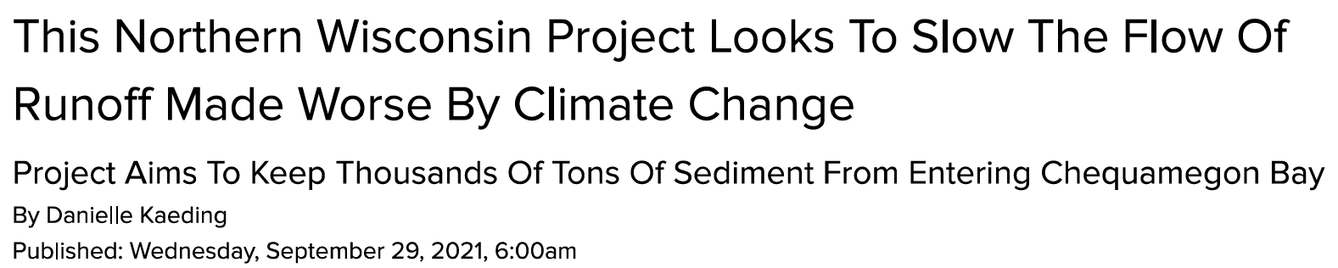
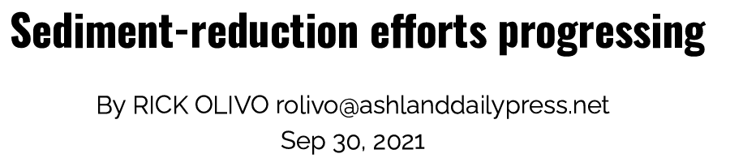
Media Event

Slide 27
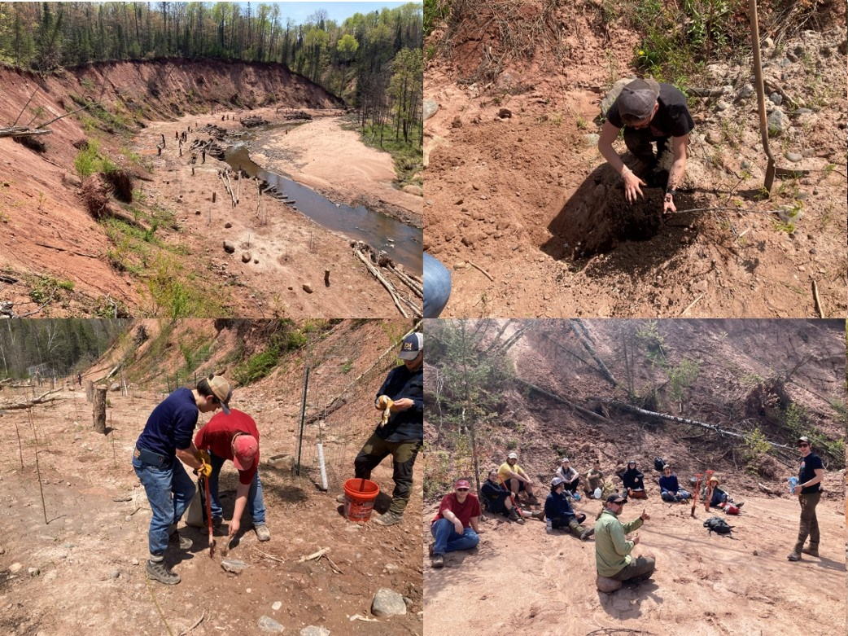
Tree Planting – May 2022

Slide 28
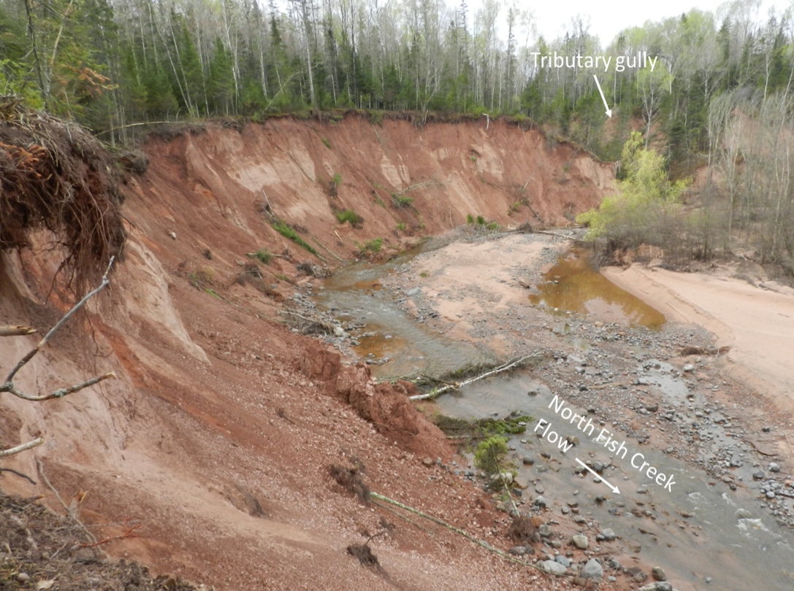
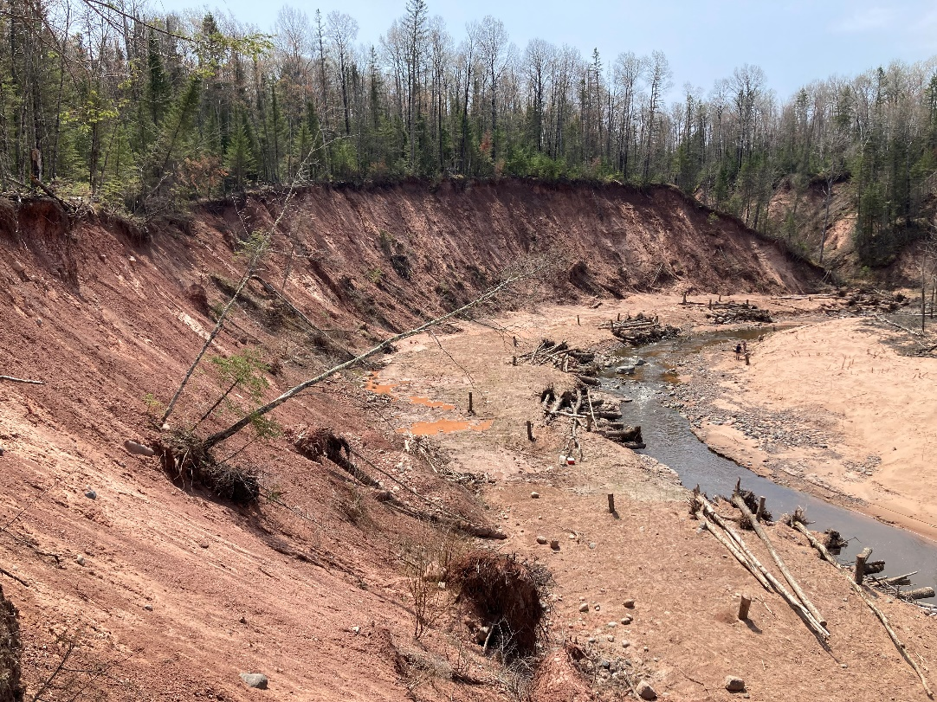

Pre- and Post-Restoration

Slide 29
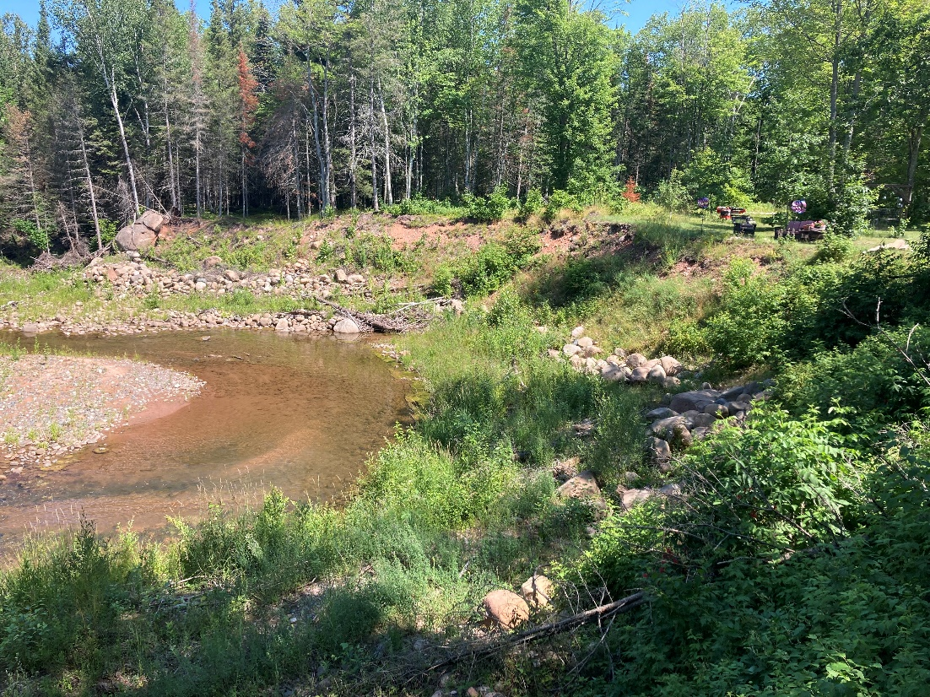
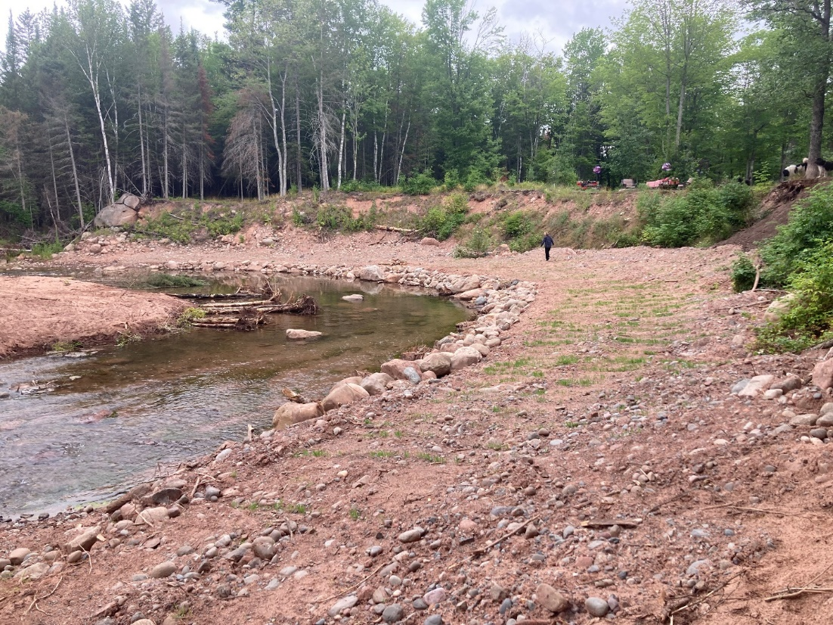
Moore Site – Completed August 2022

Slide 30
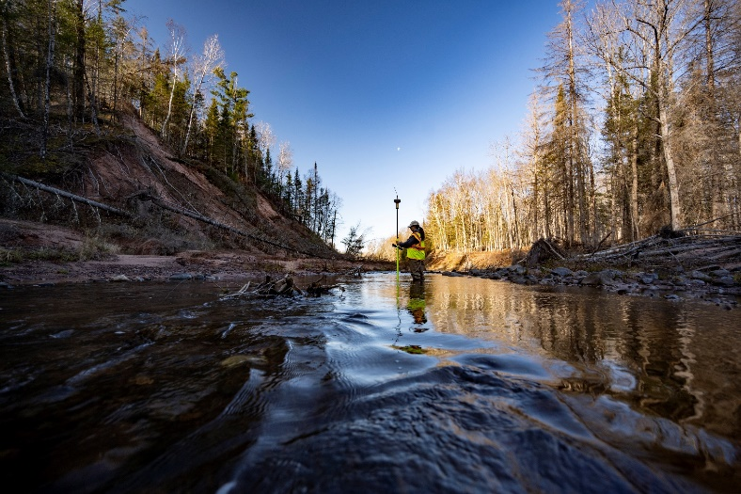
Next Steps
Complete video – estimated completion spring 2023
Winter 2022/23 meeting with partners to discuss next priorities – apply for a phase 3 project in 2023?
Continue to monitor project with photo points and surveys as resources allow

Slide 31
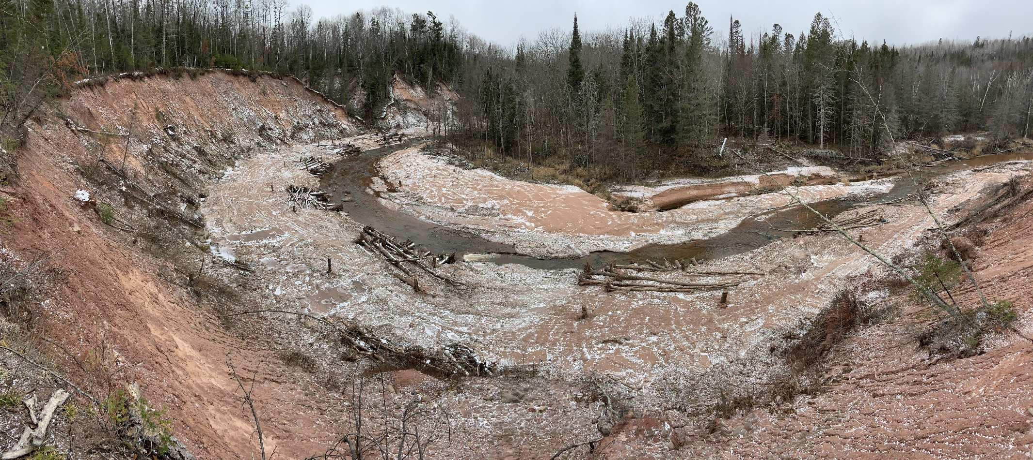
Questions

