Slide 1
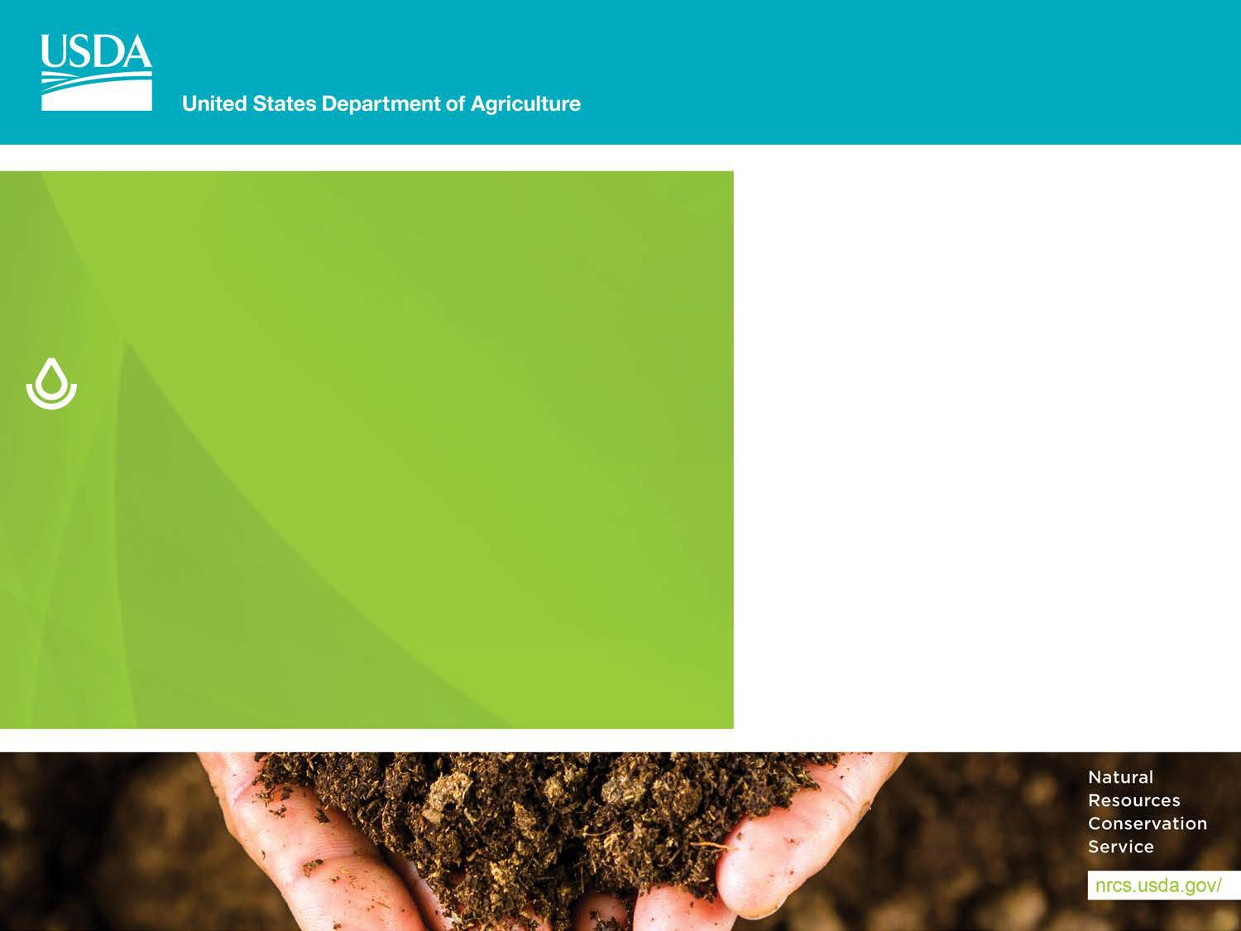


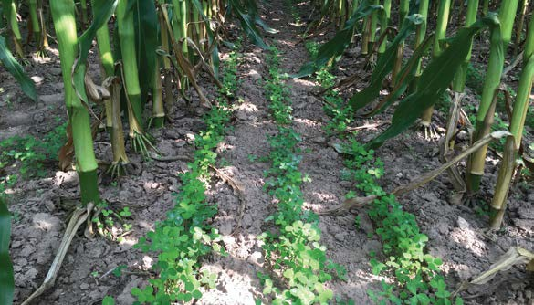

Ag Practices and Water Quality
Matt Otto
GLRI Coordinator
USDA-NRCS
Notes:
Presenter
2017-05-05 20:09:05
--------------------------------------------
GO TO VIEW > MASTER > SLIDE MASTER TO EDIT THE IMAGES ON THE TITLE AND DIVIDER SLIDES

Slide 2
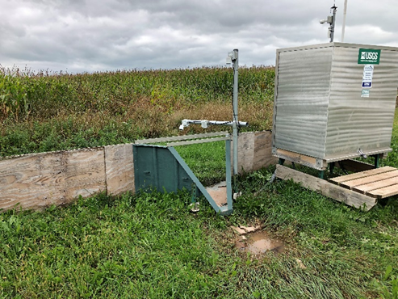
Unique Opportunities
GLRI has boosted funding for agricultural water quality practices AND monitoring
In cooperation with EPA, NRCS and USGS have partnered to monitor the edge-of-field effects from practices on working farms.
Additionally, stream monitoring taking place in watersheds prioritized for GLRI funding.

Slide 3
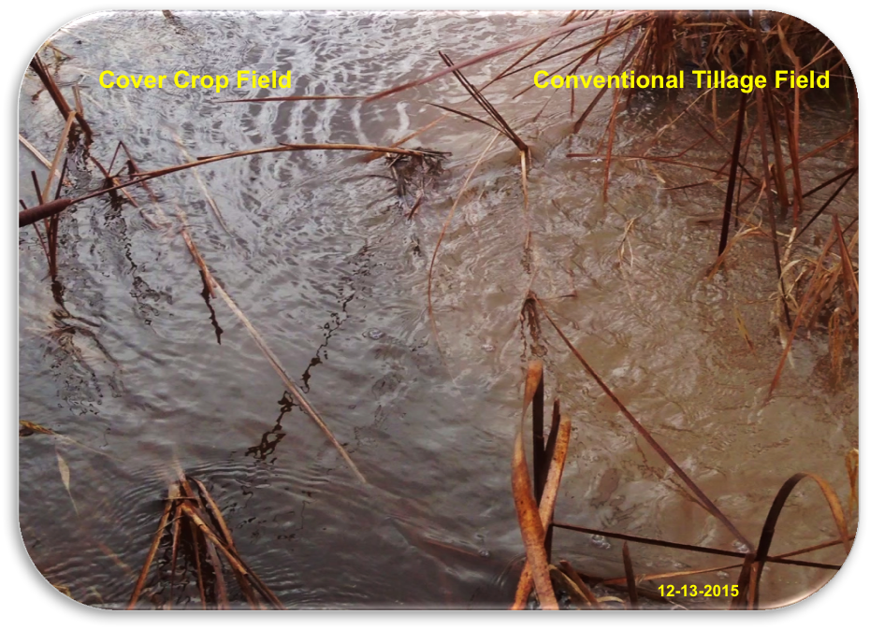
Quantifying the Change
Goal is to identify the improvements that we see and expect.
Hope to learn from the surprises
Dynamic farms and changing weather are challenging
Reducing sediment and nitrogen losses proving easier than phosphorus reductions

Slide 4
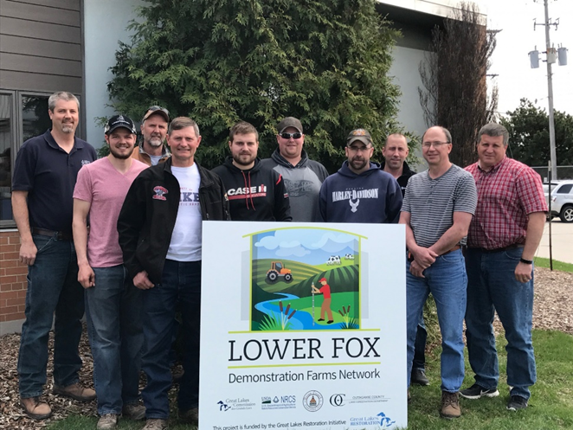
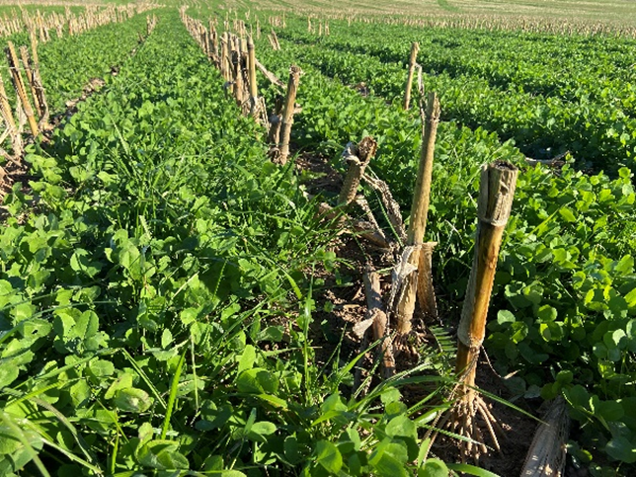
The NRCS Role
Deliver technical and financial assistance to producers and landowners for conservation planning and proven conservation practices, on a voluntary basis.
For GLRI monitoring, work with partners to find producers, sites and practices that will help to educate and lead to better outcomes.
Ongoing facilitation, information sharing, feedback and adjustments
Notes:
Both Farm Bill conservation programs and GLRI, add’l role for monitoring coordination with GLRI. Helping People Help the Land. Can also provide FA for monitoring in limited situations.

Slide 5
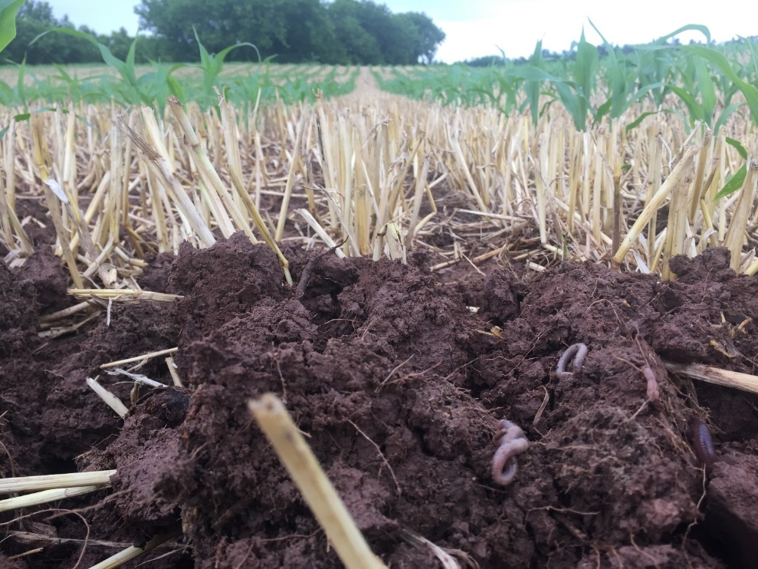
Primary Practices
Soil health practices, especially cover crops, have been the most monitored
Grassed waterways also included
Good establishment is key
Often farmers implementing a combination of practices
Can be difficult to separate cover crops, no-till planting, nutrient management changes, etc.
Notes:
Incredible change over the last 10-12 years in soil health interest and adoption with IN being a lead state early on.

Slide 6
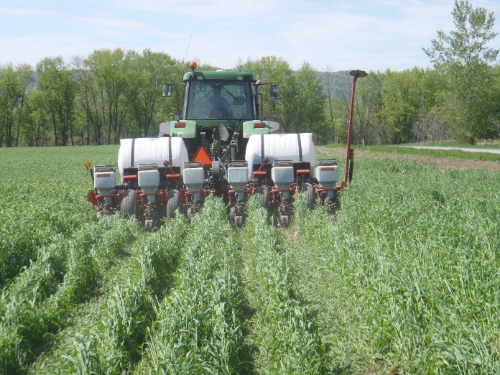
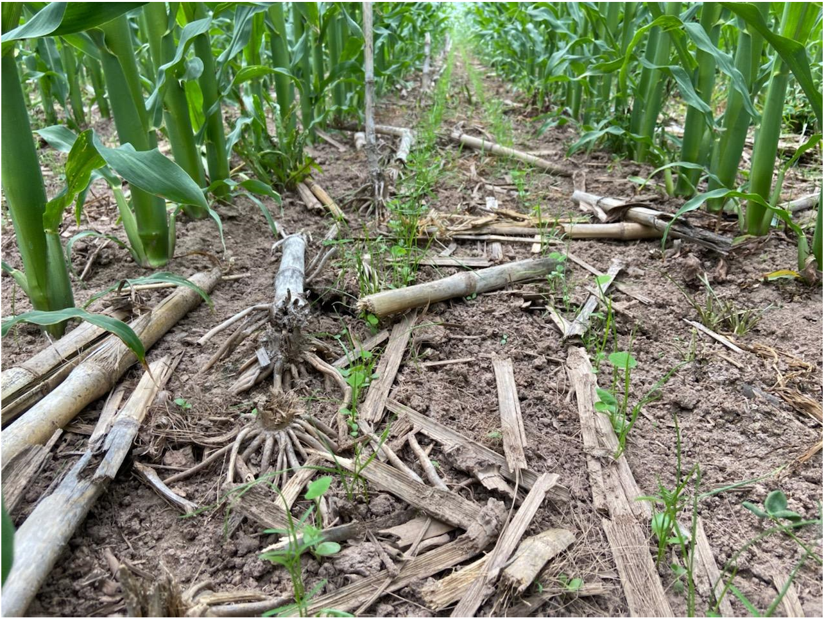
Fine Tuning
Conservationists and farmers constantly learning and adjusting
“Adaptive Management”
Planting green as opposed to “normal” no-till
Changes in cover crop timing, new mixes, interseeding
Experimenting in nutrient mgm’t with different methods, rates, timing and split manure applications
Notes:
Higher level of management and what demonstration farm networks are all about.

Slide 7
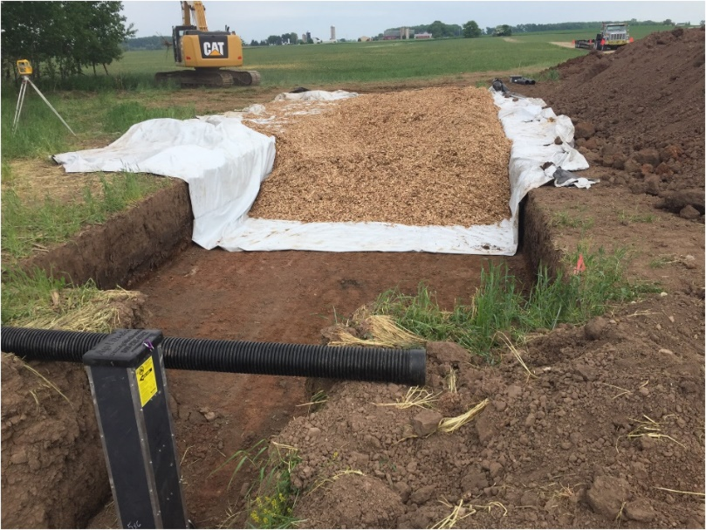
Other Monitored Practices
Denitrifying Bioreactor
Buffers
Changes in crop rotation
Addition of winter wheat showing encouraging early results

Slide 8
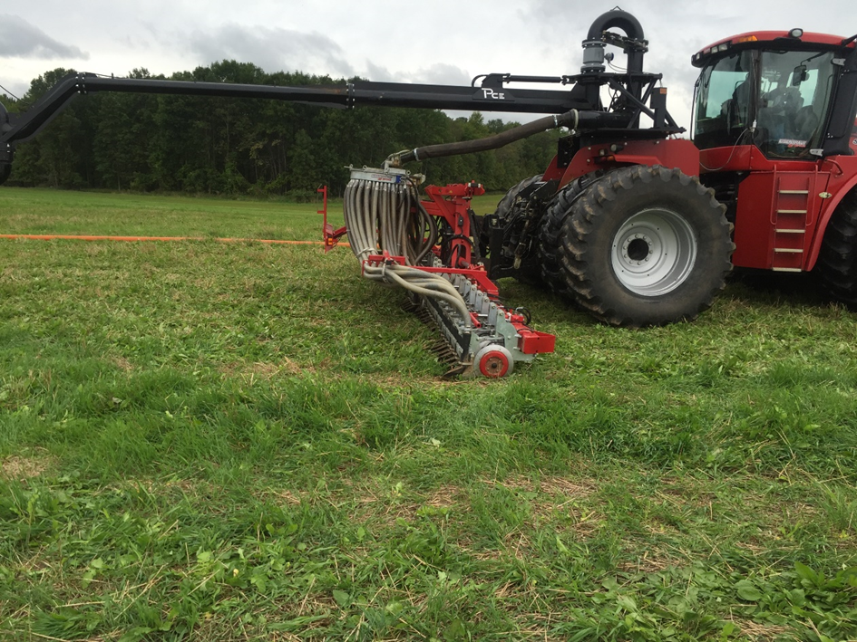
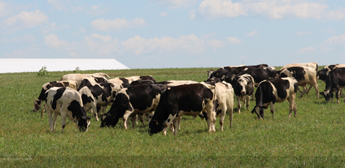
What’s on the horizon?
Increased emphasis on subsurface placement of manure and fertilizer with minimal disturbance
Effects of long-term soil health systems vs transitional soils
P Removal Systems (782)
Wetland and floodplain restoration easements
Conversion of cropland to prescribed grazing systems?
Notes:
LDMA seems to be particularly important for reducing P losses. Need to increase equipment availability, opportunities, and incentives for producers to try it in their soil health systems, hopefully the “best of both worlds.” Promising early results in ongoing ARS effort compared to surface applications.

Slide 9

Thank You!
Matt Otto, NRCS GLRI Coordinator
matt.otto@usda.gov
USDA is an equal opportunity provider and employer..

