Slide 1
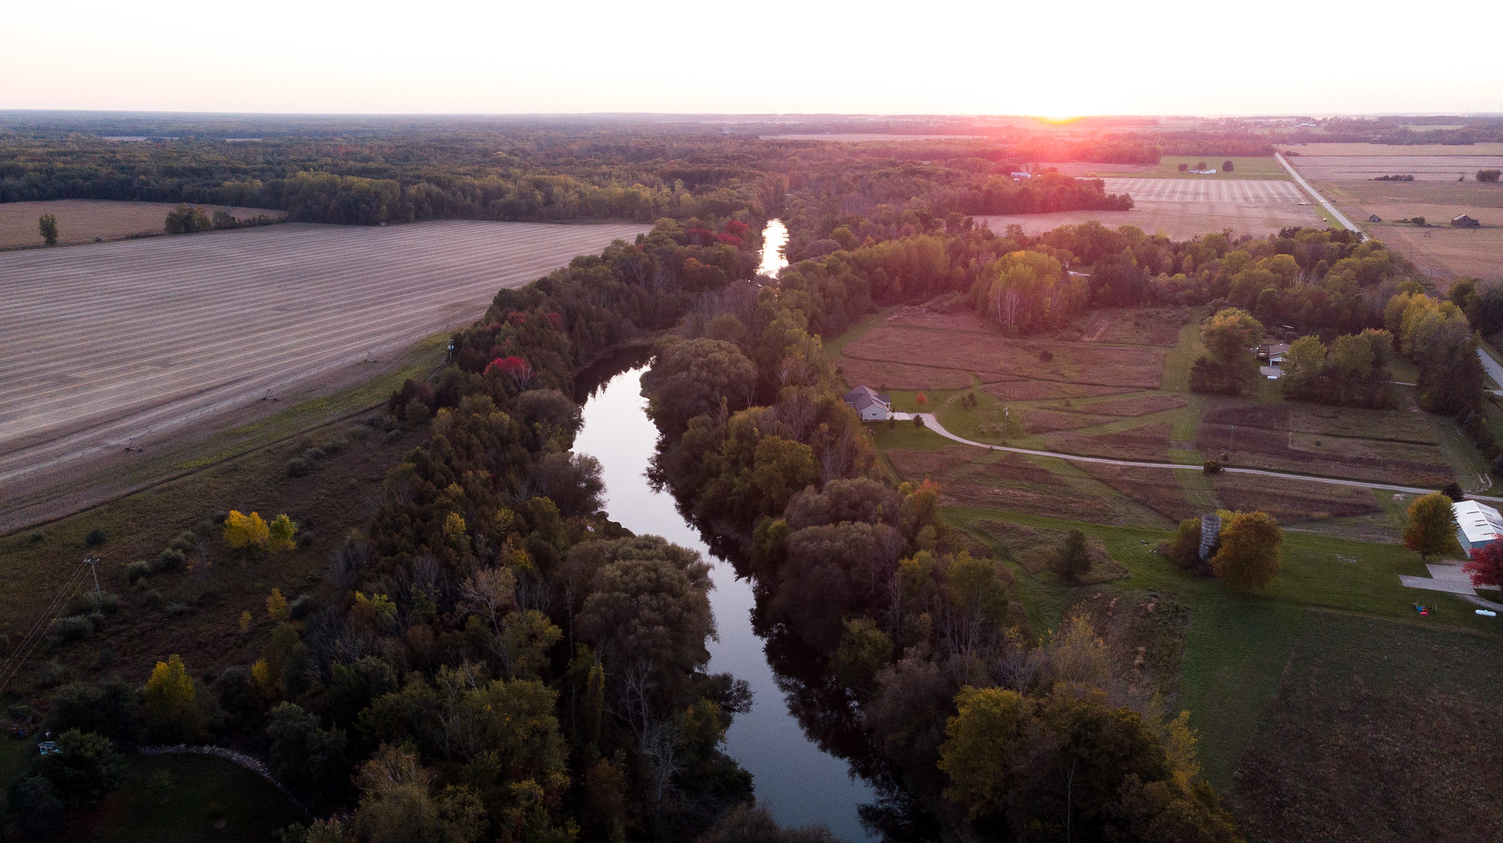
Soil Health in Saginaw Valley
Collaborating with farmers to reduce sediment and nutrient runoff in the Saginaw Bay watershed

Slide 2
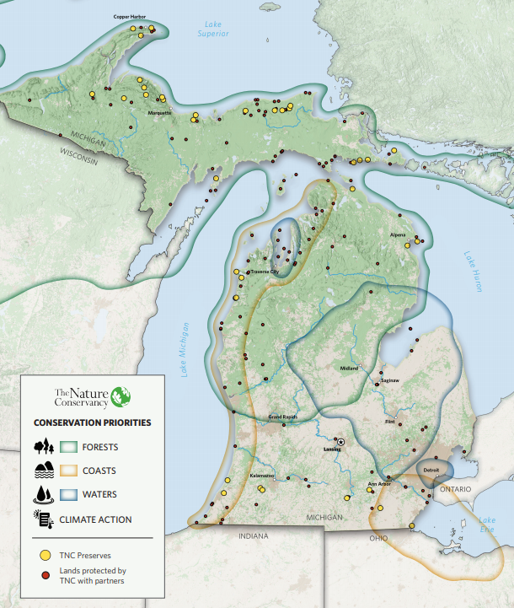
Who We Are In Michigan…
32,000+ Members
50+ Staff
24 Trustees
400,000+ Acres

Slide 3
Soil Health in Saginaw Valley
Collaborating with farmers to reduce sediment and nutrient runoff in the Saginaw Bay watershed

Slide 4
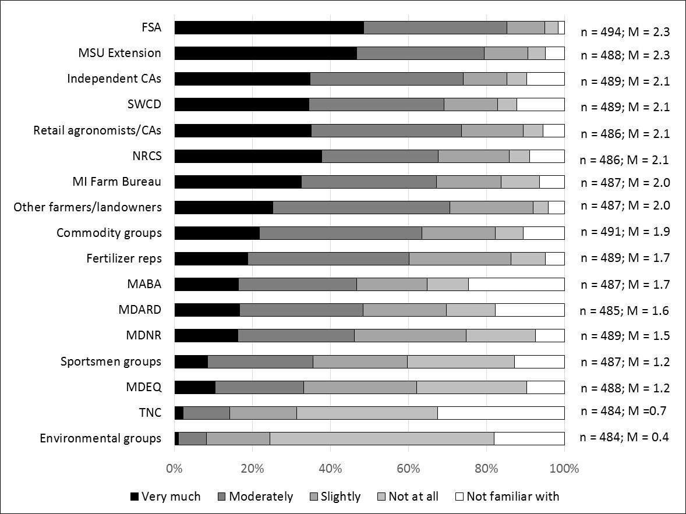
Trusted Source of Conservation Information?
Source: Purdue University Nat. Resources Social Science Lab, 2016

Slide 5
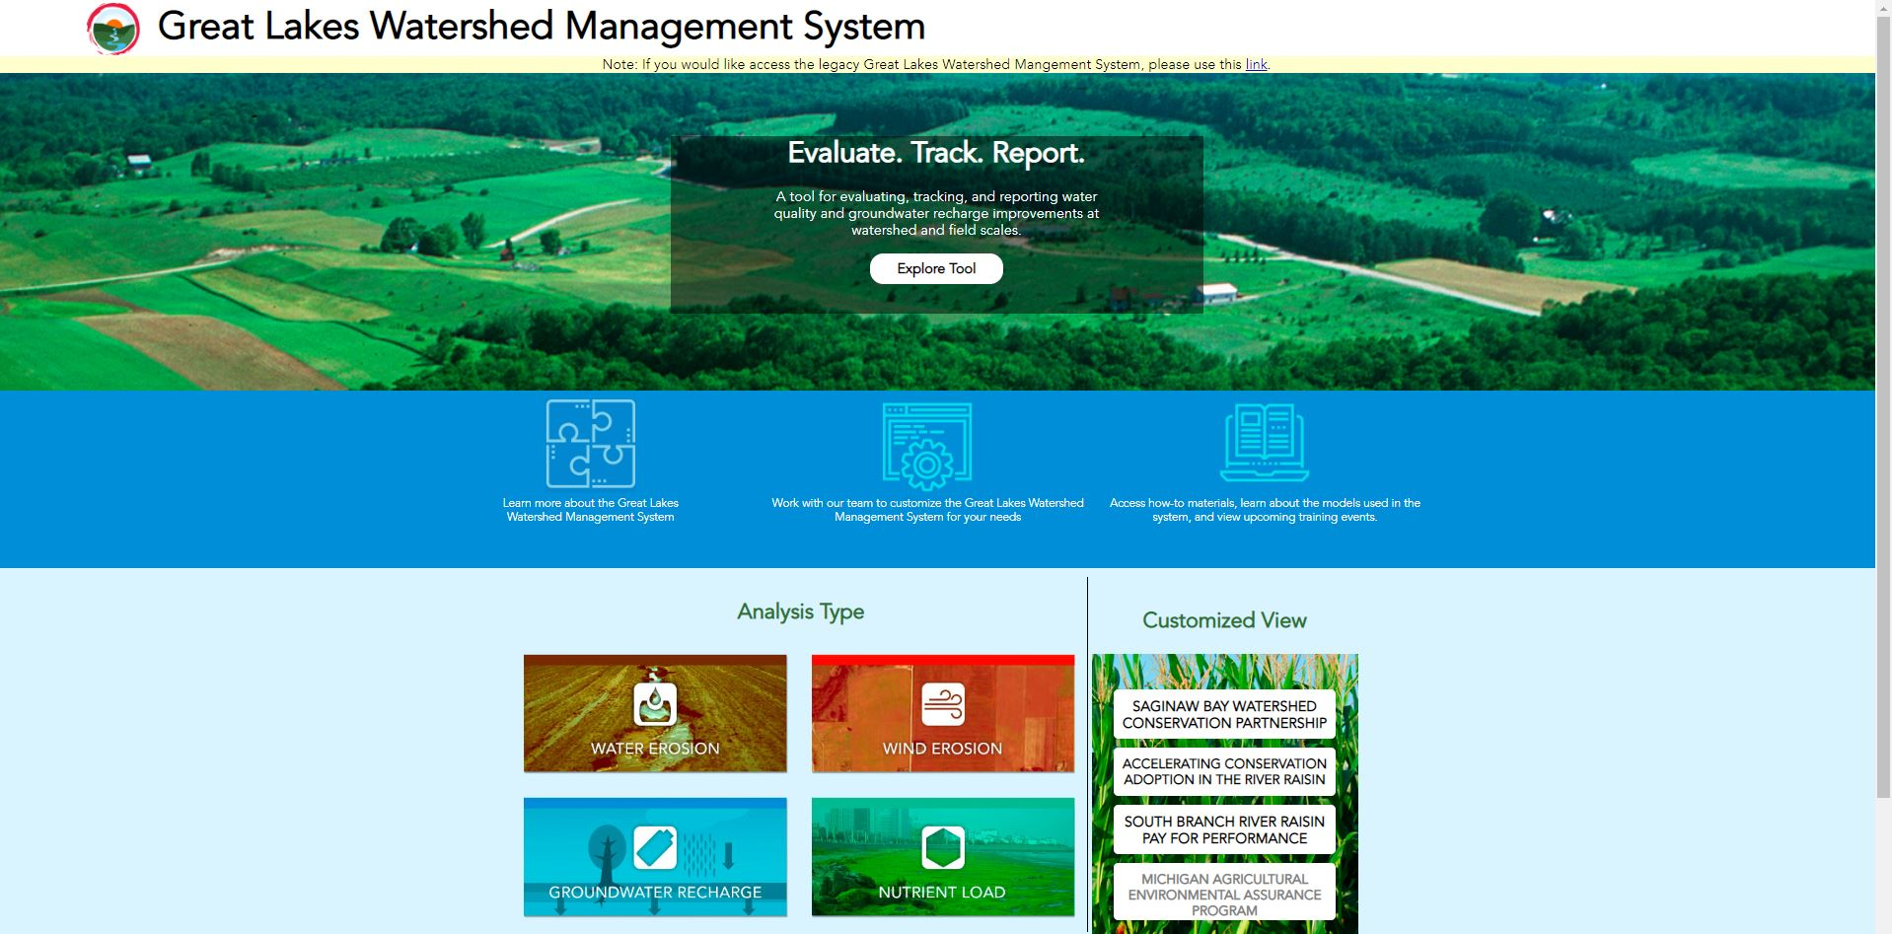

Slide 6
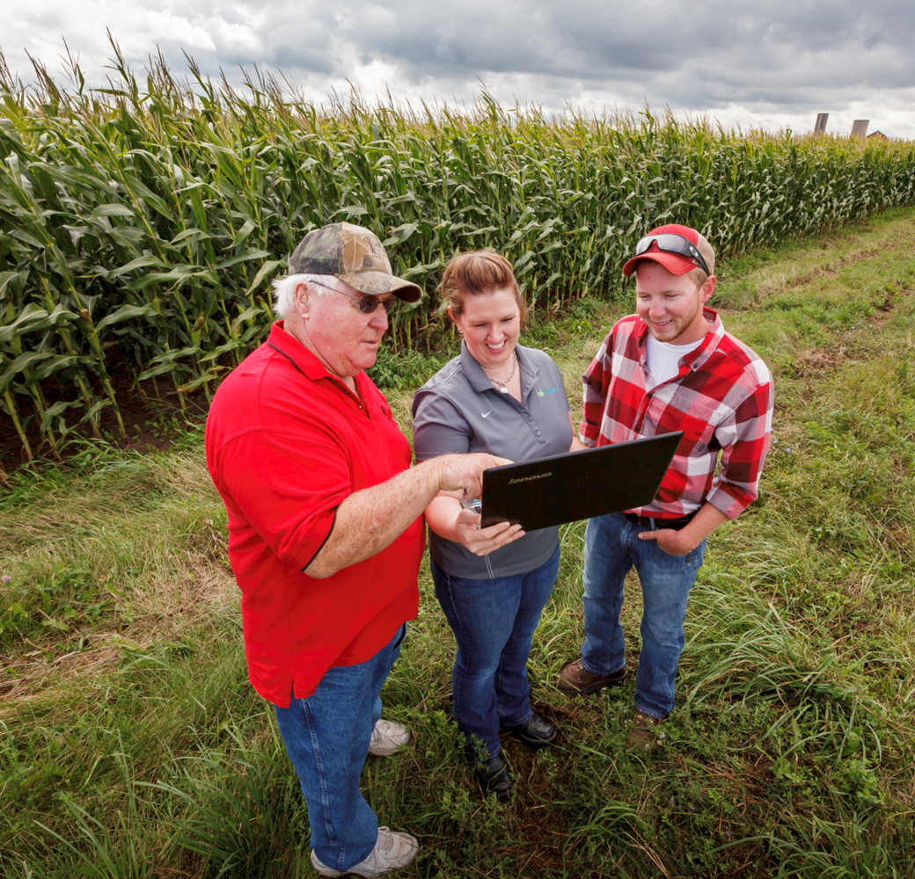

Slide 7
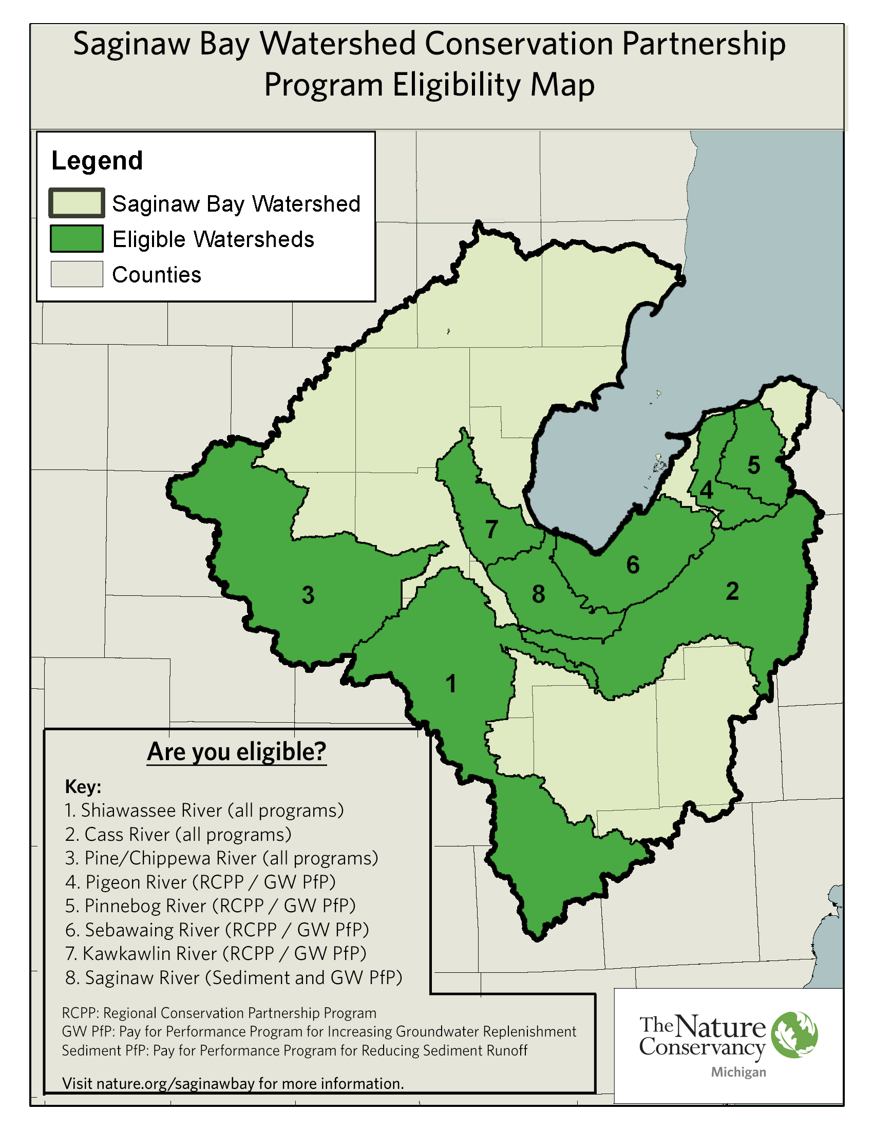
Soil Health and Water Quality
Impact on the ground
Science driving priorities
HIT
WEPS
L-THIA
STEP-L
HYDRUS

Slide 8
86,128
acres
152
farms
26,667
lbs. of phosphorus
6,827
tons of
sediment
Results so far:
Notes:
What we achieved:
Explain how this is cumulative
Note that this is via multiple projects

Slide 9
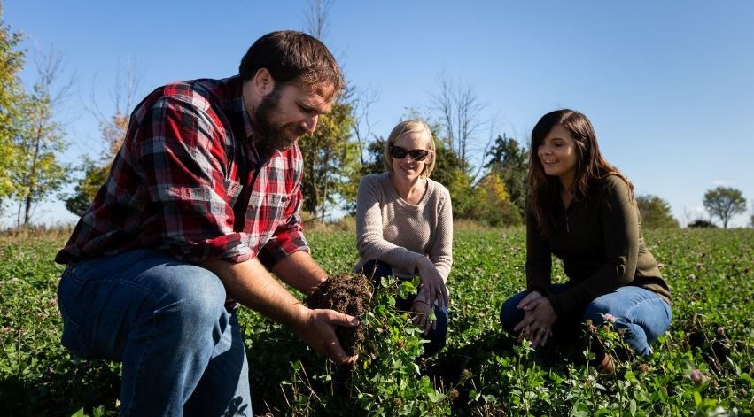
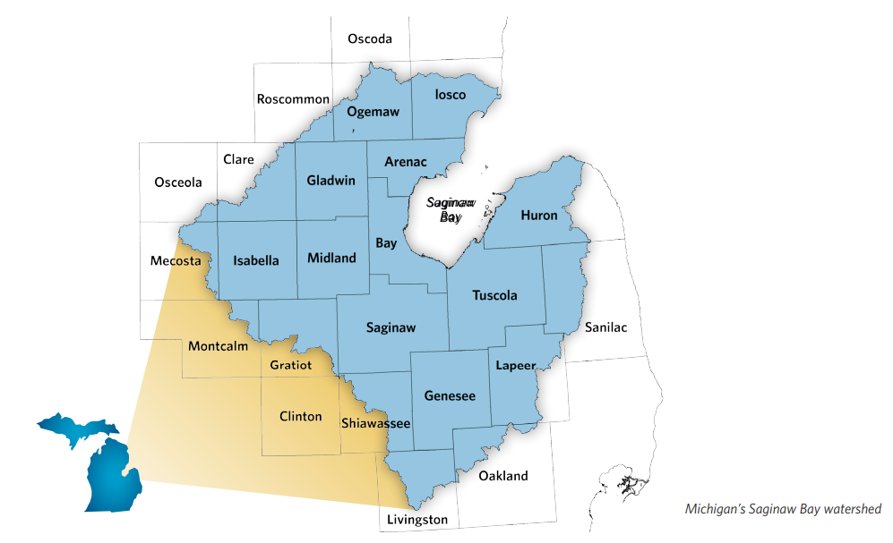
Our Ambitious Goals
50% of row crop acres in conservation practices by 2030 = 1.8M acres!
Reduce emissions & increase carbon sequestration by 50M metric tons annually

Slide 10
Incentivized Practices
In Field
Nutrition
Edge of Field
Nutrient Management
Cover Crops
Reduced Tillage
Crop Diversity
Feed Alternatives
Feed Interventions
Grazing Management
Harvestable Buffers
Filter Strips
Water retention

Slide 11
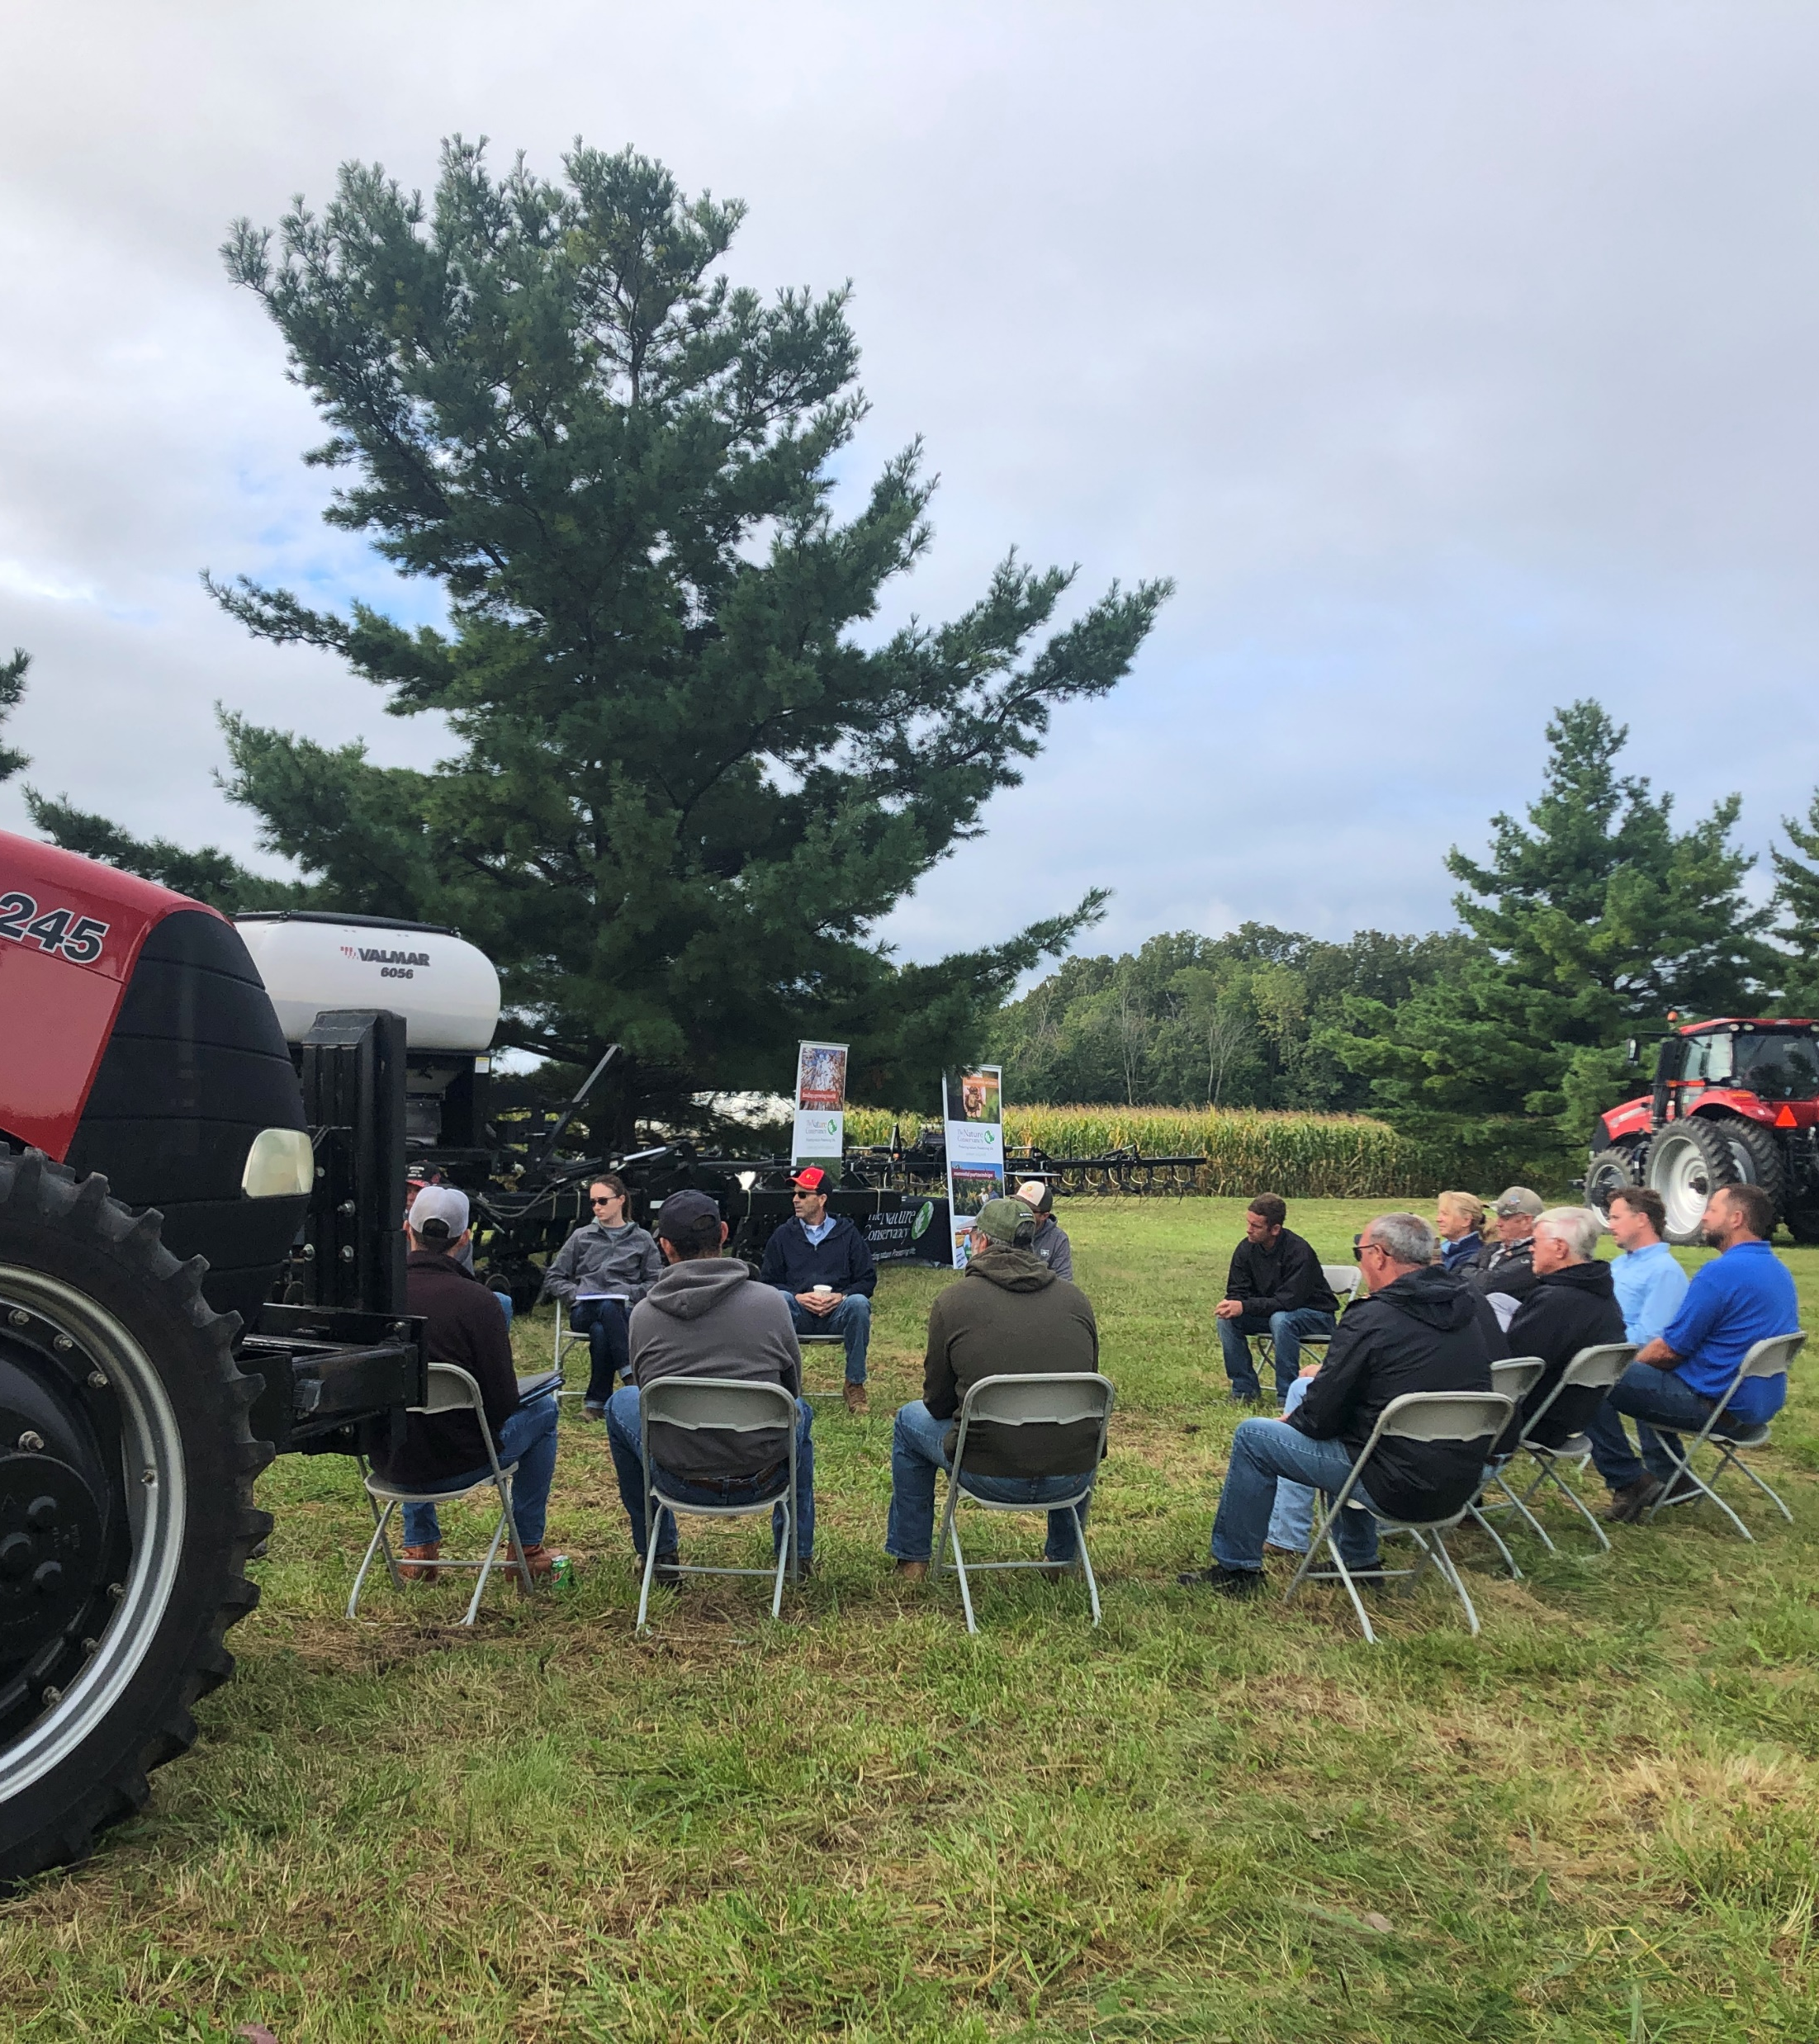
How do we get there?
Supply Chain Engagement
Science and Evaluation
Farmers Leading Change
Edge of Field Practices
Inform and Engage

Slide 12
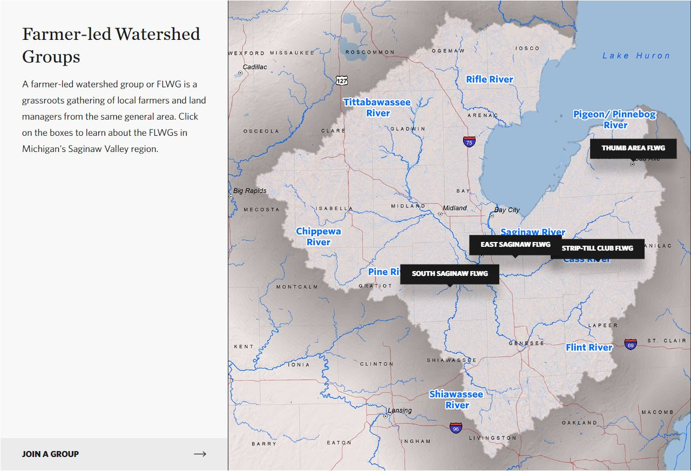
www.soilsavings.com/FarmerResources

Slide 13
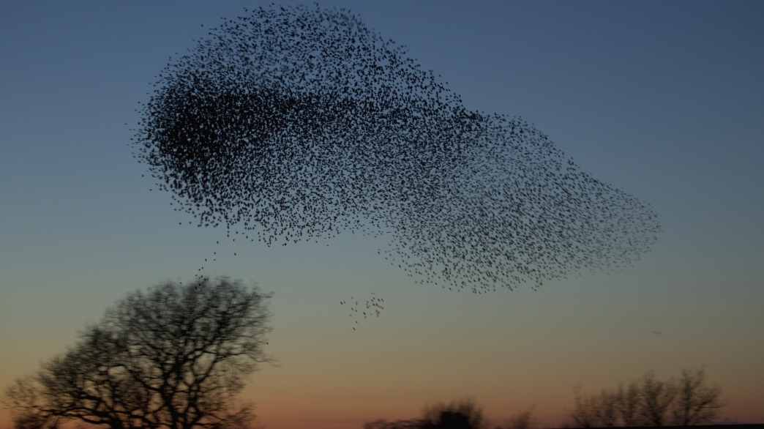
Thank You!
www.SoilSavings.com
@TNCMichigan
Speak up for nature at nature.org/actnow!

