Slide 1
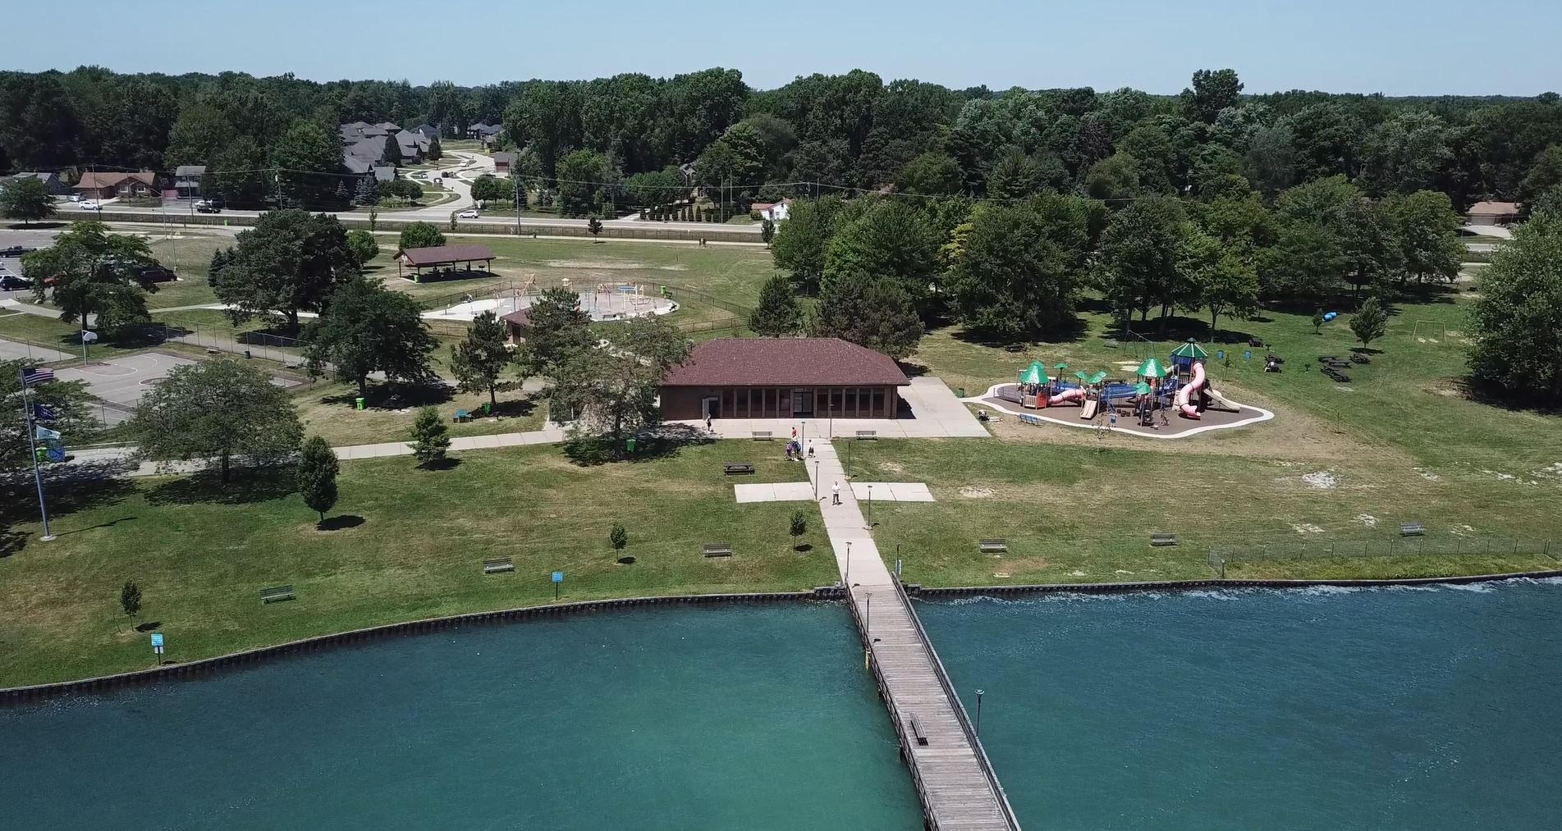
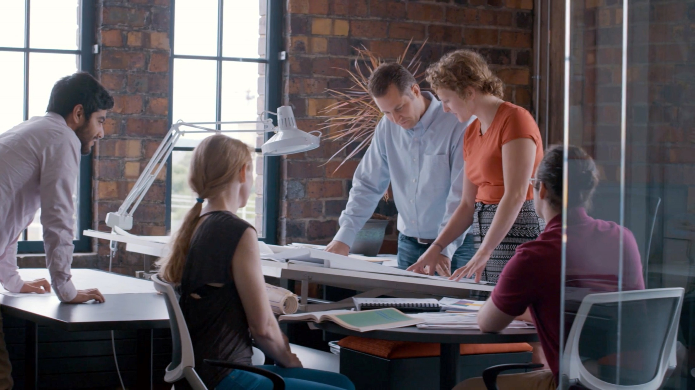
BRANDENBURG PARK
October 8, 2019

Slide 2
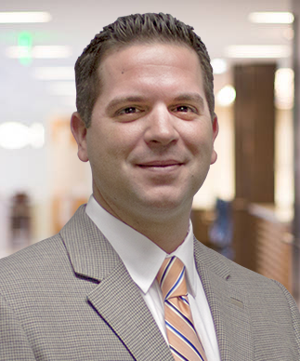
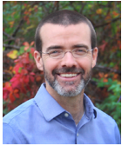
Valerie Novaes, PE
Project Manager
Steve Siklich, PE
Client Representative
Eric Ellis
Program Manager
Responsible for overseeing the project design and construction
Responsible for meeting client expectations, budgets, staffing, and schedule
Coastal Conservation and Habitat Restoration Program Project Manager with the Great Lakes Commission
OHM Advisors®

Slide 3
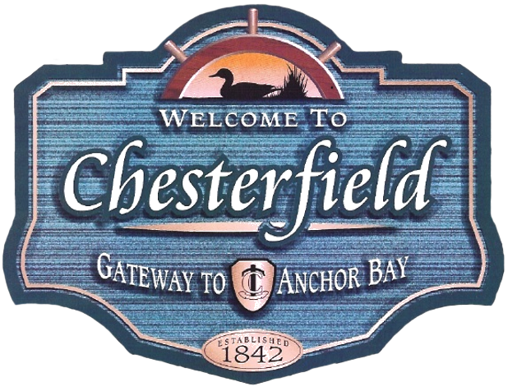
PROJECT PARTNERS
GLRI FUNDING
DESIGN
PROGRAM MANAGER
COLLABORATIVE AGENCIES

Slide 4
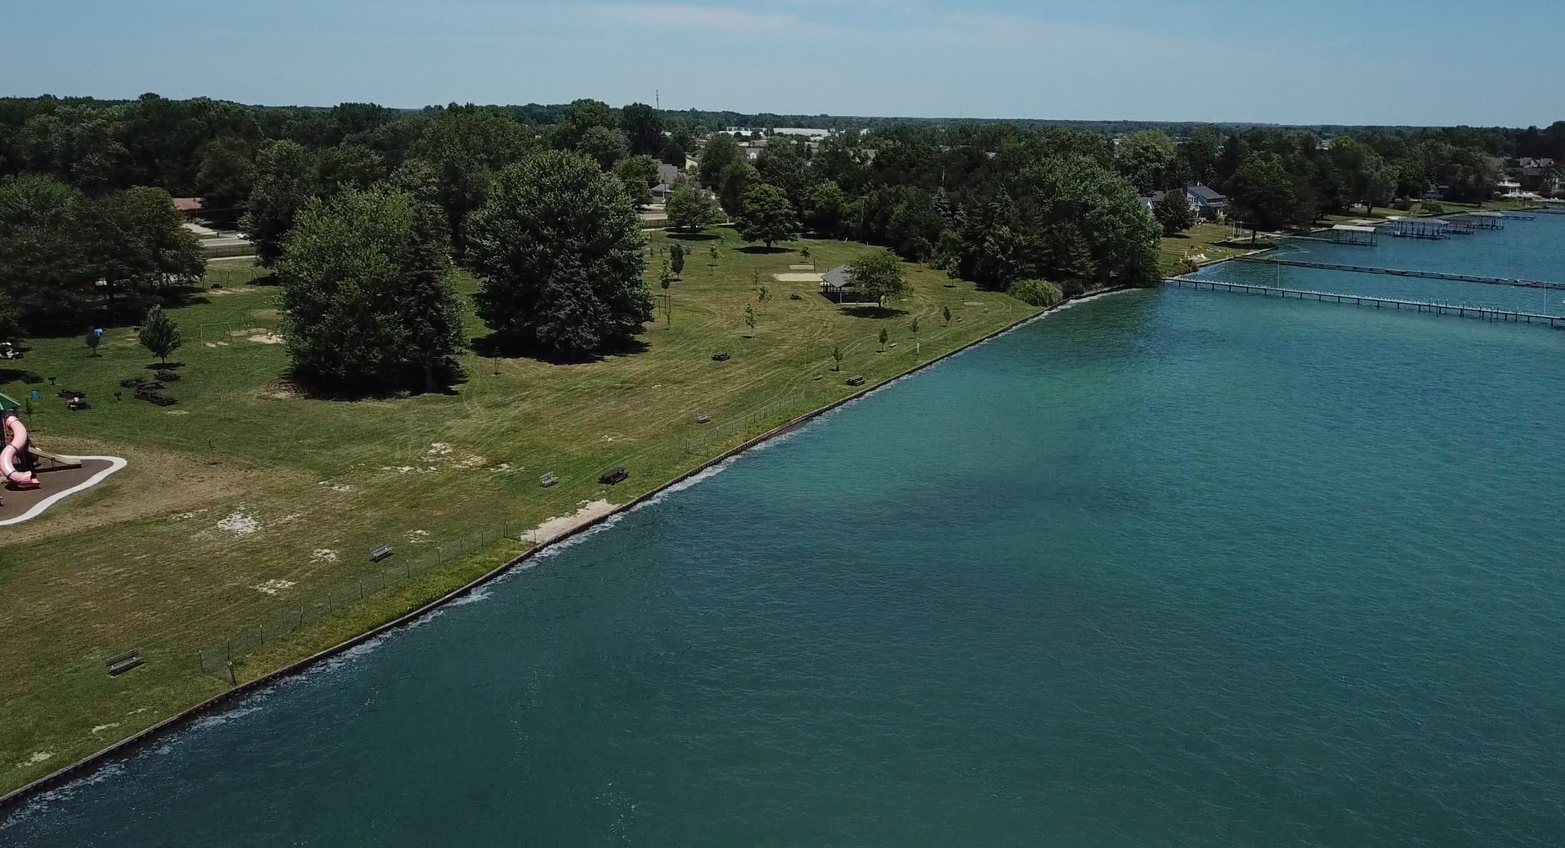
PROJECT BACKGROUND
Brandenburg Park is a 17-acre parcel positioned along the shore of Anchor Bay
The park’s 500-foot pier is one of the only few in Metro Detroit from which individuals can fish and view wildlife
Approximately $890,000 is available for the project through the GLRI, a regional program that is supporting implementation of a comprehensive restoration plan for the Great Lakes
Funding for the project is provided by NOAA through a regional partnership with the Great Lakes Commission and is being managed locally by Chesterfield Township

Slide 5
CURRENT CONDITION OF THE SHORELINE

Slide 6
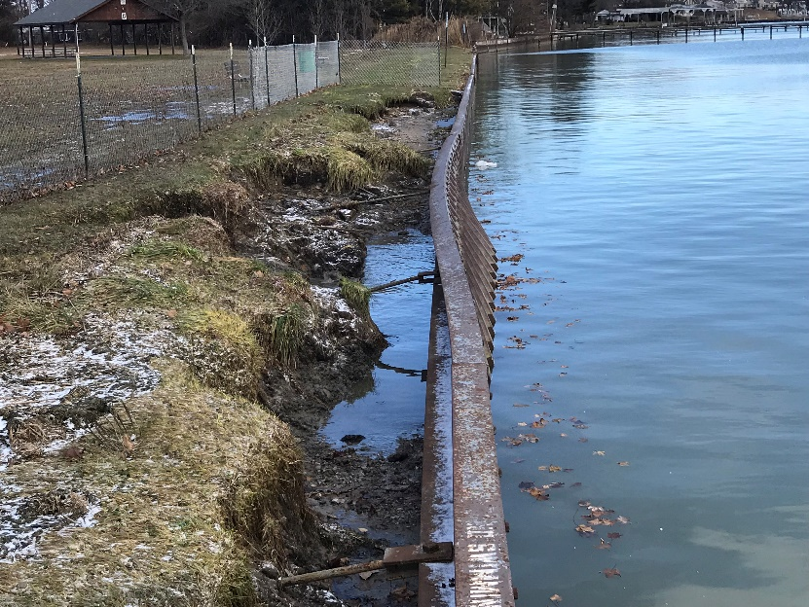
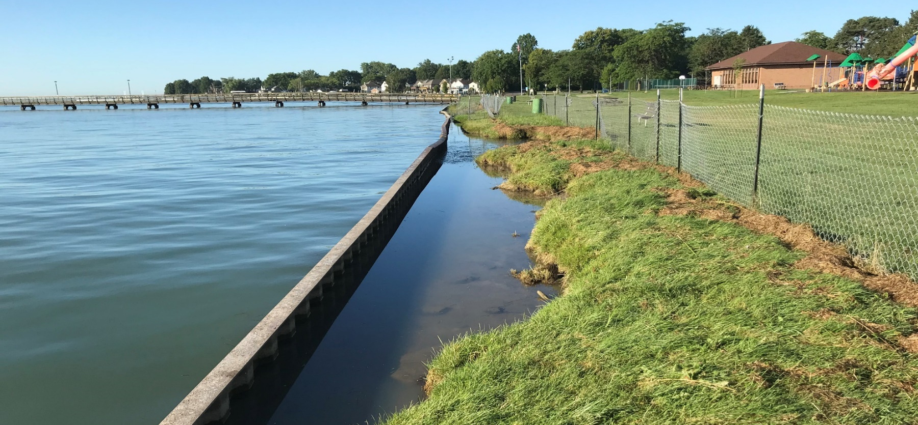
CURRENT CONDITION OF THE SHORELINE

Slide 7
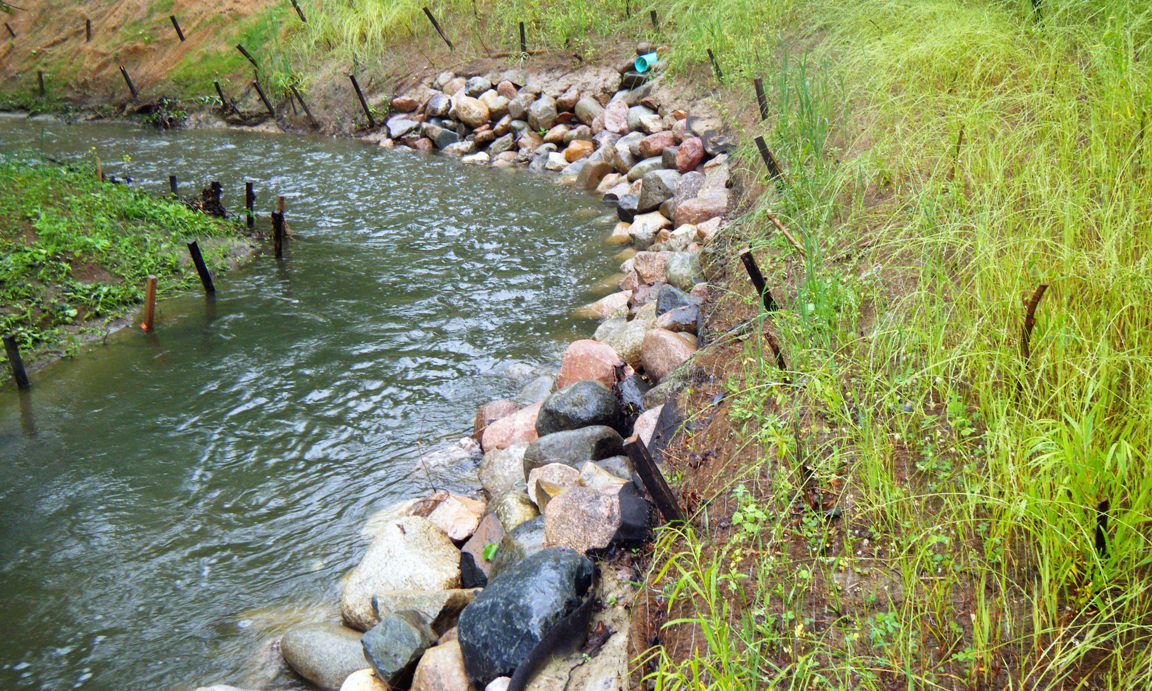
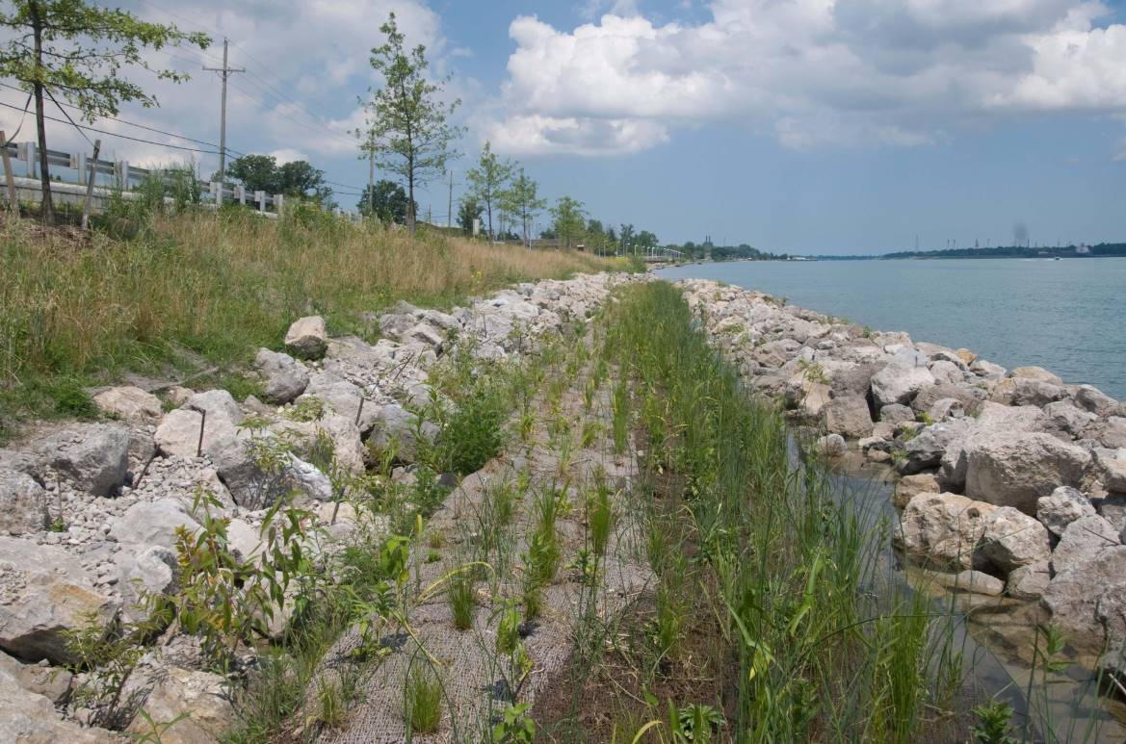
Project Highlights
The primary goal of the project is to improve habitat for fish and wildlife by naturalizing the shoreline and installing protective breakwater structures in the bay
Activities include:
Restore 740 linear feet of hardened shoreline to replace the existing failing seawall and 1.5 acres of near shore habitat
Install rocky breakwater structures along the shoreline to protect wildlife
Provide pre- and post-restoration monitoring activities

Slide 8
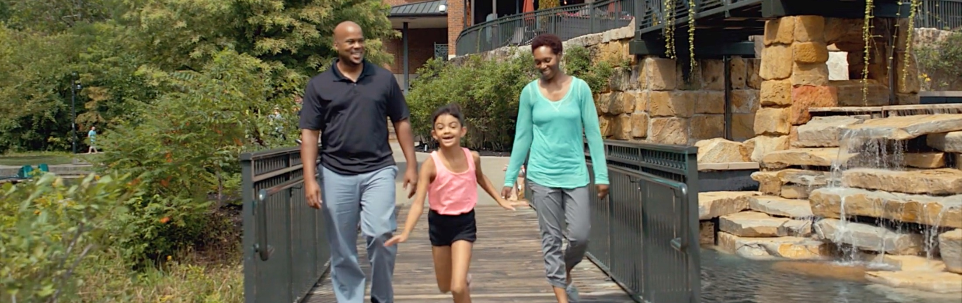
Project Benefits
ENVIRONMENTAL
ECONOMIC
COMMUNITY
Create Fish and Wildlife Habitat
Improve Hydrologic Connectivity
Improve Sport Fishing
Tourism
Recreation
Safer Shoreline
Improve Fishing Access
Kayak Launch Site

Slide 9
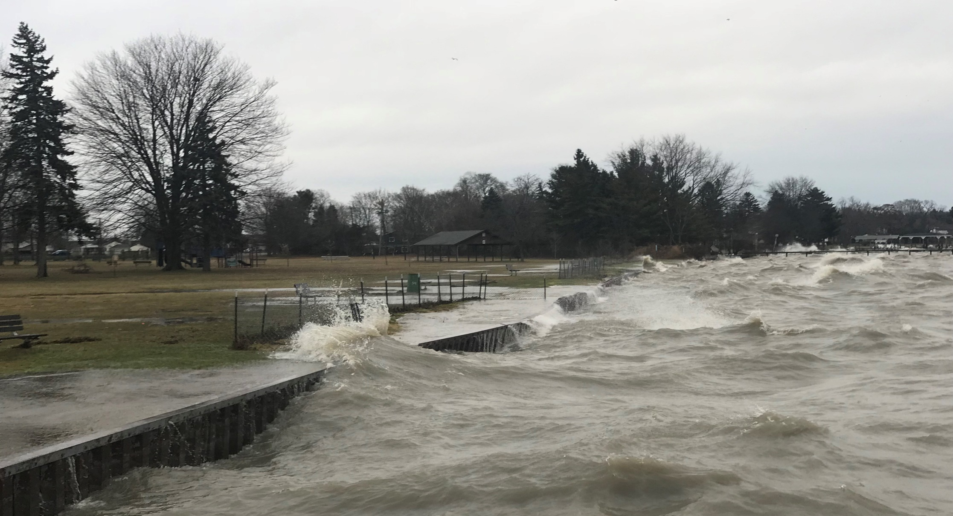
PROJECT DESIGN
Design plans are approaching 90% completion
Funded 70/30 by Great Lakes Restoration Initiative
A Joint Permit Application was submitted in June 2019 to EGLE and is under review by the US Army Corps of Engineers

Slide 10
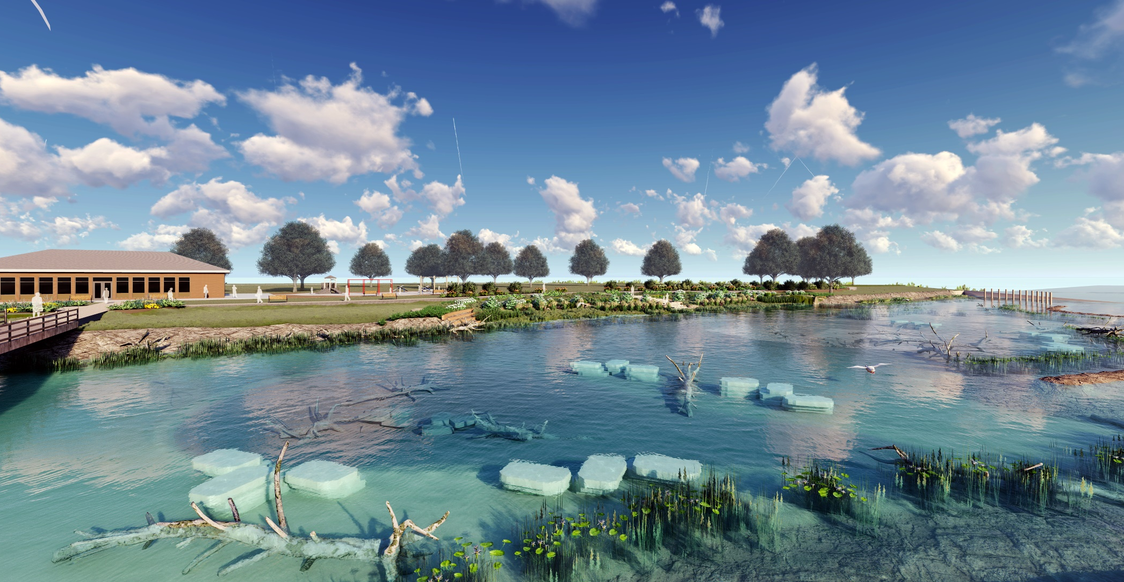
Up Next
IMPLEMENTATION
Requires permit approvals from Army Corps and EGLE
In-water work is restricted from May 1, 2020 to September 30, 2020
GLRI funds available for implementation are ~$715,000
Opinion of construction cost is $750,000
The project is scalable if market prices are higher when bid

Slide 11
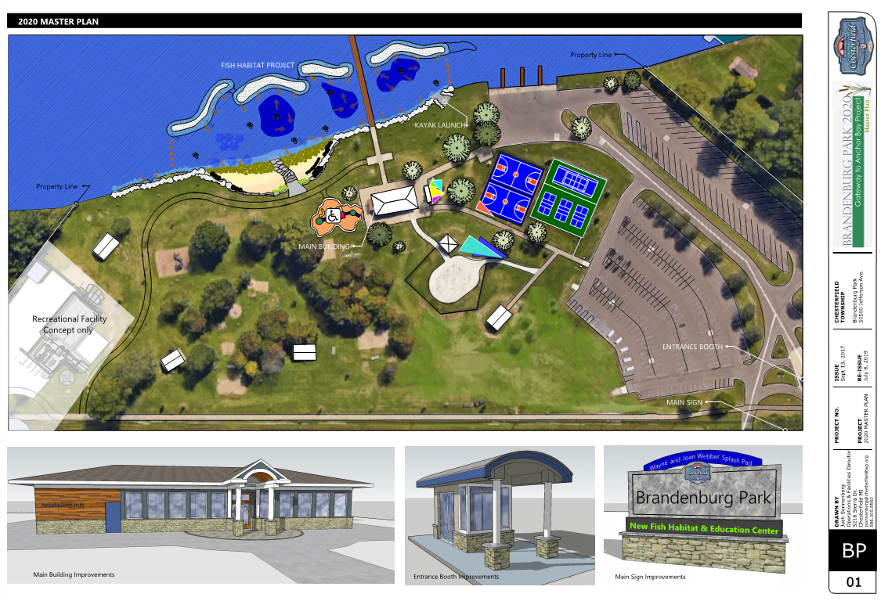
PROPOSED PARK MASTER PLAN

Slide 12
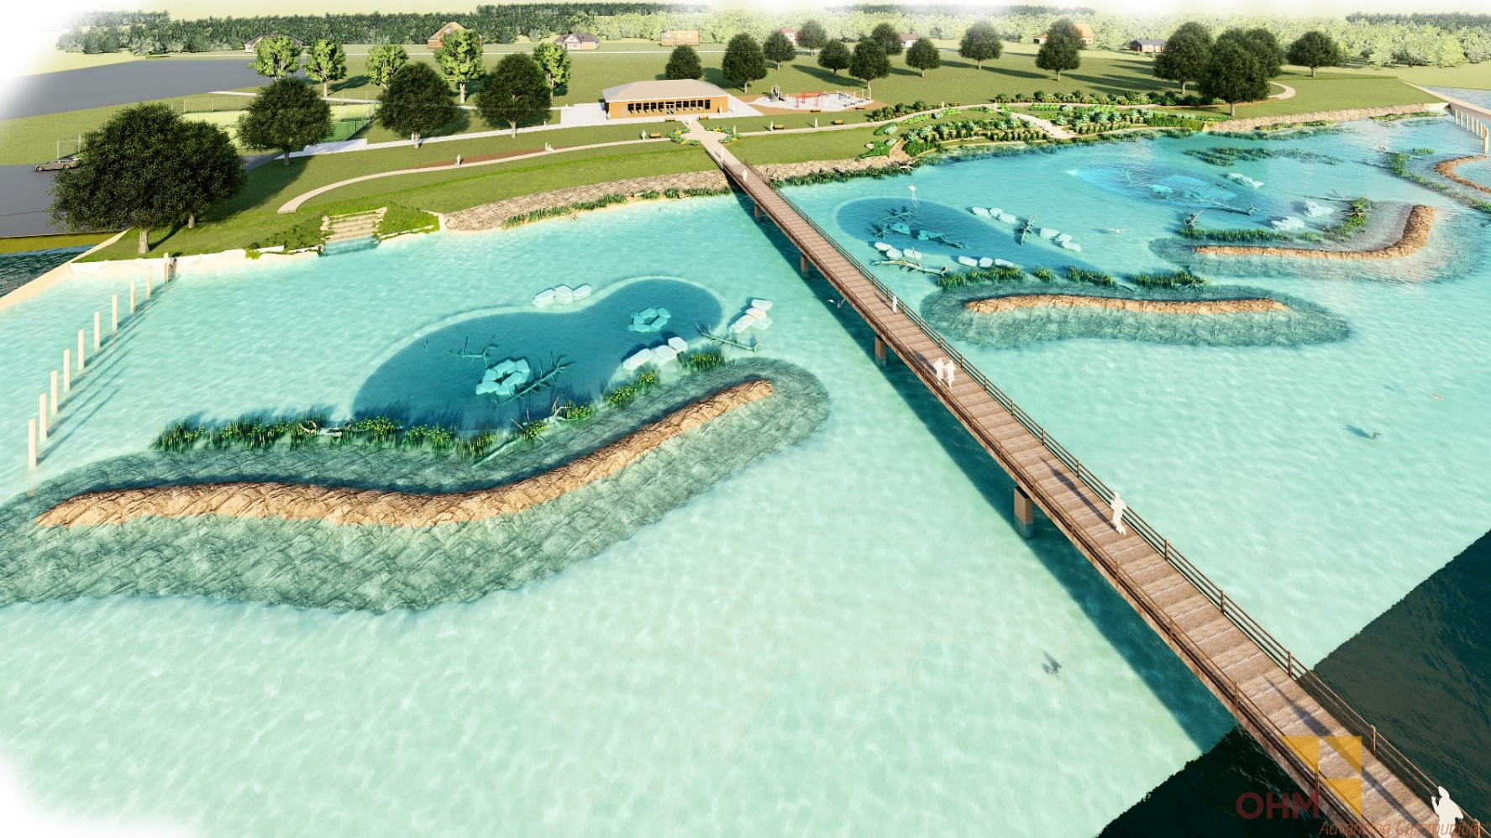
PROPOSED SHORELINE RESTORATION PLANS

Slide 13
PROPOSED SHORELINE RESTORATION PLANS

Slide 14
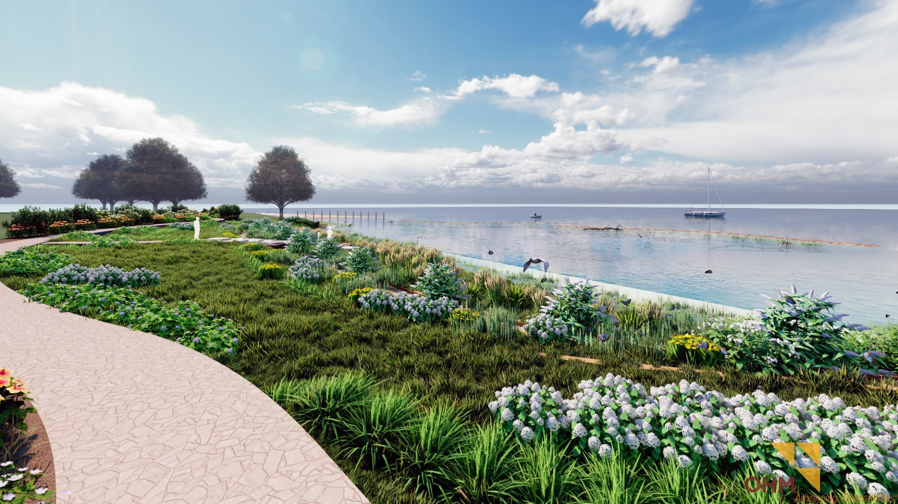
PROPOSED SHORELINE RESTORATION PLANS

Slide 15
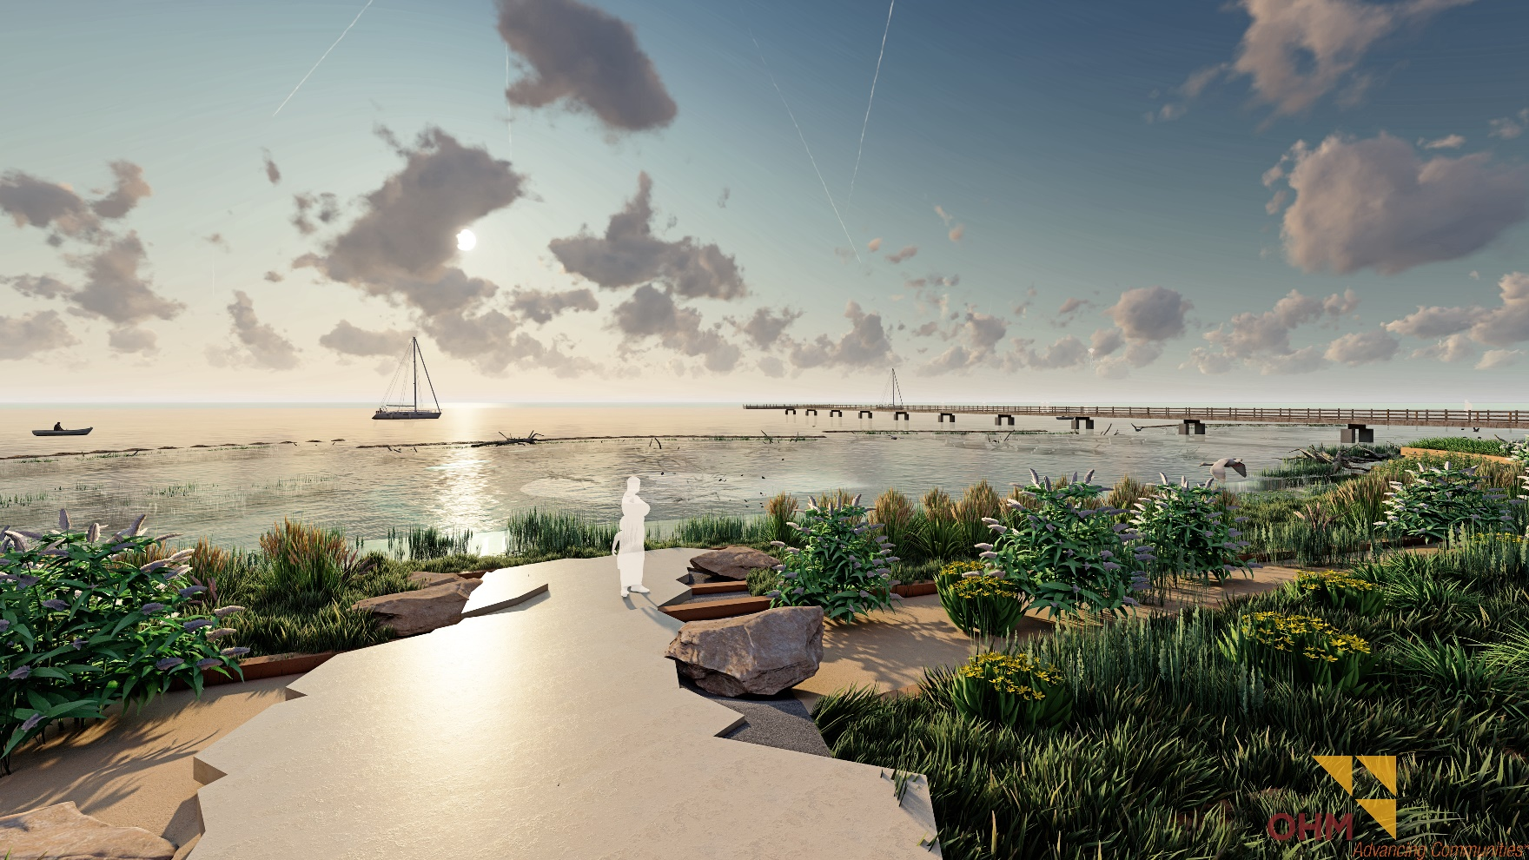
PROPOSED SHORELINE RESTORATION PLANS

Slide 16
Project Costs
Phase I - Design
Design: $137,500
Federal Request: $97,500
Non-Federal Match: $40,000
Phase II - Implementation
Construction: $884,874
Federal Request: $715,000
Non-Federal Match: $169,874
Total
Total Project: $1,022,374
Federal Request: $812,500
Non-Federal Match: $209,874 (approximately 20%)
Timing of bidding and construction is essential.
Specialized Work / Market Pricing

Slide 17
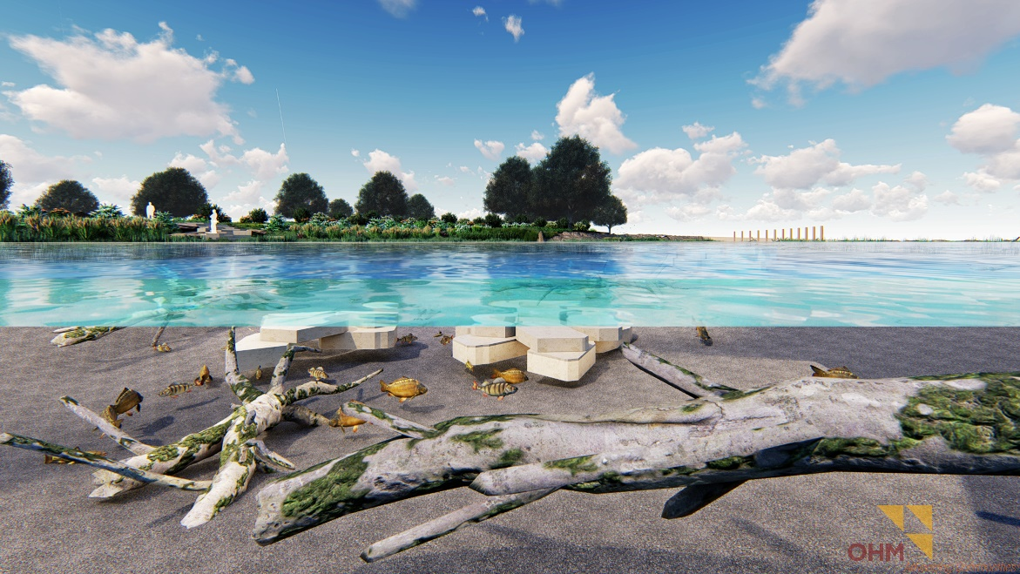
IMPLEMENTATION SCHEDULE
Permitting (in progress)
QAPP
Monitoring start
EGLE/USACE
10/10/19
10/15/19
01/02/20 (Est.)
Bidding
11/01/19 (Est.)
Submittals & Equip.
/Material Procurement
Commence construction
In-water work suspended
Post-construction monitoring
Complete construction
12/15/19
01/02/20
5/01/20-9/30/20
10/01/20
12/31/20
Majority of construction work to occur during off-peak season

Slide 18
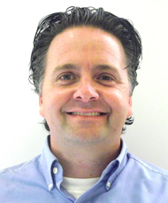
FOR MORE INFORMATION
CHESTERFIELD TOWNSHIP Josh Sonnenberg
Program Manager
Facilities and Operations Director
GREAT LAKES COMMISSION
Eric Ellis
Coastal Conservation and Habitat Restoration Project Manager
eellis@glc.org
OHM Advisors®

Slide 19
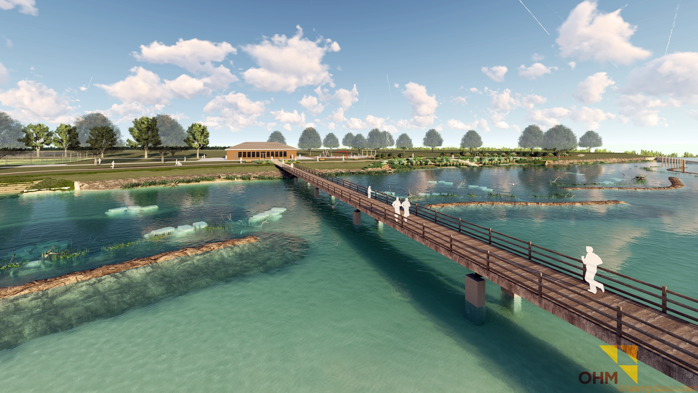
QUESTIONS?

