Slide 1
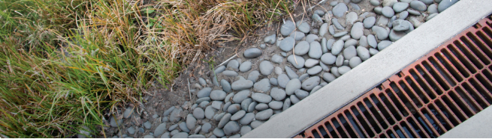
Integrated Water Asset Management
Water infrastructure financing and iwam
IWAM Webinar Series (Webinar 2 of 4)
The Great Lakes Commission
Monday March 18th, 2019
Dan Gold (dgold@glc.org)

Slide 2
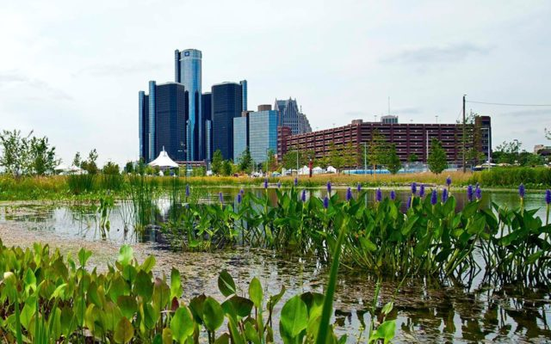
IWAM
Webinar Agenda
1
Project Overview
Panelist Presentations
Jeff Hughes Environmental Finance Center at the University of North Carolina at Chapel Hill
Robert Boos Pennsylvania Infrastructure Investment Authority (PENNVEST)
Mark Hoskins & Jay Kessen Illinois Department of Natural Resources - Office of Water Resources
Q&A + Open Discussion
2
3

Slide 3

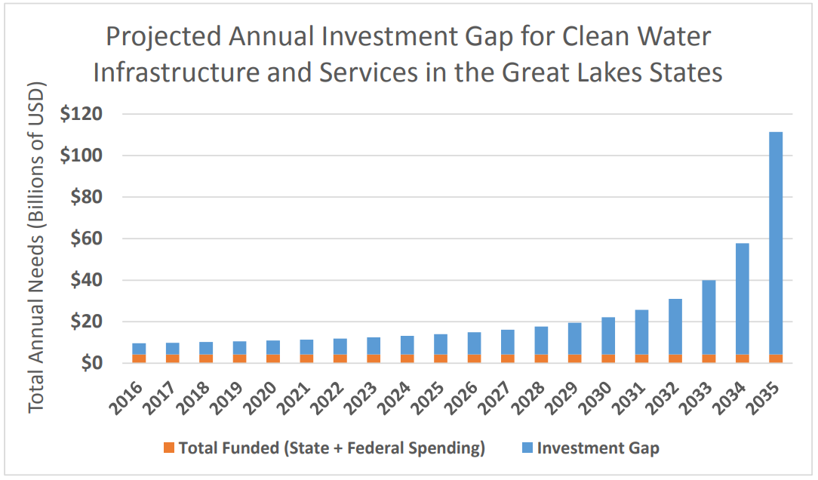
IWAM Project Overview:
Background
GLC is a regional organization that seeks shared solutions for shared problems
Joint Action Plan for Clean Water Infrastructure and Services in the Great Lakes Region (Sept 2017)
  Identified a significant investment gap
  Recommendations for state/provincial, federal, and local action
2018 funding from the Joyce Foundation to pursue these recommendations leads to IWAM
*Great Lakes Commission (2017)

Slide 4
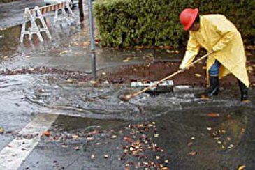
IWAM Project Overview:
Tasks & Outcomes
Webinar Series (Feb – April, 2019)
Webinar 1: What is IWAM?
Webinar 2: Water Infrastructure Financing & IWAM
Webinar 3: Technology & IWAM
Webinar 4: IWAM Policy and Program Implementation
Focus Groups (April – June, 2019)
Information gathering from communities and AM professionals advancing local or regional IWAM
IWAM Reports (Summer 2019 – Early 2020)
Phase I Report: Barriers; Opportunities; Best Practices
Proposal for IWAM Phase II: Workplan to implement Phase I results in pilot communities

Slide 5

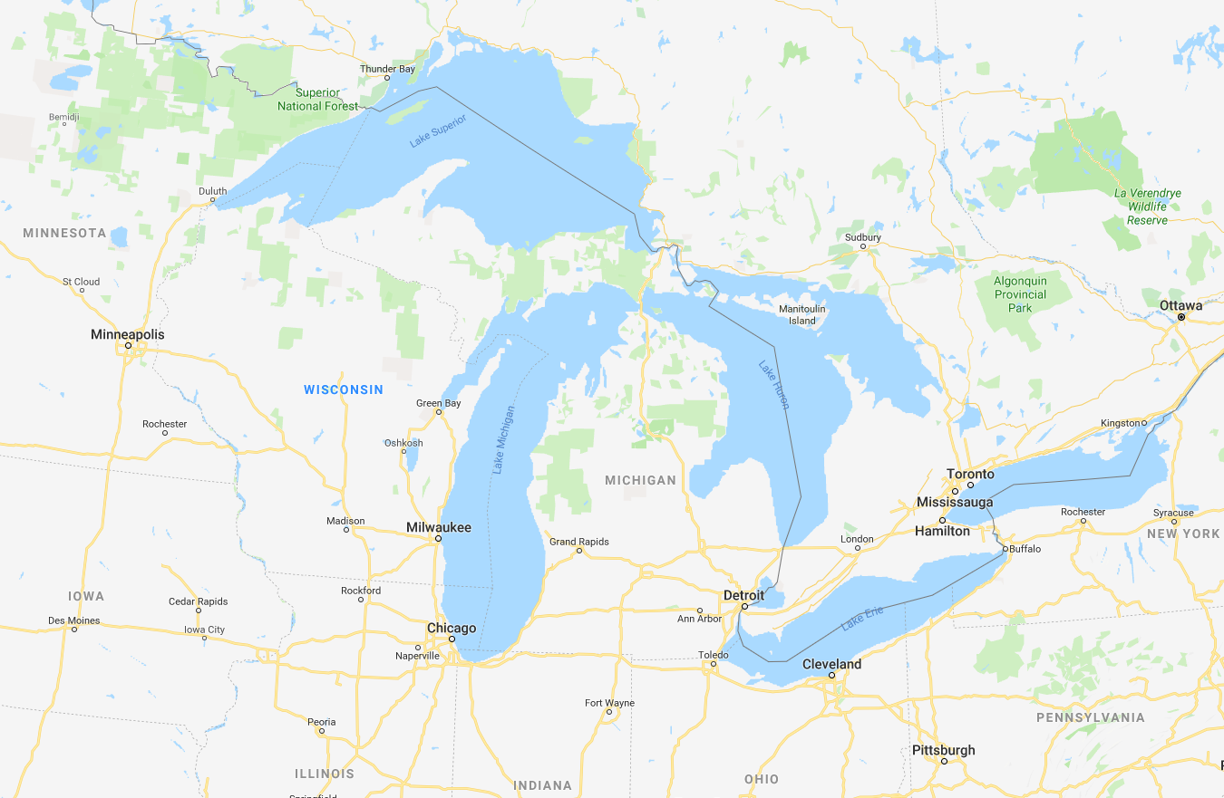






Defining IWAM: What Do We Mean By “Integrated”?
Locally: Across Siloed Sectors
Regionally: Across Political Boundaries
Waste
Green Infra
Drinking
Storm
Transportation
Energy
Communication

Slide 6
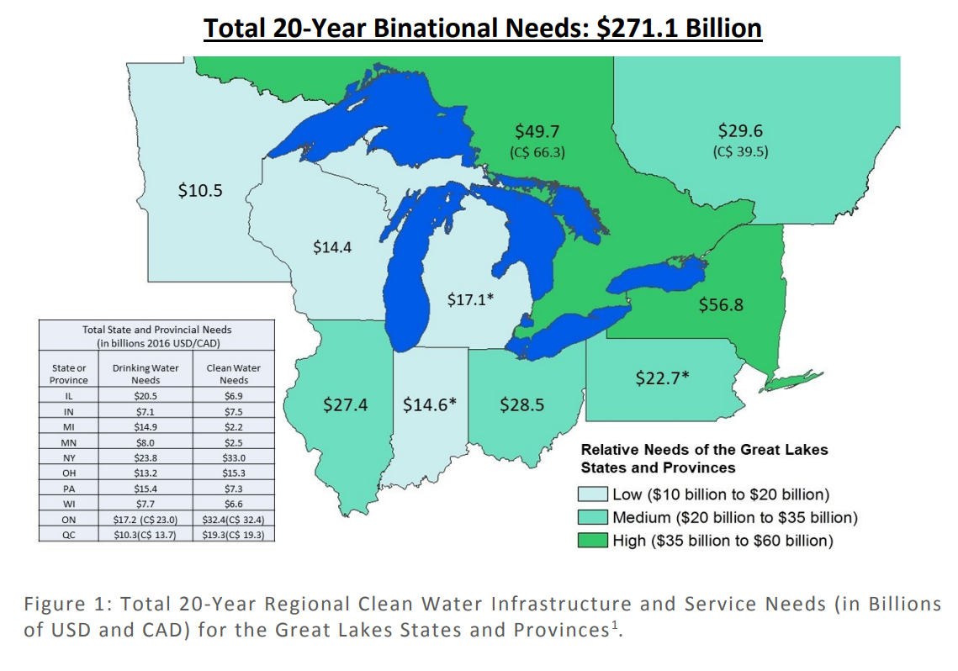
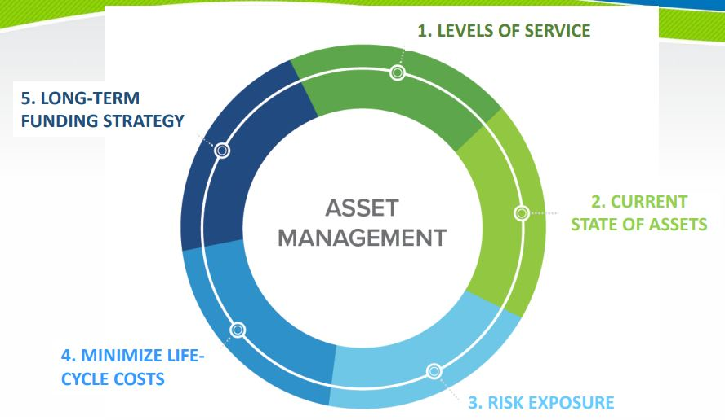
The Need for Dedicated Asset Management Financing
*US EPA’s 5 Core Questions for Asset Management
*Great Lakes Commission (2017)

Slide 7
Panelist Presentations
1
Jeff Hughes, Environmental Finance Center, UNC Chapel Hill
Rate Setting and Asset Management
Robert Boos, PENNVEST
Funding Clean Water Projects
Mark Hoskins & Jay Kessen, Illinois DNR Office of Water Resources
Stormwater Utility Fees & Asset Management
2
3

Slide 8





Rate Setting and Asset Management
Jeff Hughes, Director
Environmental Finance Center
School of Government
University of North Carolina
(919) 843-4956
jhughes@sog.unc.edu
www.efc.unc.edu

Slide 9

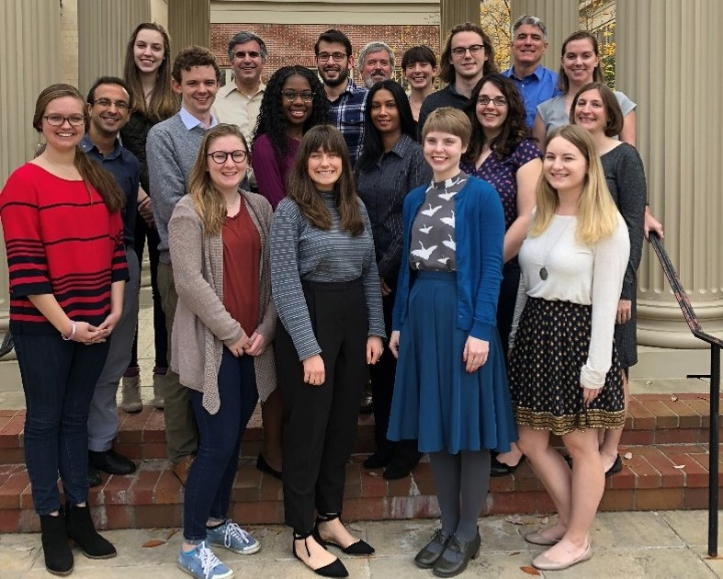
Supporting fair, effective, and financially sustainable delivery of environmental programs through:
Applied Research
Program Design and Evaluation
Teaching and Outreach
Advising
Policy Analysis
How you pay for it matters

Slide 10

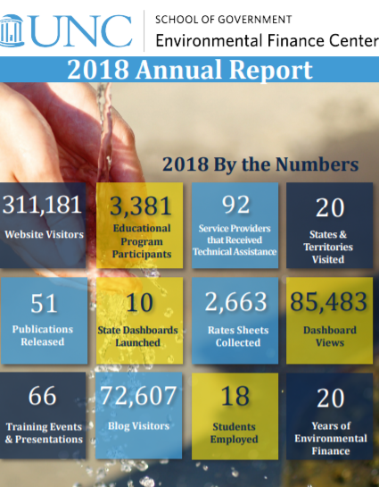
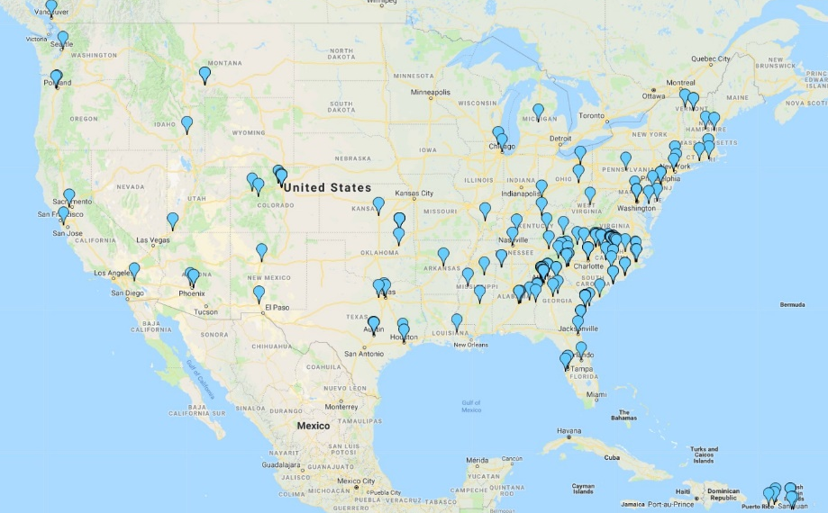
Environmentalfinance.org

Slide 11
Acknowledgements
Great Lakes Commission IWAM https://www.glc.org/work/iwam
Wisconsin Rates and Finance Dashboard, Public Service Commission https://efc.sog.unc.edu/project/wisconsin-water-rates-survey-and-dashboard
Smart Management for Small Water Systems Project and United States Environmental Protection Agency https://efcnetwork.org/small-systems-project/

Slide 12
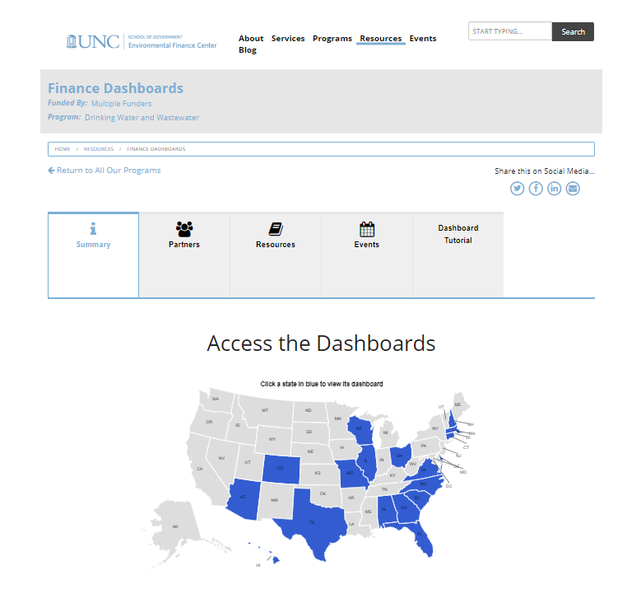
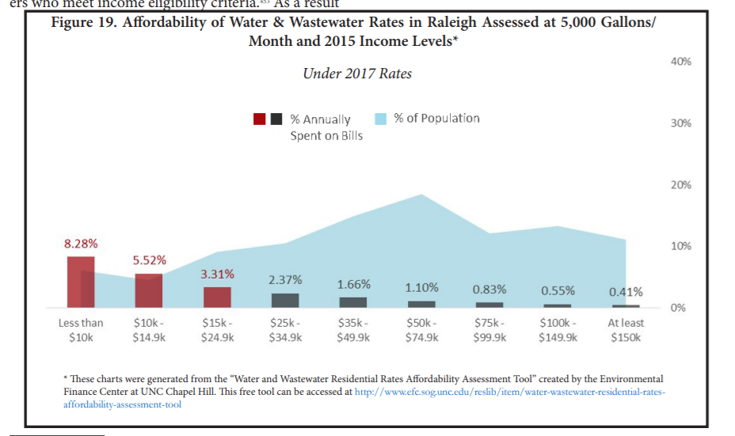
Rates Analysis and Tools
State level rates surveys and analysis
Utility rates and revenue modeling tools
Utility rates affordability assessment tools
Utility capital planning tools
Survey results and presentations
Rate setting publications and guides

Slide 13
Rates and Funding for Asset Management: Take-Aways
Assets generate your revenue!
Insufficient rates often lead to insufficient asset management
Many utilities rates generate revenue sufficient for basic operation and maintenance but not serious capital renewal and replacement
Rates sufficient to generate needed revenue may exceed what some households can readily afford

Slide 14
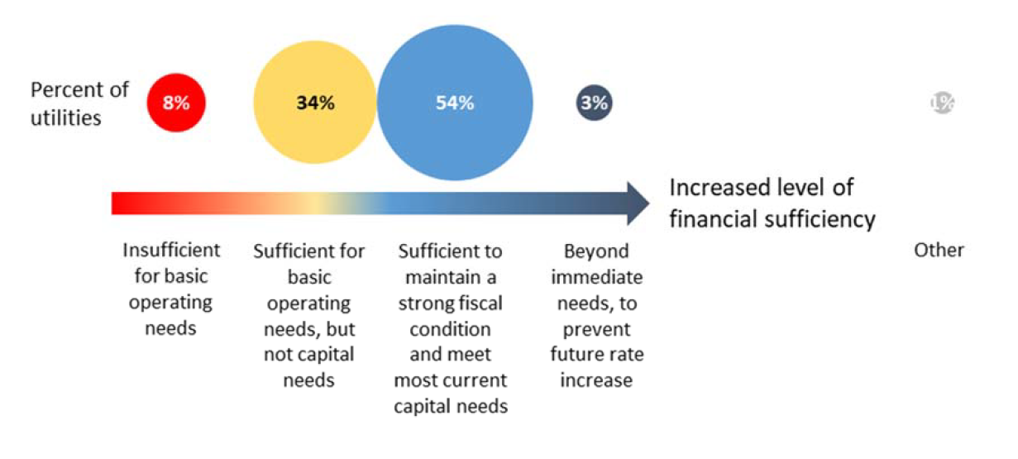
Is Revenue Sufficient?
Source: UNC-EFC: Results of the 2017-2018 North Carolina
Water and Wastewater Utility Management Survey

Slide 15
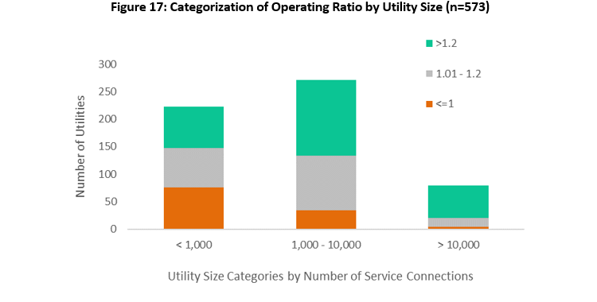
What not including depreciation looks like (Wisconsin)

Slide 16
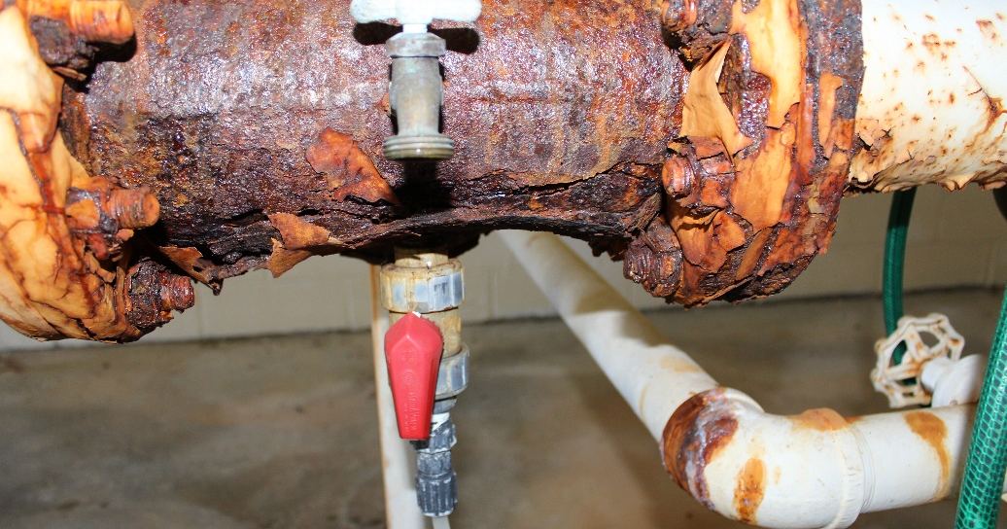
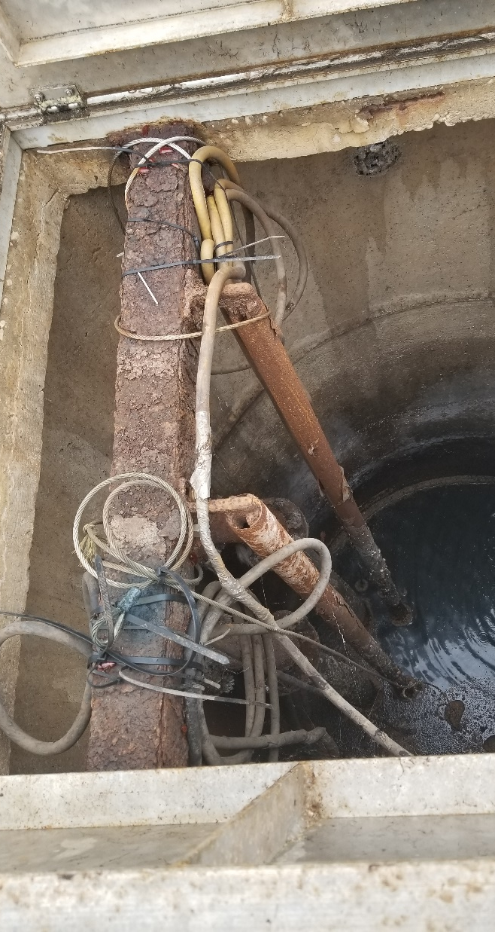
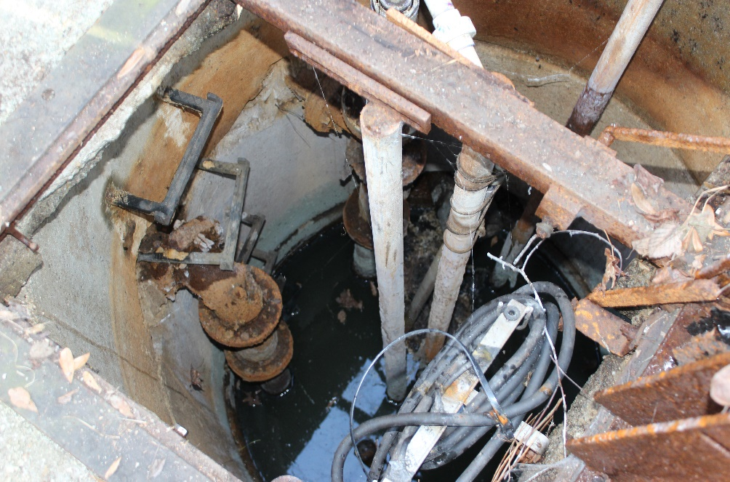
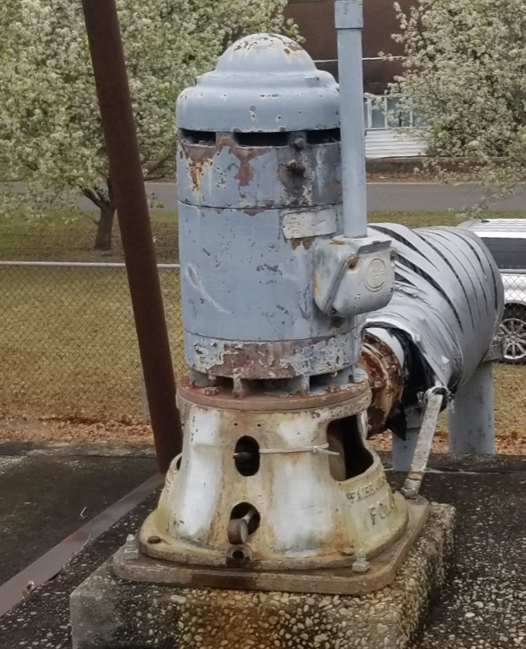
What not including depreciation looks like
Fair Bluff Causey St. PS

Slide 17
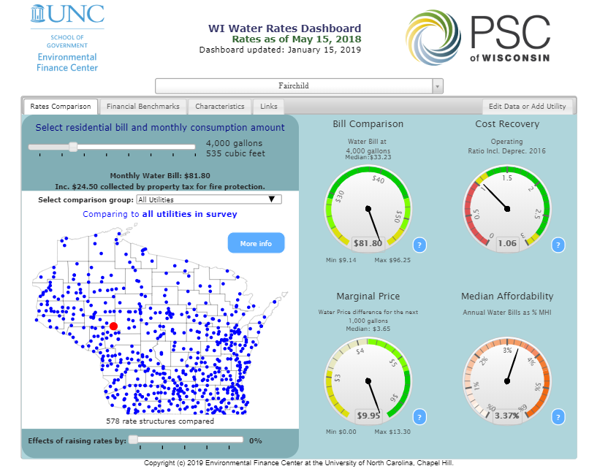
Rate Challenges: Affordability https://efc.sog.unc.edu/resource/wisconsin-water-rates-dashboard

Slide 18
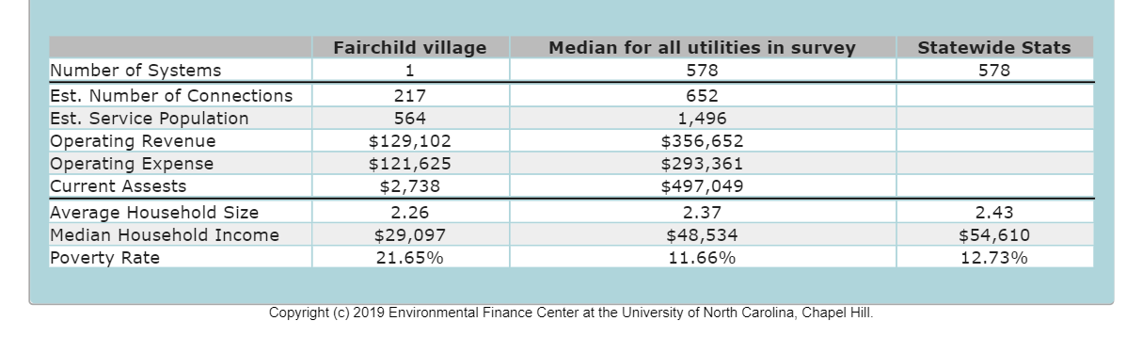
Affordability
Still a value, but….
Bills reaching new highs (e.g. > $100)
High poverty rates
Rates growing faster than income

Slide 19
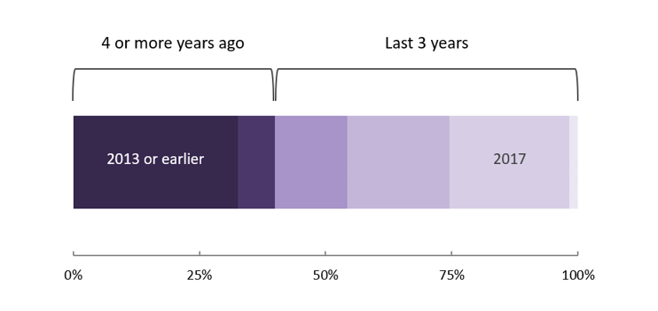
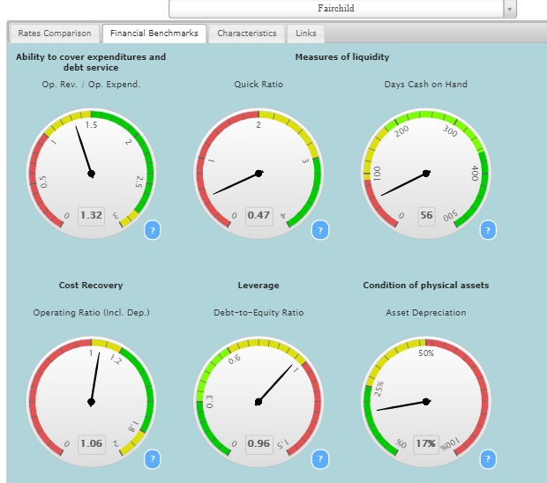
Some Basic Rate Strategies
More frequent rate adjustments
Set rates that generate revenue for capital (sinking funds, debt service)
Multi-factor analysis (not just “bill”)
Education and communication
Customer assistance programs
Source: 2018 Wisconsin Rate Analysis

Slide 20
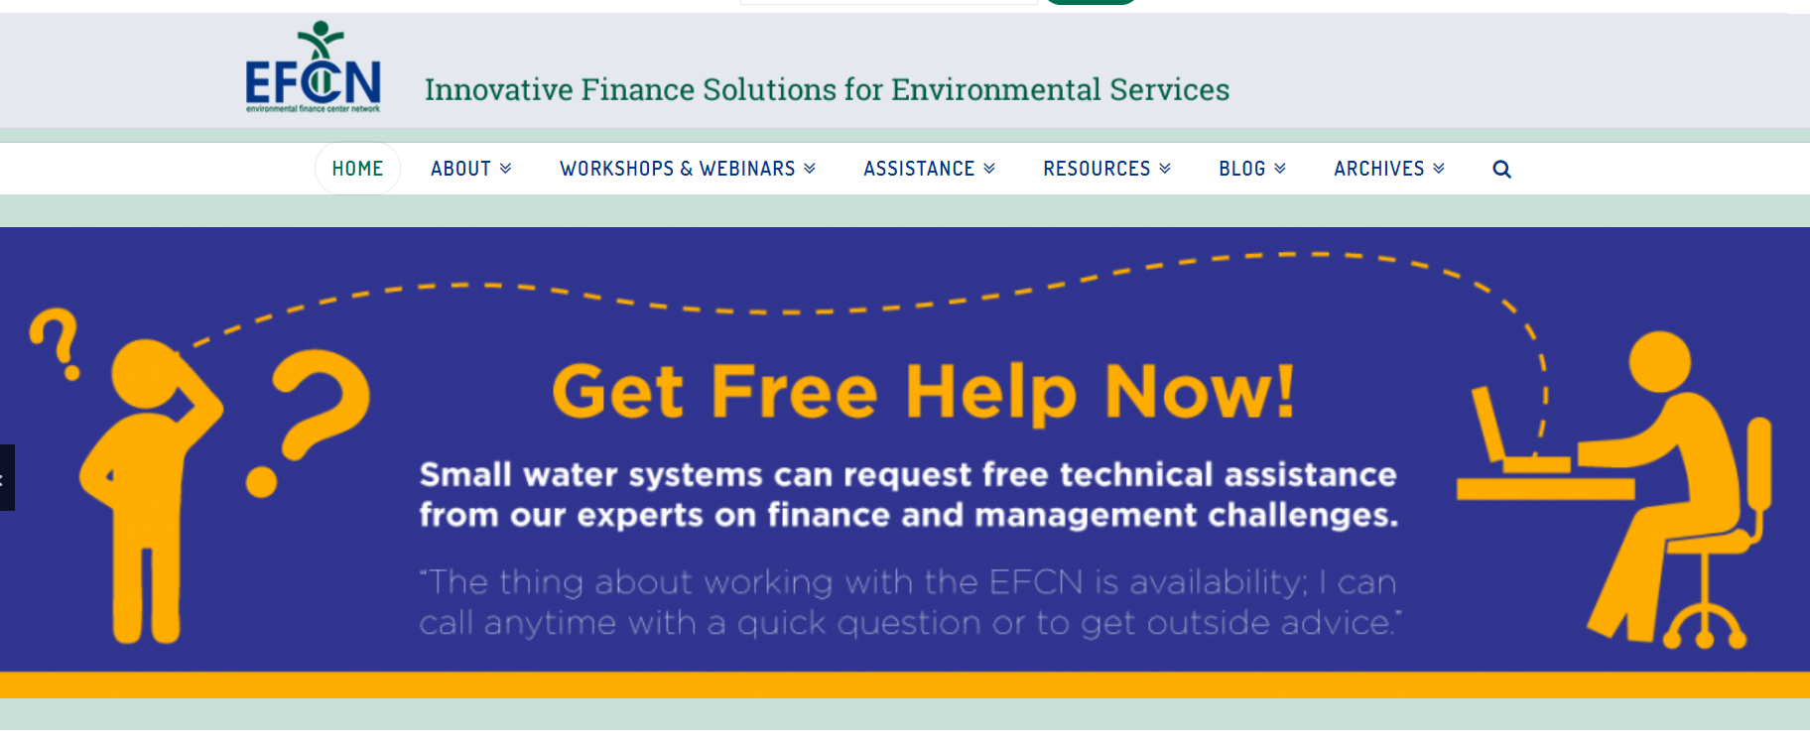
Resources
Basic reviews and assistance
Water systems serving fewer than 10,000 people
https://efcnetwork.org/assistance/request-assistance/

Slide 21
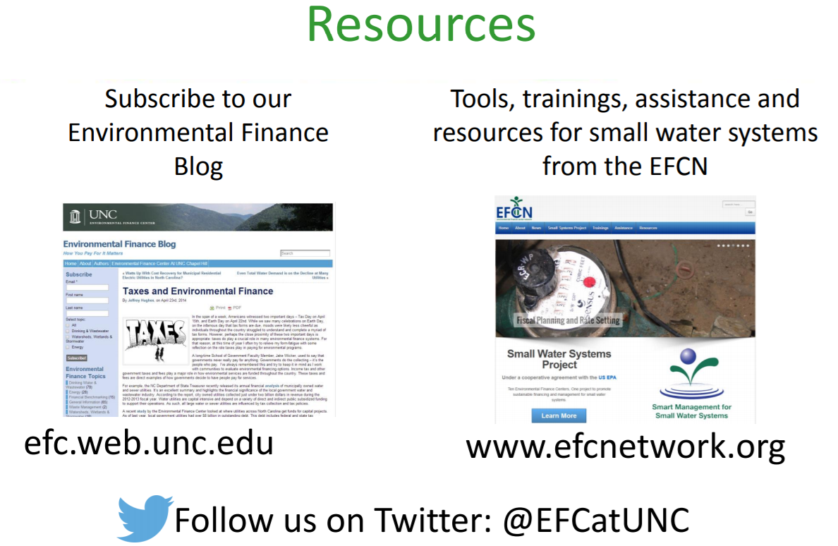

Slide 22

31 Years of Funding Clean Water Projects

Slide 23
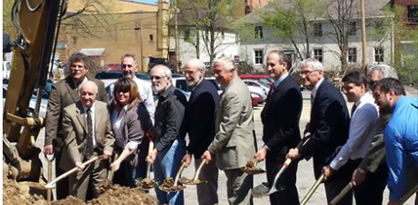

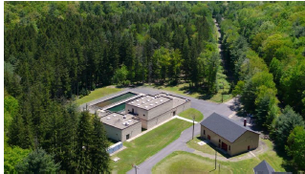
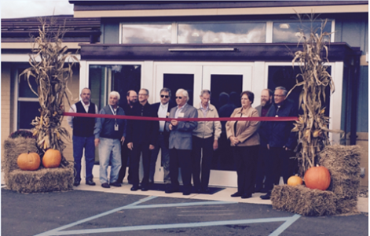
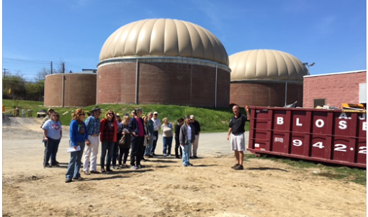
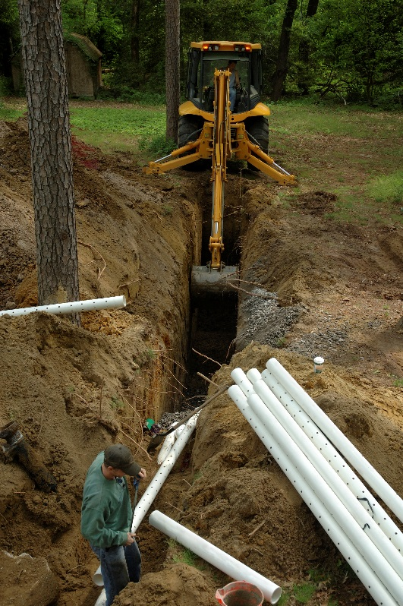
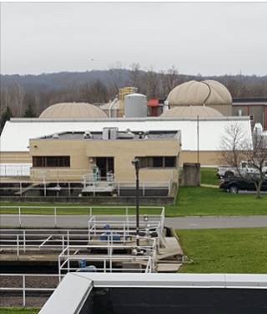
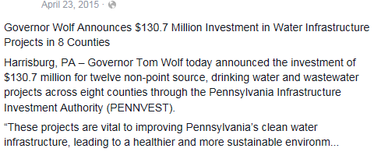
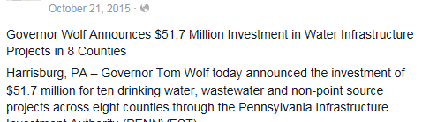
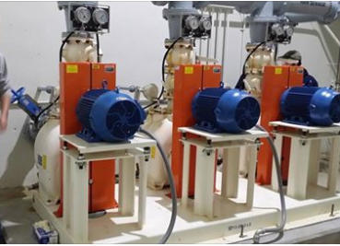
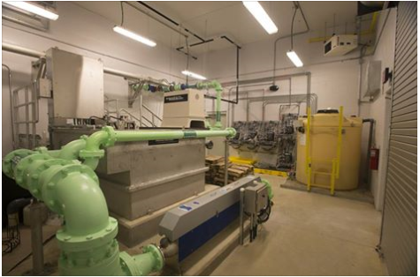
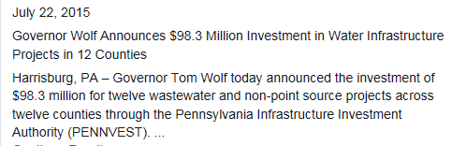
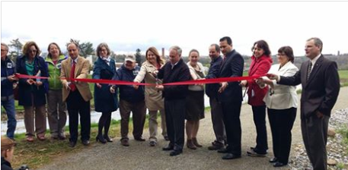
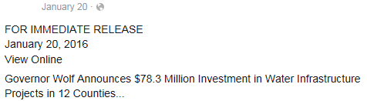

Funding Clean Water Projects! !

Slide 24
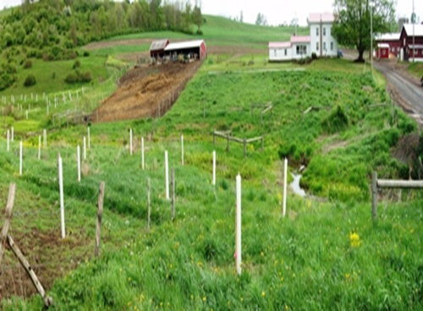
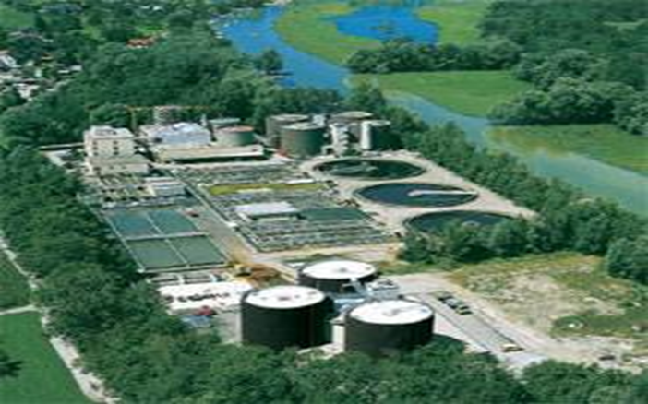
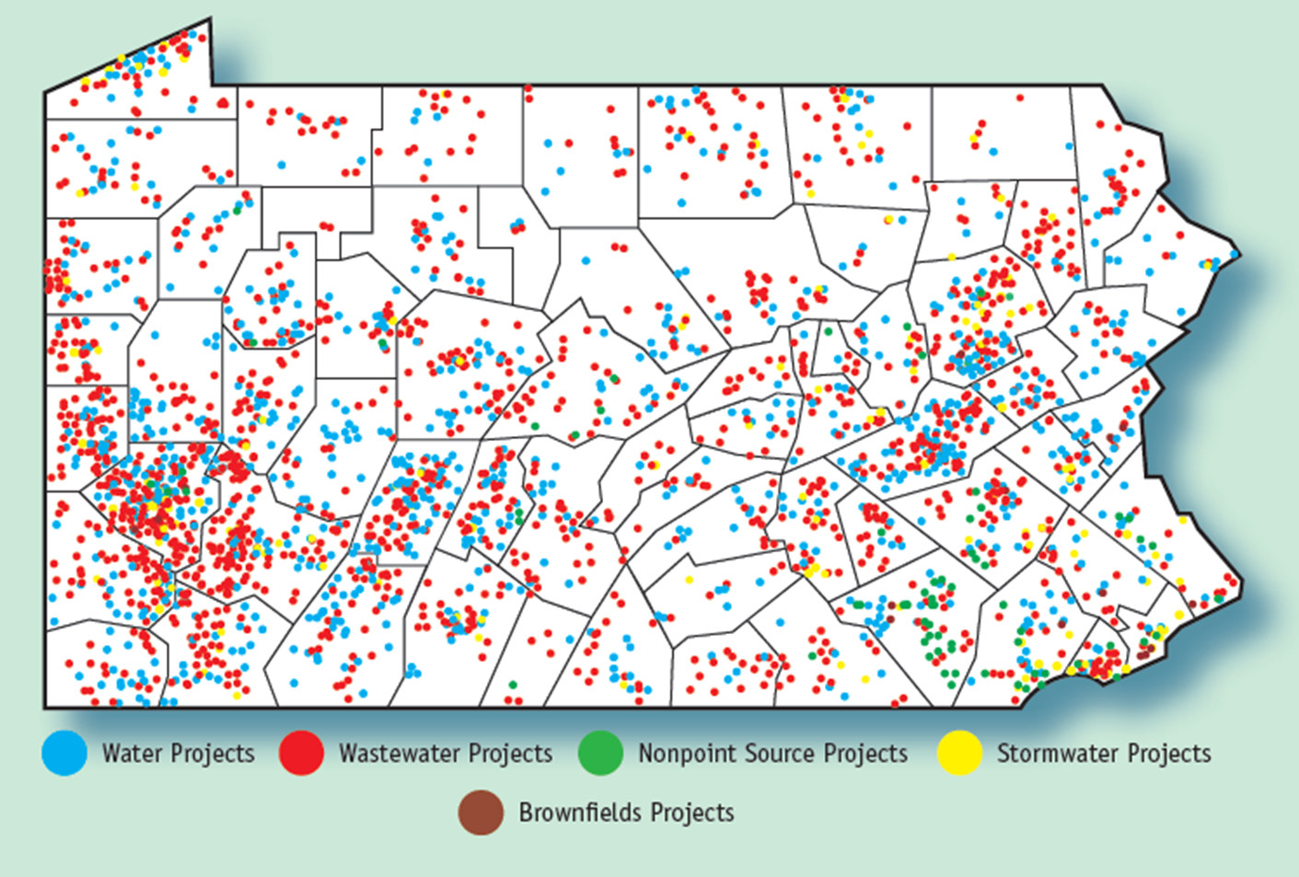
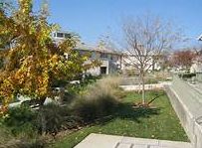
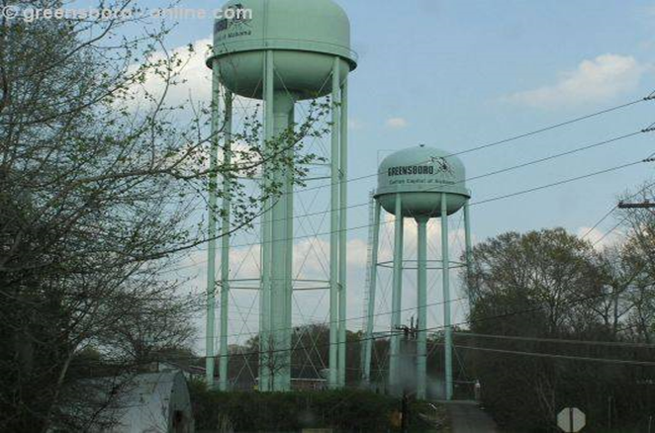
Non Point Source
Sewer
Storm Water
Water

Slide 25
PENNVEST Financing
Projects Approved: 3,878 for a Total Funding of $8.69 Billion
$570 Million Budgeted for 2018-2019
• 1,043 Drinking Water
• 1,640 Wastewater
• 17 Brownfield
• 157 Non-Point Source
• 3 Acid Mine Drainage
• 129 Storm Water
• 802 On-Lot repairs
• 10 sewer laterals replaced
• 77 new sewer connections

Slide 26
PENNVEST BOARD MEETINGS
APPLICATION CUT-OFF DATES BOARD MEETING DATES
May 2, 2018 July 18, 2018
August 8, 2018 October 17, 2018
October 31, 2018 January 30, 2018
February 6, 2019 April 17, 2019
May 1, 2019 TBD

Slide 27
How Can PENNVEST Help?
  Drinking Water – Public/Private
  Wastewater – Public/Private
  Storm Water – Public/Private
  Non – Point Source
    Ag BMPs – Public/Private
    Acid Mine – Public/Private
    Brownfield – Public/Private
    Green Infrastructure – Public/Private
    Nutrient Trading – Public/Private
    On-lot systems – Principal Residence

Slide 28
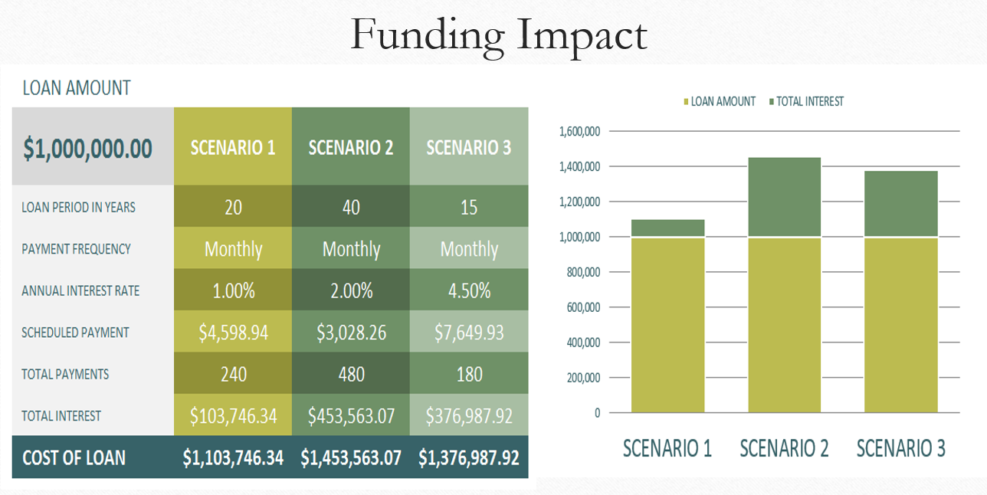
COMPETITVE TERMS

Slide 29
Funding Determination
User Rate Projection based on County Cap Rate and compared with community Target Rate
If resulting rate below target – all loan
If resulting rate above target – hardship
Hardship considerations
Reduced interest rate to 1.000% for full term
Grant funds – grants are often prorated
Loan term stretched up to 30 years
PENNVEST will extend the best possible funding offer.
No guarantees on hitting Target Rate
In some cases you may need to leverage other sources if affordability is an issue

Slide 30
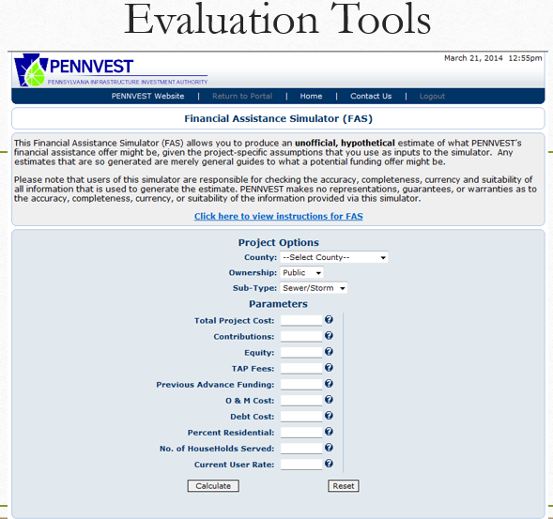
ENTIRE PROCESS IS WEB-BASED
The Web Based system allows for:
+ the collection and evaluation of information for project review, ranking and recommendation
+ Submittal of as bid project costs and documents necessary for settlement
+ Submittal, review and disbursement of eligible costs associated with reimbursement for costs associated with the implementation of construction
+ PENNVEST review of change orders and project close-out
+ Collection of repayments, and annual financial statements
24/7 access to the information and status of your project along the way!

Slide 31
Project Review/Priority
DEP -technical
  Public Health, Safety, Environment, Compliance, Adequacy & Efficiency
DCED – economic development
  Economic Development, Community Action Team
PENNVEST – community capacity
  Land Use, Infill, Financial Capability, Funding Offer and Collateral

Slide 32
Asset Management Incentivized
Increased Ranking Points.
Asset Management Plan eligible cost up to $25,000.
Fiscal Sustainability Plans required for all new wastewater treatment infrastructure improvements.

Slide 33
How is PENNVEST Incentivized Asset Management going?

Slide 34
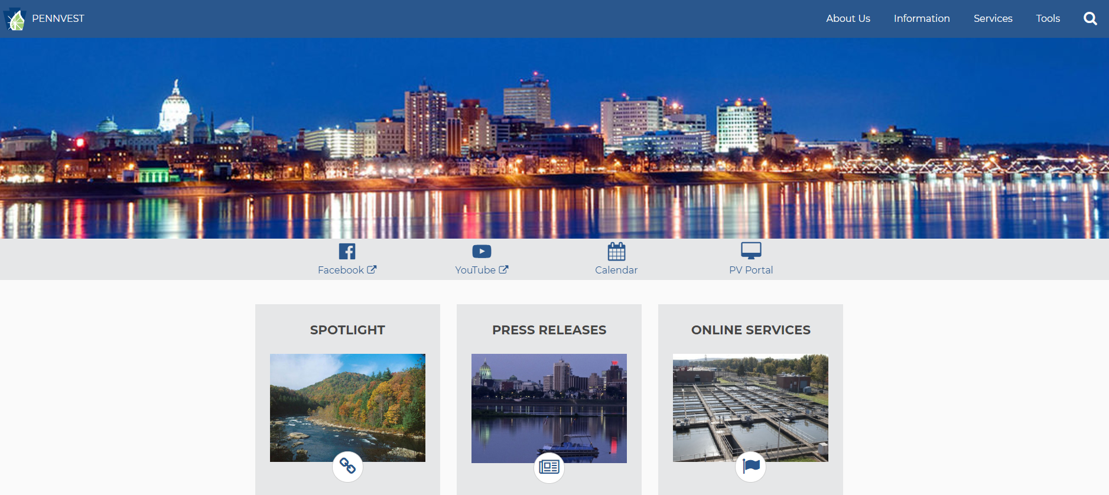
http://www.pennvest.pa.gov

Slide 35
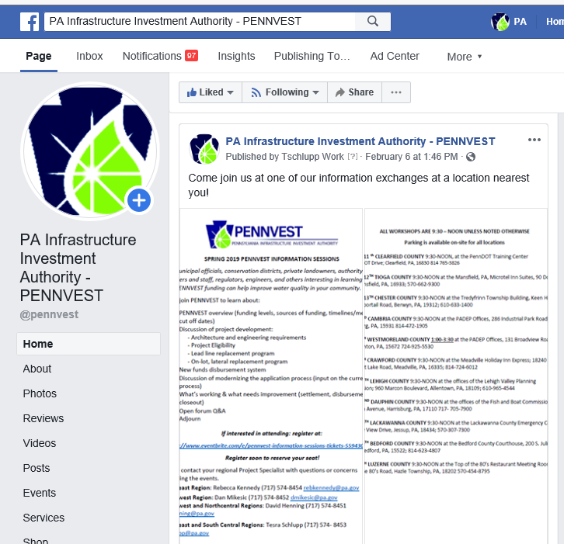
You can follow us on Facebook

Slide 36
Questions
Robert H. Boos
Deputy Executive Director for Project Management
PENNVEST
Phone – 717.783.4493
E-mail - rboos@pa.gov

Slide 37
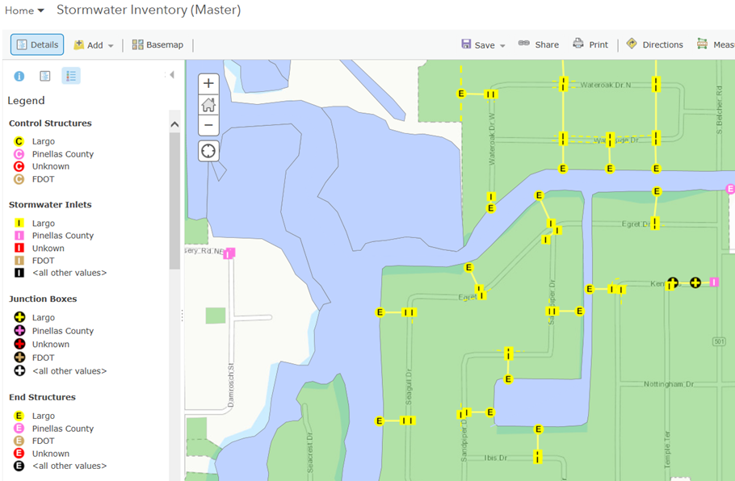
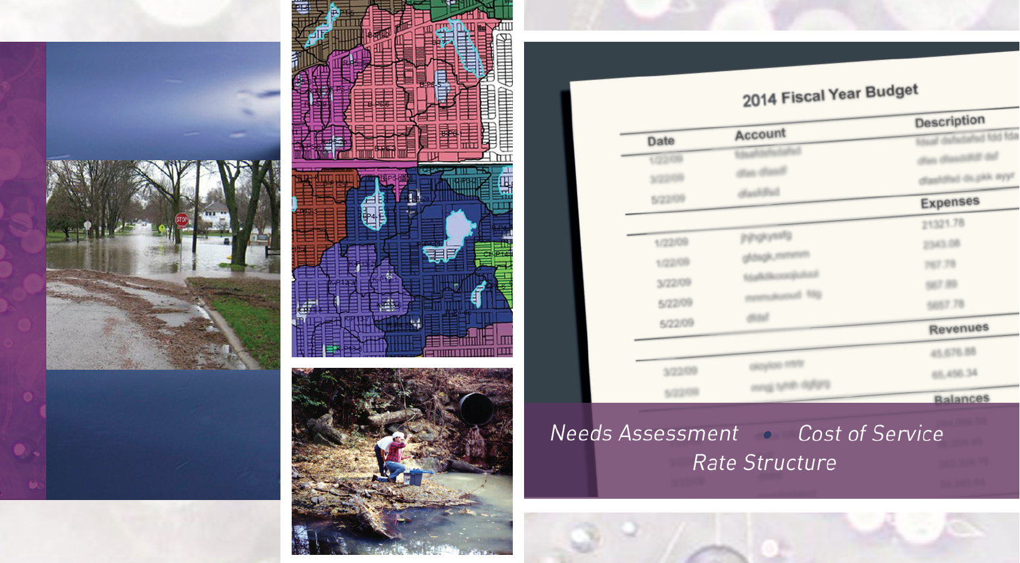
Stormwater Utility Fees
& Asset Management
Mark Hoskins
and
Jay Kessen
Illinois Department of Natural Resources
Office of Water Resources

Slide 38
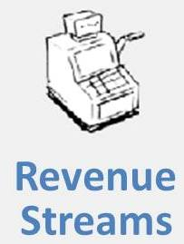

What are Stormwater Utility Fees?
Dedicated Revenue Stream
Fee not a Tax
Capacity-Based
Defined Level of Service
Flexible

Slide 39
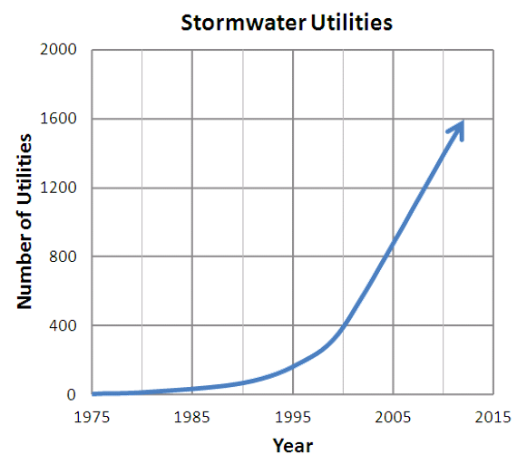

A Brief History
1970s and 1980s
1990s
Today
SOURCE: Wood Group, formerly Amec Foster Wheeler
SOURCE: Western Kentucky University Stormwater Utility Survey 2018

Slide 40

Legal Criteria
Rational Nexus
Voluntary
Dedicated Regulatory Purpose

Slide 41




Process
Feasibility Study
Implementation

Slide 42



Process
Feasibility Study
Implementation

Slide 43

Process
Feasibility Study
Implementation

Slide 44


Minneapolis, MN
History
System
Asset Management Program Goals

Slide 45







Potential Barriers & Issues
Inadequate public outreach
Fails after feasibility phase
Perceived as moving target

Slide 46

Next Steps & Opportunities for Collaboration
Join us for the 3rd Webinar in our Series:
  Technology & IWAM
  Thursday, April 11th, 10:30-12:00pm EST
Please contact us to continue this discussion:
  Your take Financing & IWAM?
  Lit review suggestions
  Who else should we contact?
  Pilot community suggestions

Slide 47
Thank You!
Integrated Water Asset Management
Visit https://www.glc.org/work/iwam
or
Contact Dan Gold dgold@glc.org
Monday, March 18th, 2019

