Slide 1
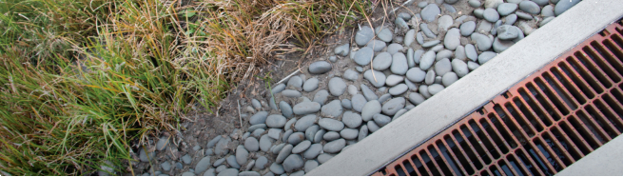
Integrated Water Asset Management
Technology and asset management
IWAM Webinar Series (Webinar 3 of 4)
The Great Lakes Commission
Thursday April 11th, 2019
Dan Gold (dgold@glc.org)

Slide 2

IWAM
Webinar Agenda
1
Project Overview
Panelist Presentations
Heather Himmelberger Southwest Environmental Finance Center
Jody Caldwell & Bryon Wood Great Lakes Water Authority
Steve Rozycki Macomb County MI Public Works Department
Q&A + Open Discussion
2
3

Slide 3

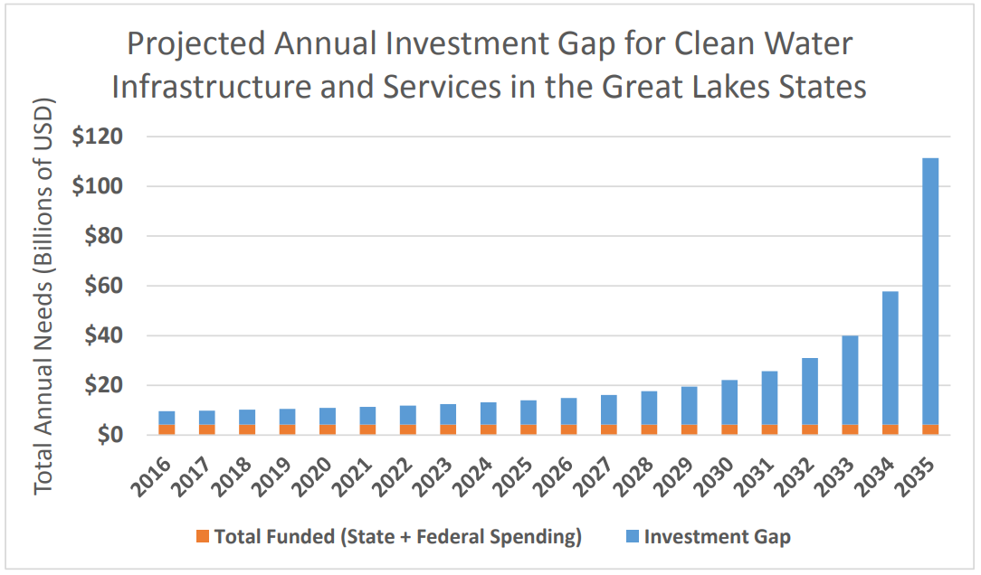
IWAM Project Overview:
Background
GLC is a regional organization that seeks shared solutions for shared problems
Joint Action Plan for Clean Water Infrastructure and Services in the Great Lakes Region (Sept 2017)
  Identified a significant investment gap
  Recommendations for state/provincial, federal, and local action
2018 funding from the Joyce Foundation to pursue these recommendations leads to IWAM
*Great Lakes Commission (2017)

Slide 4
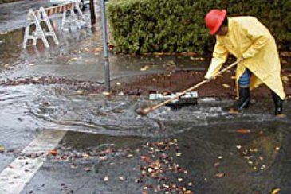
IWAM Project Overview:
Tasks & Outcomes
Webinar Series (Feb – May, 2019)
Webinar 1: What is IWAM?
Webinar 2: Water Infrastructure Financing & IWAM
Webinar 3: Technology & IWAM
Webinar 4: IWAM Policy and Program Implementation
Focus Groups (May – June, 2019)
Information gathering from communities and AM professionals advancing local or regional IWAM
IWAM Reports (Summer 2019 – Early 2020)
Phase I Report: Barriers; Opportunities; Best Practices
Proposal for IWAM Phase II: Workplan to implement Phase I recommendations in pilot communities

Slide 5

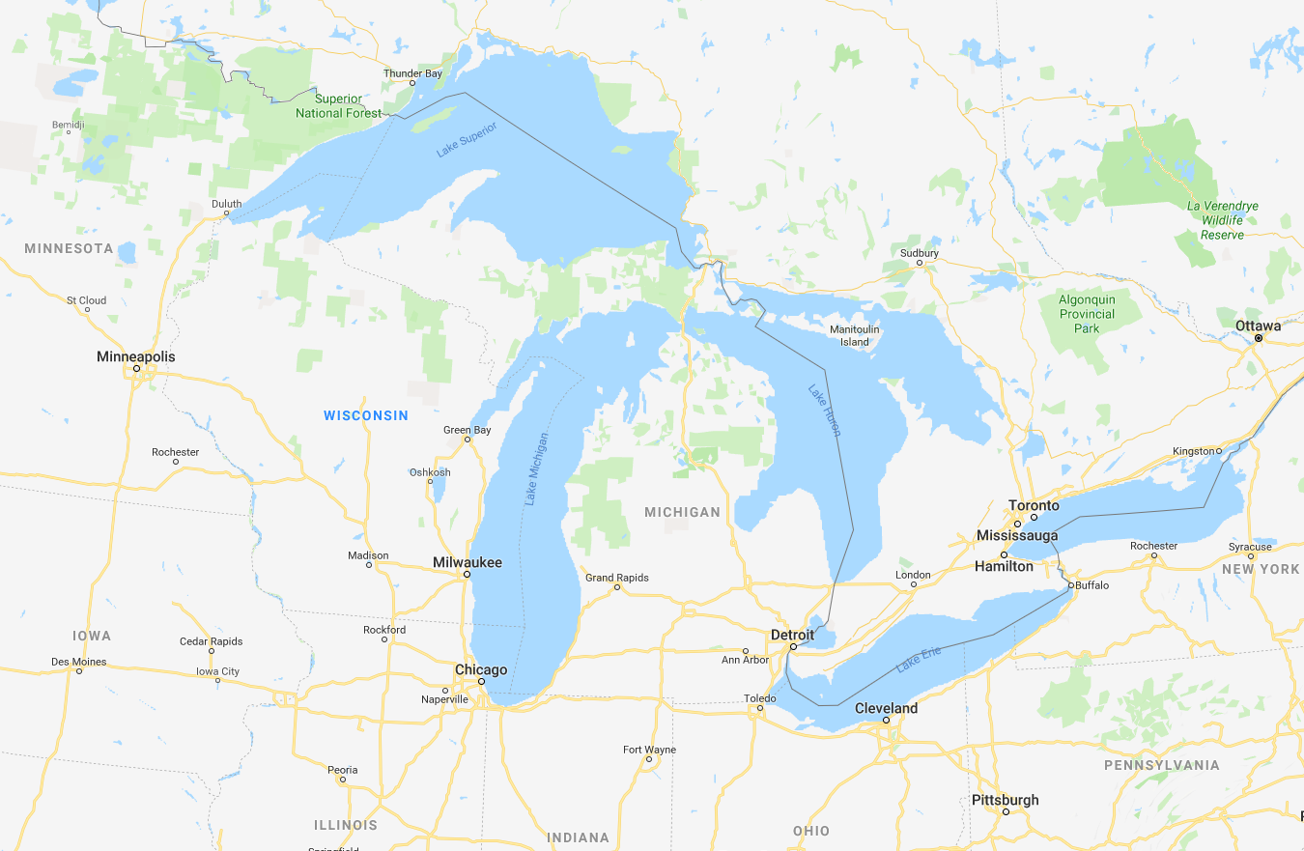






Defining IWAM: What Do We Mean By “Integrated”?
Locally: Across Siloed Sectors
Regionally: Across Political Boundaries
Waste
Green Infra
Drinking
Storm
Transportation
Energy
Communication

Slide 6
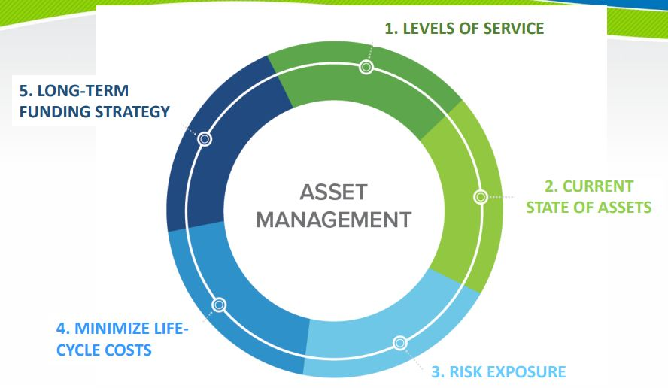
What Role Does Technology Play in Asset Management?
Technology Asset Management
No one size fits all solutions
Upgrade from the “million dollar binder”
Facilitate knowledge and data transfer
*US EPA’s 5 Core Questions for Asset Management

Slide 7
Panelist Presentations
1
Heather Himmelberger Southwest Environmental Finance Center
Choosing Asset Management Software
Jody Caldwell & Bryon Wood
  Great Lakes Water Authority
GLWA’s Journey to its Next Generation Enterprise Asset Management System
Steve Rozycki Macomb County MI Public Works Department
MCPWO & IWAM
2
3

Slide 8
CHOOSING ASSET MANAGEMENT SOFTWARE
Presented By: Heather Himmelberger, P.E.
Director, Southwest Environmental Finance Center

Slide 9










Asset Management is a Thought Process
CURRENT STATE OF THE ASSETS
CRITICALITY
LONG-TERM FUNDING
?
?
LEVEL OF SERVICE
LIFE CYCLE COSTING

Slide 10


Most Important Thing to Know: Software is a Tool to Help With Asset Management NOT Asset Management

Slide 11
Asset Management is a Thought Process
Software Can Be Used for Many Different Parts of Asset Management to Store Data, Sort it, Analyze it, Provide Reports
CURRENT STATE OF THE ASSETS
CRITICALITY
LONG-TERM FUNDING
?
?
LEVEL OF SERVICE
LIFE CYCLE COSTING

Slide 12

Does your utility need software at all?

Slide 13
Do you have a lot of assets, a complex system, a lot of staff?
What does your record-keeping look like? Is it chaotic and/or inefficient with related material kept in different locations?
Is it hard to manage and locate assets?
Do you have a process for knowledge management?

Slide 14
Are routine processes moving smoothly and efficiently?
Are you able to communicate what needs to be completed on a daily basis? How is other information communicated within the utility?

Slide 15
Have you ever failed to complete repairs in a timely manner because important spare parts were unavailable?
Maybe you have the part but have no idea where it is.
Or you though you had it only to realize you used it in a previous repair and forgot to order another?

Slide 16


The Number 1 Question We Get Is Some Version of “What Software Should I Buy?” “What’s the Best Software?”

Slide 17
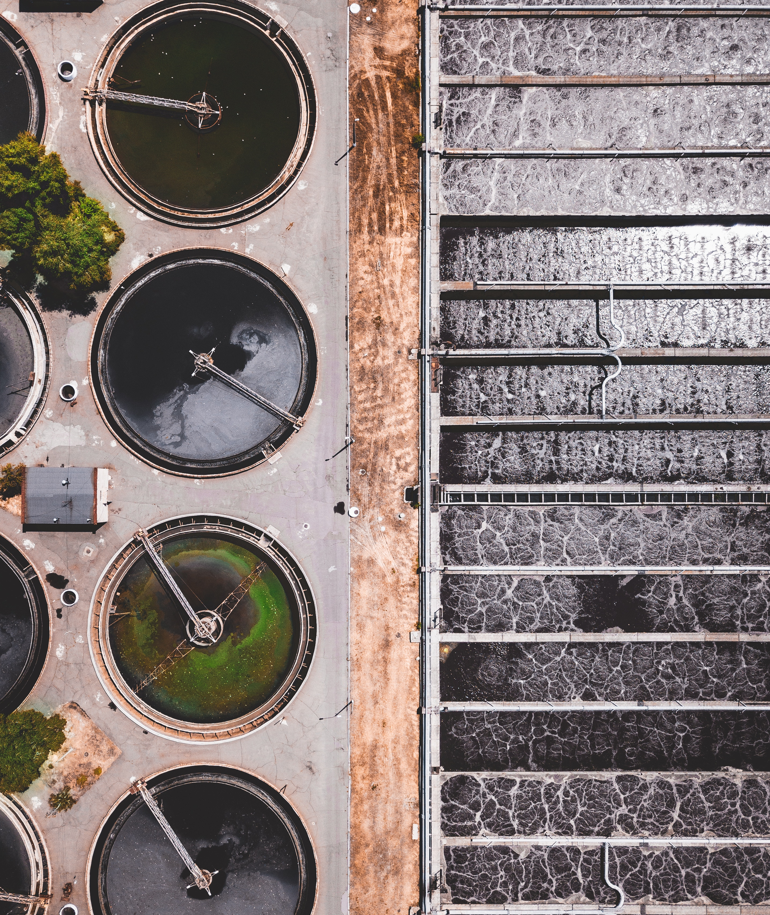
C Computerized
M Maintenance
M Management
S System
A Asset
M Management
S Software
Software for Asset Management Can Have Different Names

Slide 18
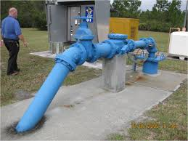
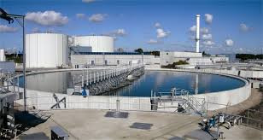
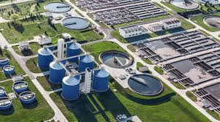
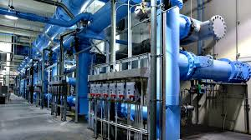
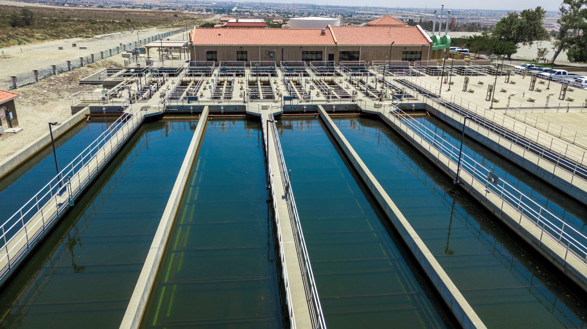
GENERAL PURPOSE OF SOFTWARE
Designed to simplify data storage and retrieval to make tasks easier (e.g., maintenance)
Goal: Improve organization and business practices to help extend asset lifespans and reduce costs
Can be used for simple or complex facilities, a single building or an entire campus

Slide 19
Potential Functionalities
Monitor work orders
Quickly generate reports
Schedule repairs
Create inventory forecasts
Determine which assets require maintenance and when
Manage spare parts
Equipment records
Preventative maintenance
Safety plans
Improve work completion rate
Increase visibility and transparency
Create paperless work environment

Slide 20


Important Question to Start With:
WHAT DO YOU WANT TO GET OUT OF THE PROGRAM?
What’s most important?

Slide 21
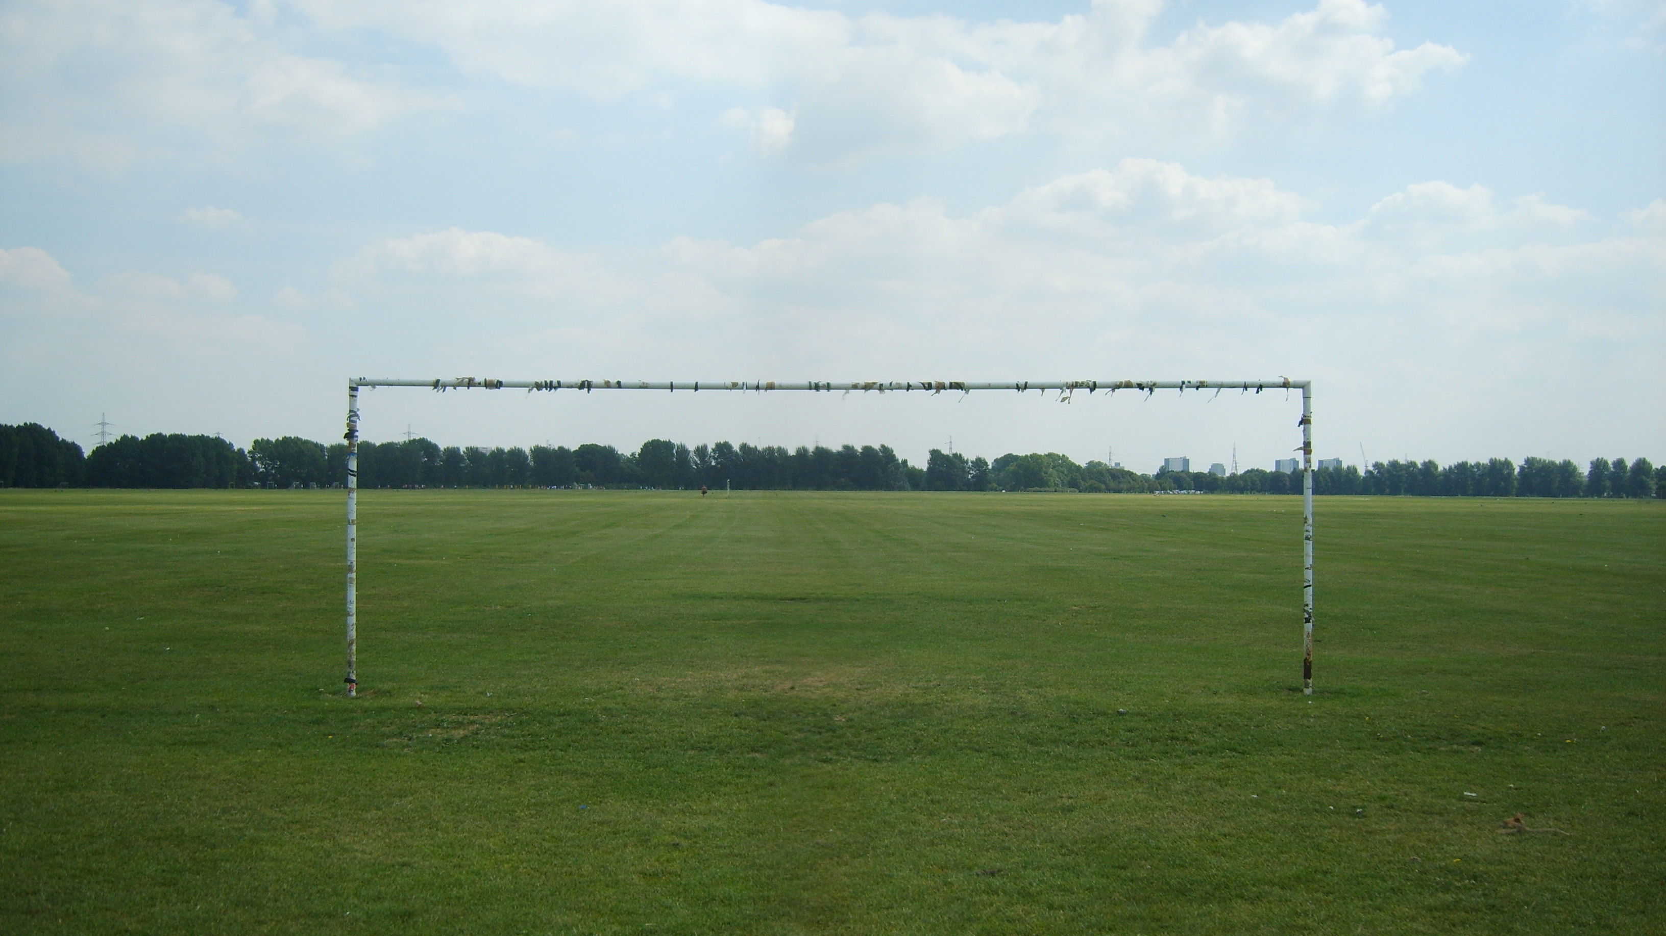
Start with clearly defining your goals

Slide 22




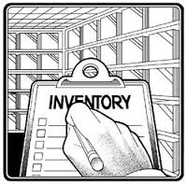




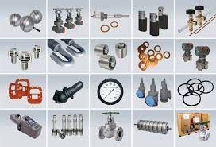
WHAT FUNCTIONS DO YOU WANT THE PROGRAM TO SERVE? WHAT FUNCTIONS SHOULD IT BE ABLE TO TALK TO?

Slide 23


Distinguish Between Must Haves and Nice to Haves
Essential (Must Haves):
Asset Management Tracking
  Asset Inventory
  Cost Data
  Maintenance Records
Generates Work Orders
Spare parts inventory tracking
Communicates with tablets or smart phones for in-field updating and accessing (mobile option)
Optional (Nice to Have):
Clean user interface
Easy to use
Connects horizontal assets (GIS based inventory) and vertical assets
Communication with (future) SCADA systems

Slide 24

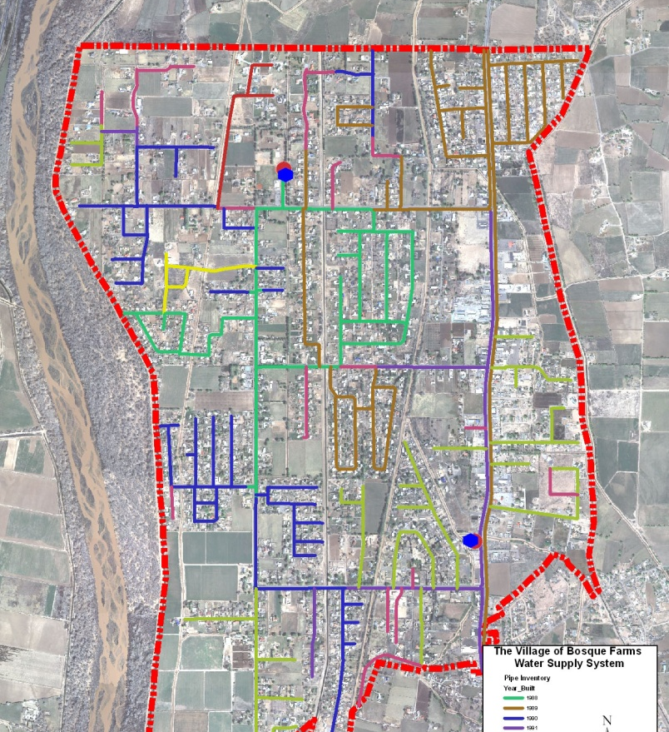

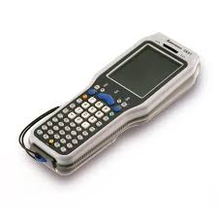

HOW MUCH FIELD INFORMATION AND/OR FIELD DEVICES DO YOU WANT TO INCLUDE?

Slide 25
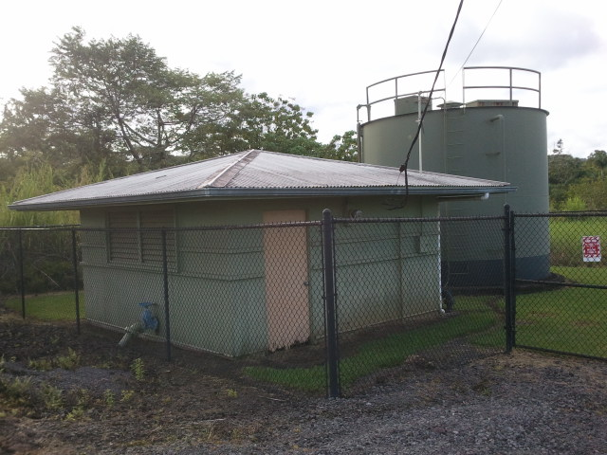

WHAT CAN YOU AFFORD TO PAY?
INITIALLY AND EACH YEAR?
CMMS can be expensive
Each company has very different pricing schemes
Subscription or license based
For an accurate estimate know the following :
  gallons per day
  number of connections
  number of users.
May ask for the total number of software users or ask for the number of concurrent users

Slide 26
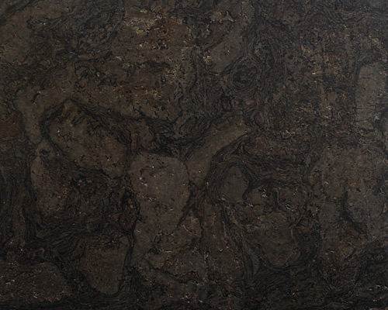


WILL THE PROGRAM HAVE TO BE CUSTOMIZED FOR YOUR FACILITY OR WILL IT WORK RIGHT OUT OF THE BOX?
HOW MUCH & WHAT TYPE OF TRAINING WILL BE REQUIRED? DID YOU BUDGET FOR IT?

Slide 27



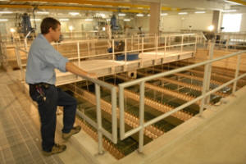

WHO WOULD BE ABLE TO USE THE PROGRAM?
WILL DIFFERENT PEOPLE HAVE DIFFERENT ACCESS? (READ/WRITE)

Slide 28

Image source: http://www.huenei.com/index.php/en/2017/08/28/benefits-of-cloud-vs-on-premise/
A cloud-based system requires fewer upfront costs because you don’t have to set up and manage the server
Updates can be quickly implemented
Issues with the software can be solved remotely
An on-premise solution has better security
If your utility has data or regulatory requirements that force the data to stay on site then it will be the best option for you

Slide 29
Time to explore your options
Think about functionality and ease of use as the demo is going on. Is it user friendly?
Ask questions! (The more prepared you come to the demo, the more you will get out of it)
Make a phone call and set up a demo
Usually the company will ask your goals or needs from the AM software so they can better tailor the demo. (this is why you did the previous step way back on slide whatever)
Image source: https://conceptually.org/concepts/explore-or-exploit

Slide 30


Who to involve In Discussing Software Needs?
Everyone!

Slide 31



Consider Using an RFP (or Similar) Process
Develop the RFP to match your needs

Slide 32
Challenges
Put in the time up front to make sure you pick the right program
Most AM software failures are due to lack of research and lack of ownership
The goal is to get exactly what you want because switching AM software is a big pain and big expense
It won’t solve all your problems but can help

Slide 33

If you have put in the effort up front, you will be on the right track with your asset management software

Slide 34
Great Lakes Water Authority’s Journey to its Next Generation Enterprise Asset Management System
Great Lakes Commission
Integrated Water Asset Management Series - Webinar 3
April 11th, 2019

Slide 35
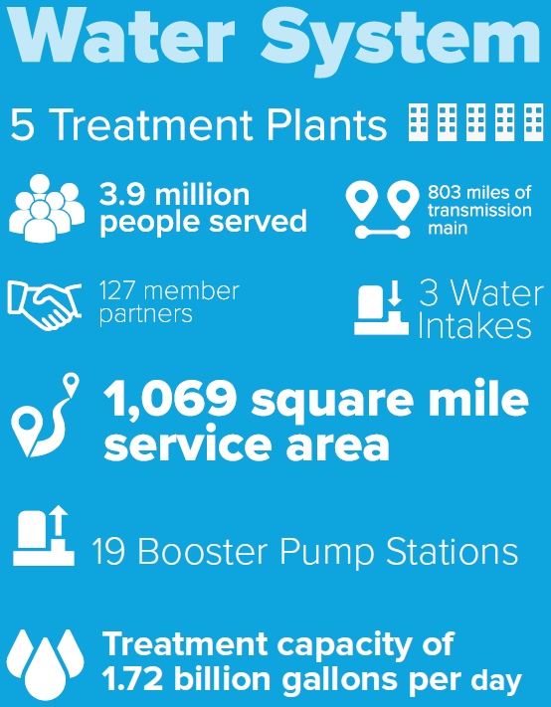
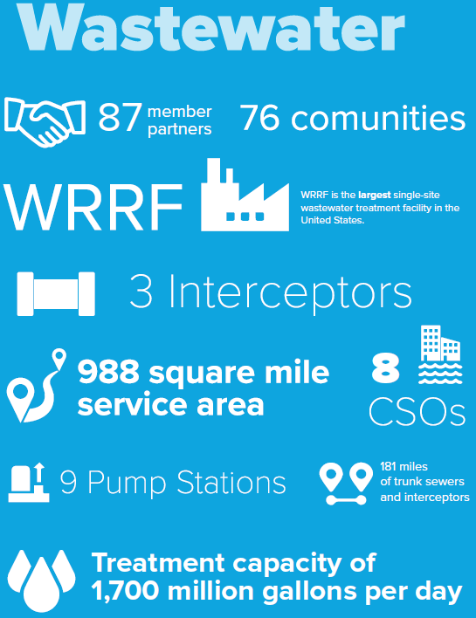
Background

Slide 36
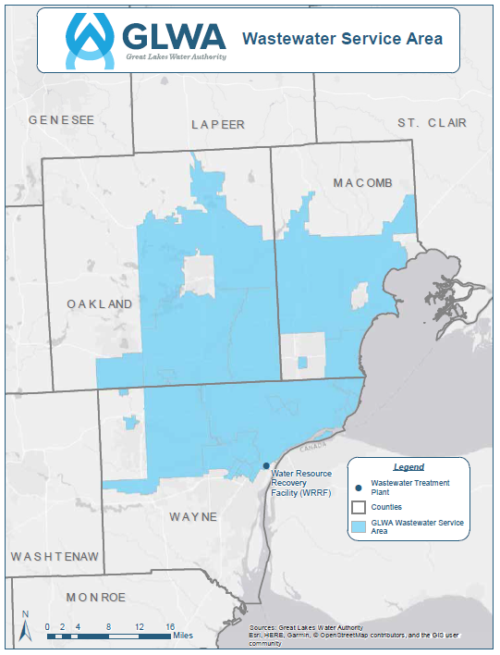
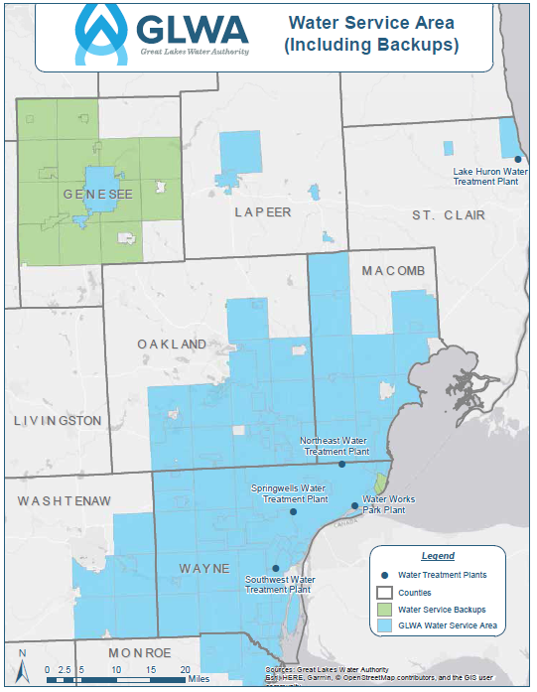
Background

Slide 37
GLWA Asset Management
People, Process & Technology

Slide 38
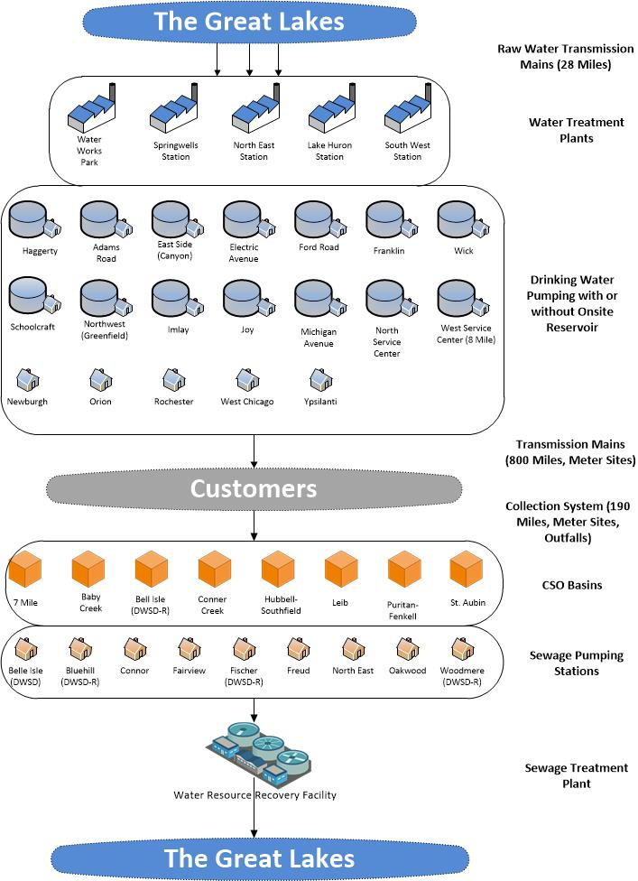
People
  Large organization ~1,000 employees
  Recent significant organization changes
    Reorganization & job redesign
    City of Detroit bankruptcy
    Transition from DWSD
  Newly created Planning Service Area &
  AM/CIP Group
  Multiple plant locations/facilities
  Limited time & competing resources
  Challenges with the configuration of Enterprise Asset Management System (EAMS)

Slide 39
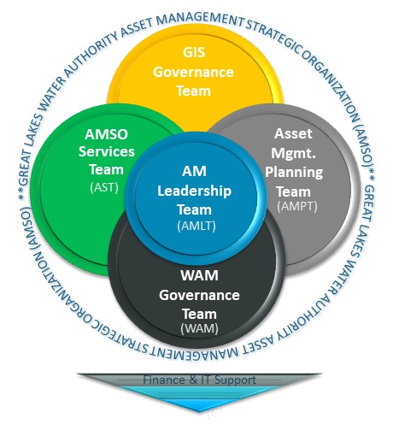
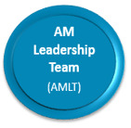
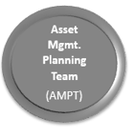
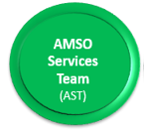

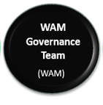
People (Cont’d)
Asset Management Leadership Team (AMLT)
Provides strategic guidance for asset management programs and overall guidance, direction and leadership to the AMSO satellite teams
Asset Management Planning Team (AMPT)
Develop standards for how GLWA manages its assets across the organization
AMSO Services Team (AST)
Help develop and document standard business processes, best practices, training, communication plans, etc.
GIS Governance Team (GIS)
Provide governance and guidance for the use and maintenance of the Geographic Information Systems
WAM Governance Team (WAM)
Provide governance, guidance and coordination to manage assets through the use of the CMMS application

Slide 40
People (Cont’d)
AMSO General Successes
Interdepartmental collaboration including those traditionally not part of the asset management functions, (Engineering, Finance, Public Affairs, Organizational Development, etc.)
Widened the scope of asset management initiatives
Created a monthly forum for developing new ideas & to improve accountability
Increased senior executive involvement in asset management initiatives
Increased involvement of O&M staff in asset management strategic planning
Improved asset management related communications & training opportunities
Created well-defined governance structure now used for all AM projects and initiatives

Slide 41
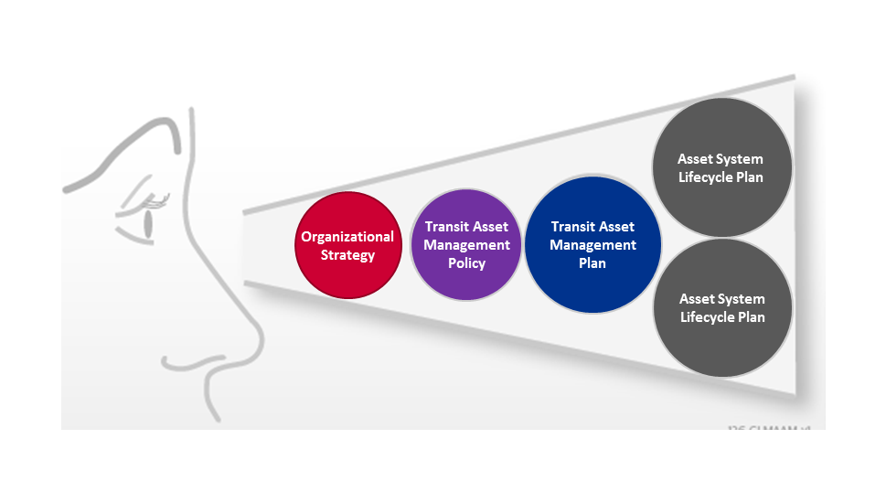
Process: Line-of-Sight Concept
Line of Sight
Water System
Asset Management Plan
Organizational Strategy
Asset
Management
Policy
Strategic
Asset Management Plan
Wastewater System Asset Management Plan
Effective and sustainable Asset Management requires a clear “Line-of-Sight” between organizational strategy and on-the-ground activities

Slide 42
Process: Strategic Asset Management Planning
1
OCT
AM ASSESSMENT
2
DEC
WSAA AM Assmt & Benchmarking
Interviews
Org Assmt, Tech/Data/Bus Processes, Programs Assmt
3
SAMP PLANNING
JAN TO JULY
SAMP Annotated Outline & Teams
Schedule
COMPLETE SAMP, including AM ROADMAP
Context & Risks
AM Policy
AM Strategy
Service Levels
AMP Framework
Data and Tech Systems
Enablers
Financial Strategies
Continuous Improvements
AM Roadmap and Implementation Plan
Resource Needs
4
STARTS IN JULY
AMPs
AM Drivers
Asset Profile
Asset Risks
Ops & Maint
Renewal, Rehab, Replacement
Funding Needs
Improvement Initiatives
AM TRAINING
BLUE RIBBON PANEL

Slide 43
Process: Journey to World Class
Asset Management
Continuous Improvement
Act
Plan
Do
Check
Continuous
Improvement
Act
Plan
Do
Check
Assessment
Act
Plan
Do
Check
Assessment
Assess &
Implement
Performance
Assessment
Assess &
Implement
Time
Notes:
By ranking the business drivers against a combination of the importance and preparedness scores, a picture emerges, one that describes the most strongly evolving and potentially disruptive challenges to which the organization is either less equipped to meet, or just starting to work out how to respond.

Slide 44
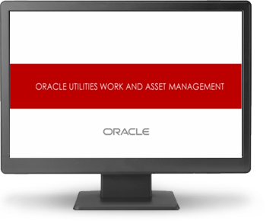
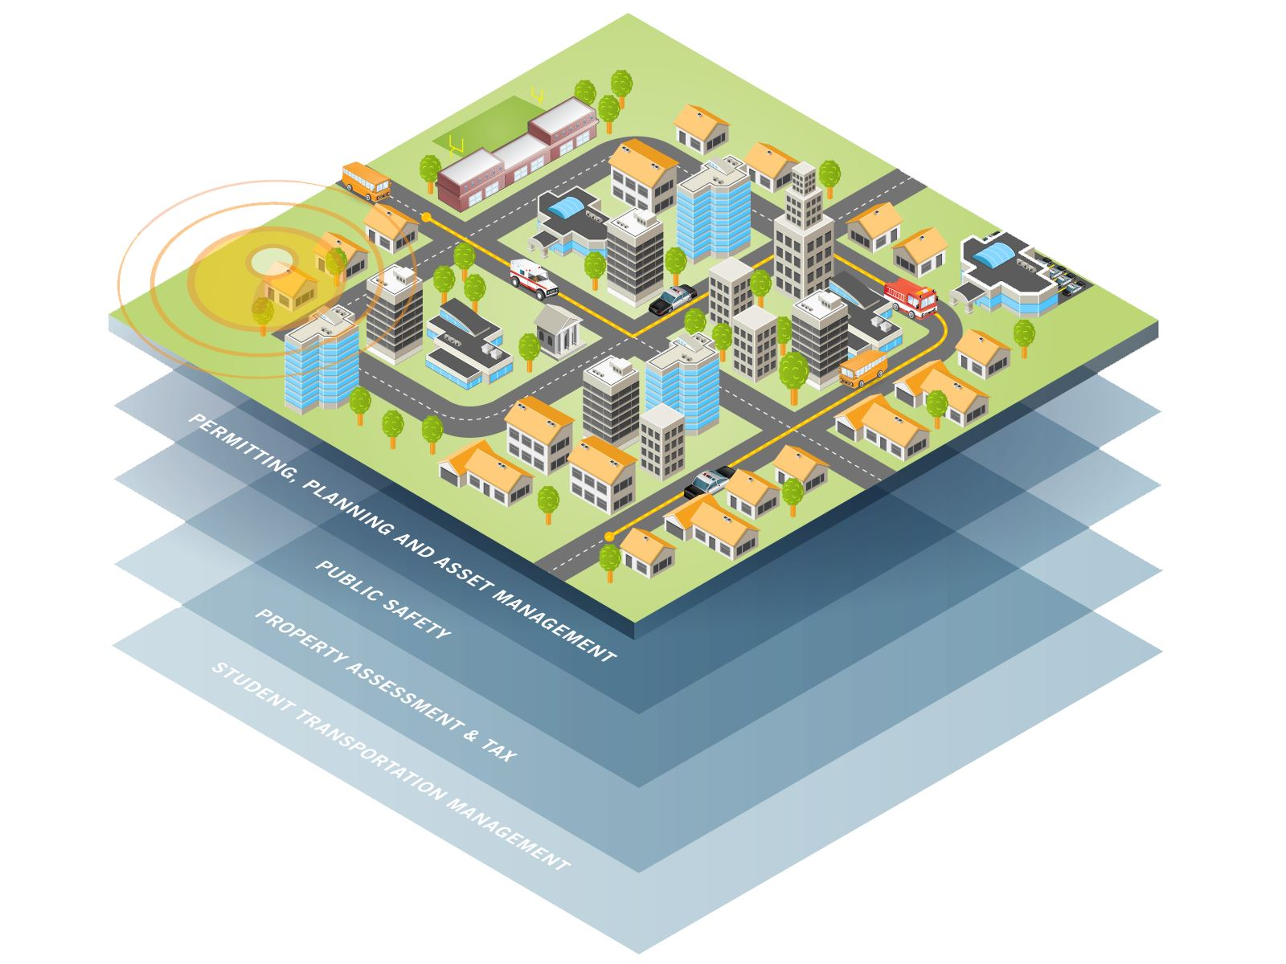
Technology: Continuous Improvement Cycle of
GLWA’s Enterprise Asset Management System
Enhance Existing System and Data (WAM)
Develop New System Requirements
Select and Configure
New System
Integrate with new ERP and GIS Data (Esri)
Provide
On-going Support, Improvements, and Training

Slide 45
Technology: Next Generation EAM System
Implementation Steps
Strategic Asset Management Plan
IT Governance
Solicitations
Business Application Design
and
Business
Functional
Final
Evaluations
Process
Infrastructure Design
Design
Requirements
Requirements
Document
Specification
Integration Design

Slide 46
Technology: Linking the Strategic Plan, People and Processes to the EAM System Requirements

Slide 47
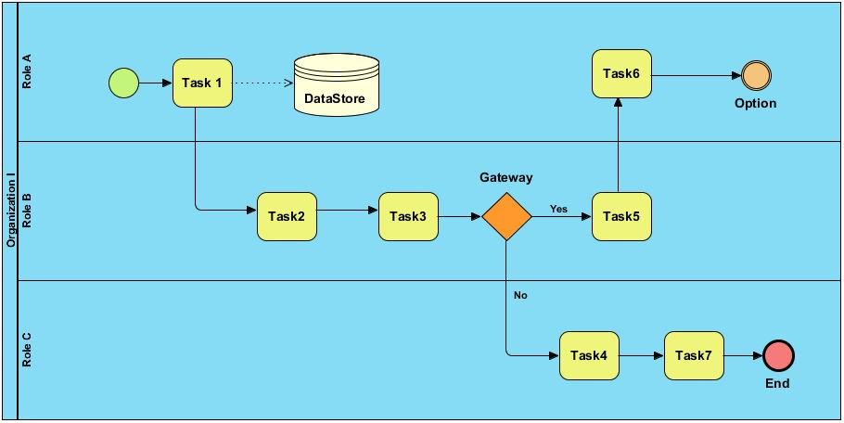
Technology: People before Process before Technology

Slide 48
Technology: Capture Requirements Based on Highest Needs from People and Process
Accounting Tool
Work Order Management
Inventory Control
Predictive Maintenance
First determine:
Primary Function(s)
Financial and HR System Interfaces
Reporting / Decisions
Ease of Use
Ease of Configuration
Training and Support Resources
Degree of Mobility
Fleet Management
Enterprise Asset Management Systems
Resource Scheduler
Mobile First
Vertical Equipment Management
Cloud-Based
Reliability Analysis
Labor Resource Management
GIS Centric
Service Request Management

Slide 49
Technology: Potential Causes for EAM System Failure
Unrealistic expectations – may take years to reach desired ROI
System does not address organizational or strategic goals
People not thinking about or asking for additional resource or skill needs
Only a few people’s input on a system needed by many people
Leaders not holding their teams accountable to using the new system
Staff resistance to change / new system
Limited training / no on-going training for existing and new staff
No feedback loop for front line staff
Additional skills / resources needed for the system
Additional IT resources need to maintain the software

Slide 50
Technology: Potential Causes for EAM System Success
    Complete and appropriate requirements and understanding of to-be processes
    Obtaining buy-in on underlying issues to resolve as part of the project
    Appropriate estimates of costs (e.g., all modules, implementation, training, upgrades)
    Appropriate planning for data conversion
    Appropriate level of asset, WO, WR, etc. data capture and use -> KPI, dashboards, decisions, etc.
    Ease of use
    Continuous user training / education
    Staff buy-in
    Feedback loop
    Process development, ownership, and use
    Completeness and accuracy of asset inventory
    Appropriate levels of vendor support
    Thoughtful implementation and interface planning
Identify, Understand & Asses
Implement
Monitor & Improve
Mitigate & Optimize

Slide 51
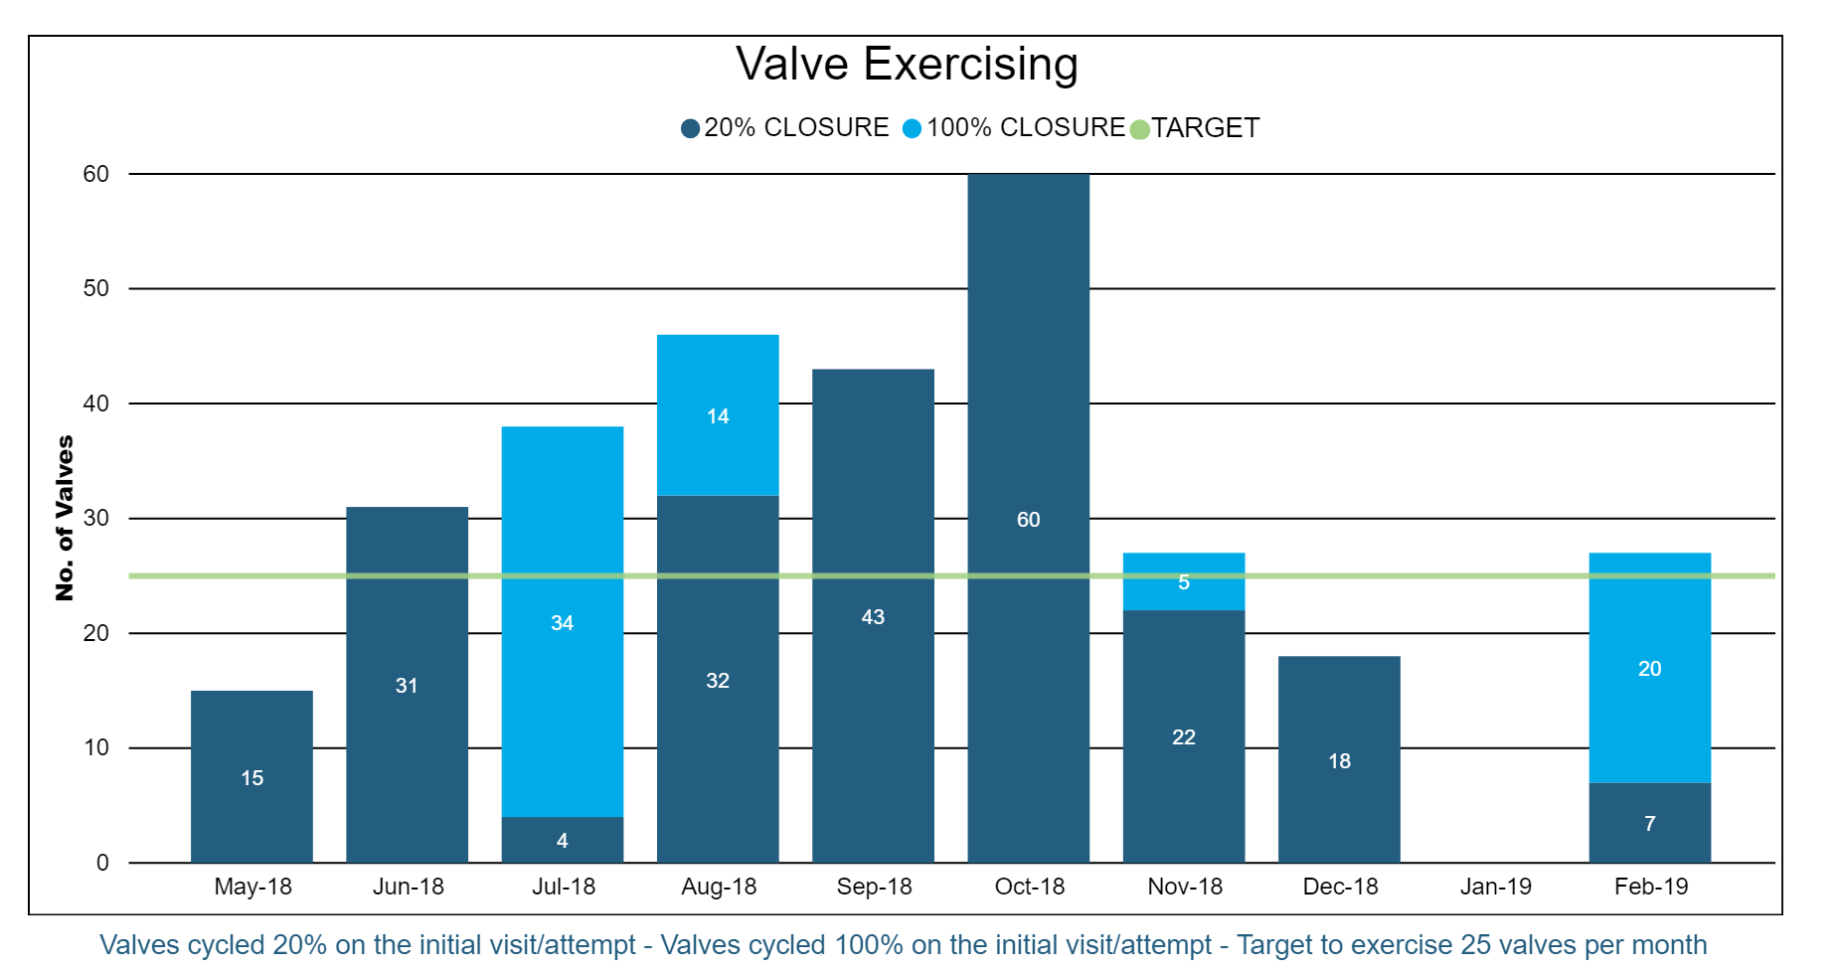
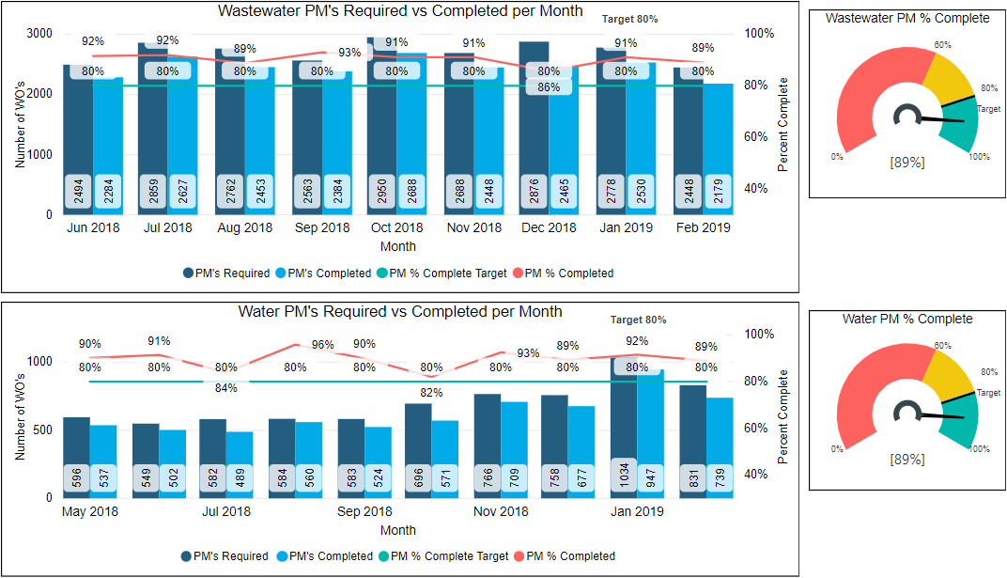
Technology: What Gets Measured, Gets Managed

Slide 52
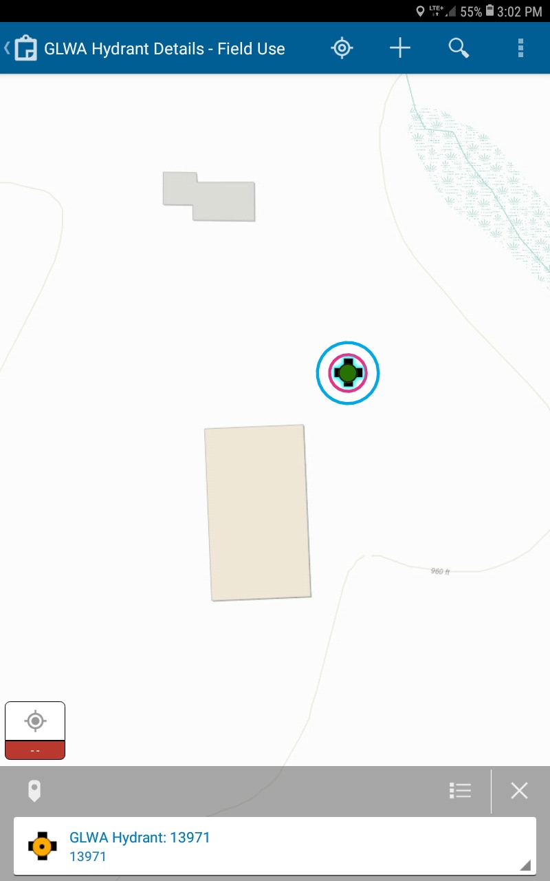
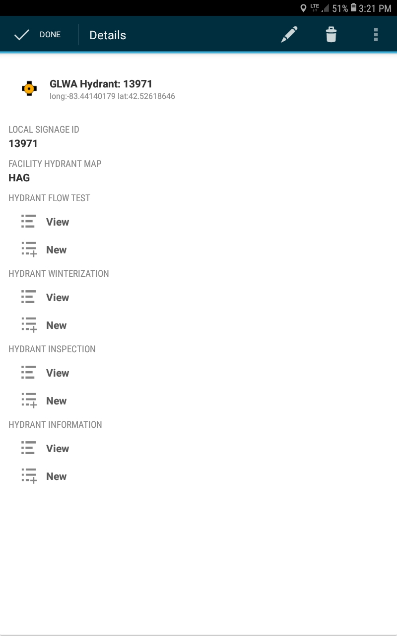
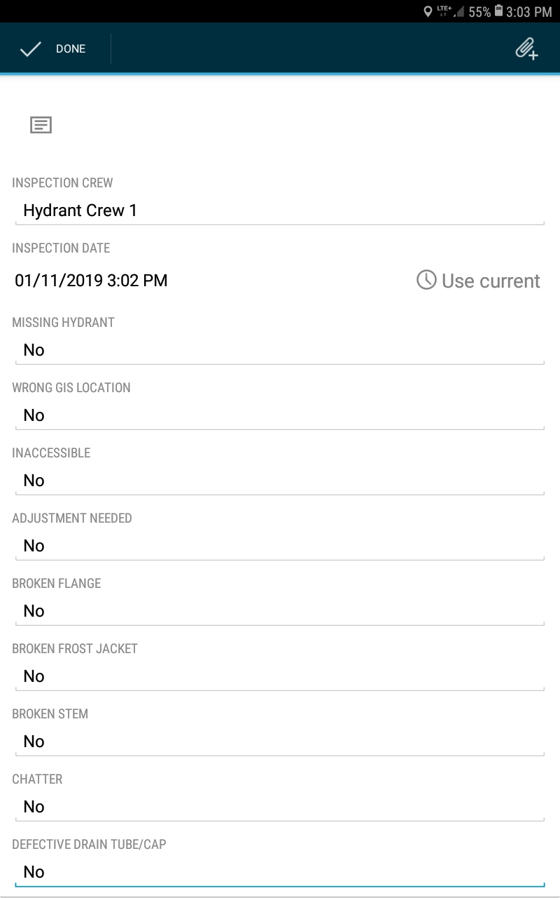
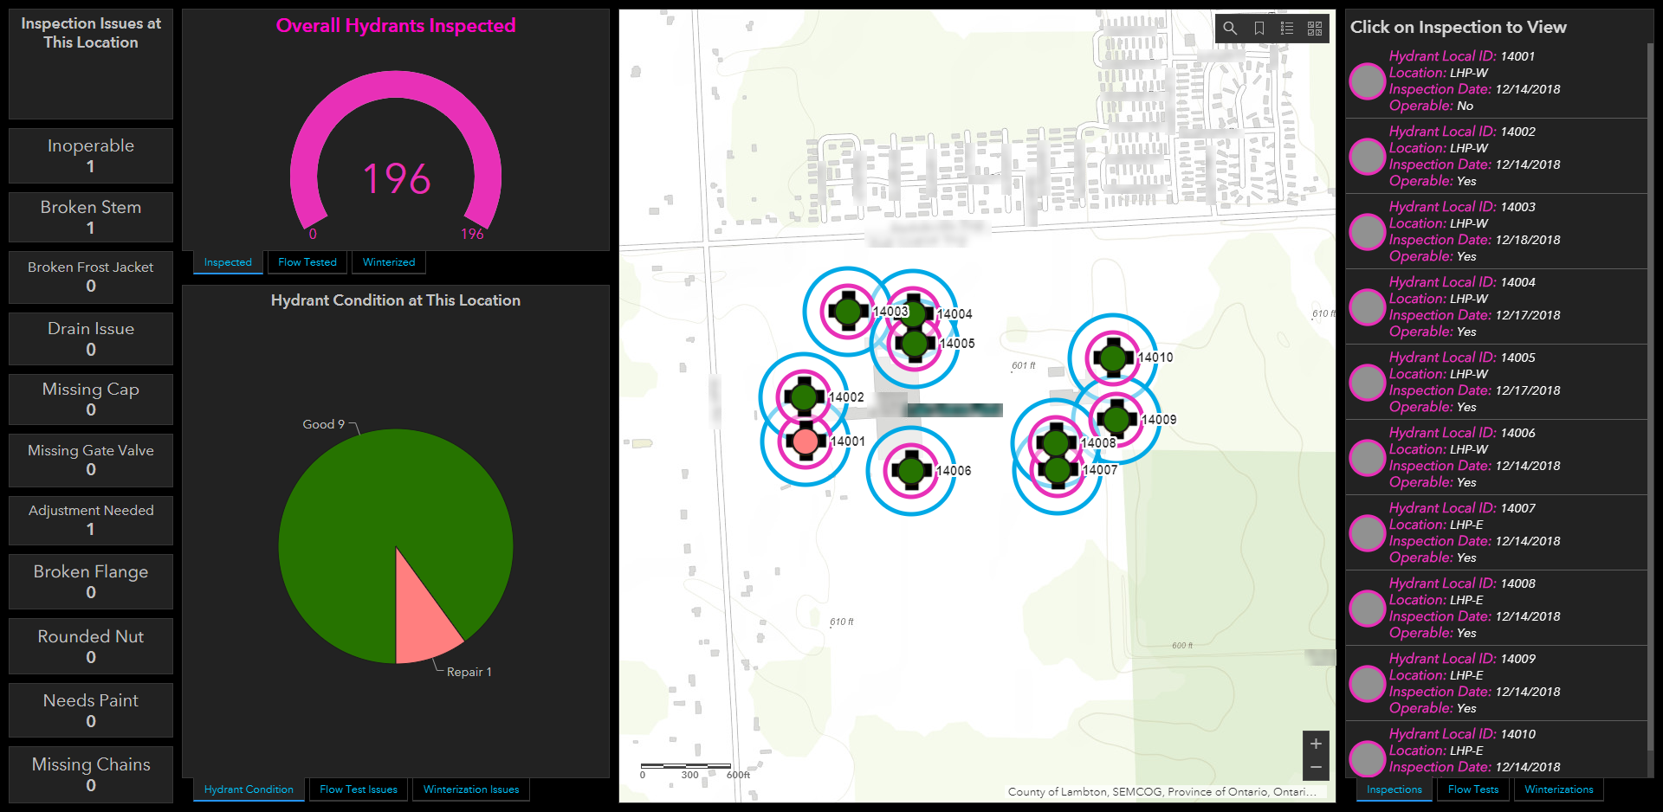

Slide 53
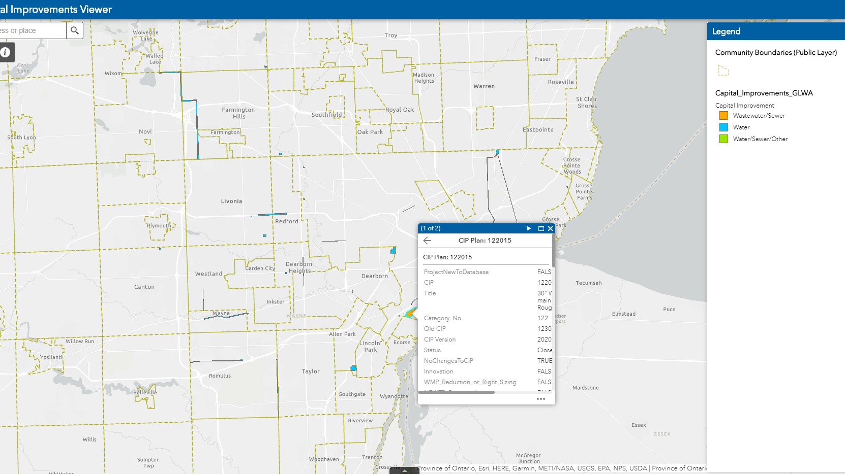
Regional Collaboration
Capital Improvement Plan Viewer
GIS Data Sharing Agreements
21st Century Infrastructure Commission Pilot and On-Going Participant

Slide 54
Technology: The Vision, One Step at a Time
Where Are We Going?
Optimized Workflow
Lifecycle Analysis
Data Availability & Accuracy
Adaptability
Sustainable Business
Knowledge Sharing
Less Stress
Proactive Asset Management
More Flexibility
Planning for the Future State
Link System Closely to Processes
Identify Business User Requirements
Determine Reporting Needs
Educate and Train Staff
Monitor Efforts & Benefits
Plan Resources for the Future State

Slide 55
Have a Great Day!

Slide 56

Next Steps & Opportunities for Collaboration
Join us for the 4th Webinar in our Series:
  IWAM Policy & Program Implementation
  Wednesday, May 1st, 1-2:30pm EST
Please contact us to continue this discussion:
  Your take on Technology & IWAM?
  Lit review suggestions
  Who else should we contact?
  Pilot community suggestions

Slide 57
Thank You!
Integrated Water Asset Management
Visit https://www.glc.org/work/iwam
or
Contact Dan Gold dgold@glc.org
Thursday, April 11th, 2019

